Slide 1
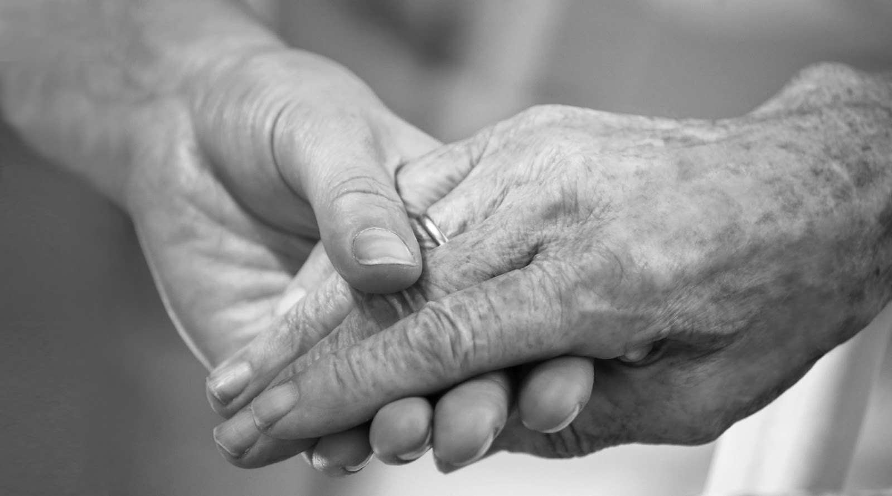
Updates to the Nurse Aide Training & Competency Evaluation Program, Oral Health Curriculum
Molly Mihlbachler, RDH, MS
Luke Burroughs, RDH, MPH

Slide 2
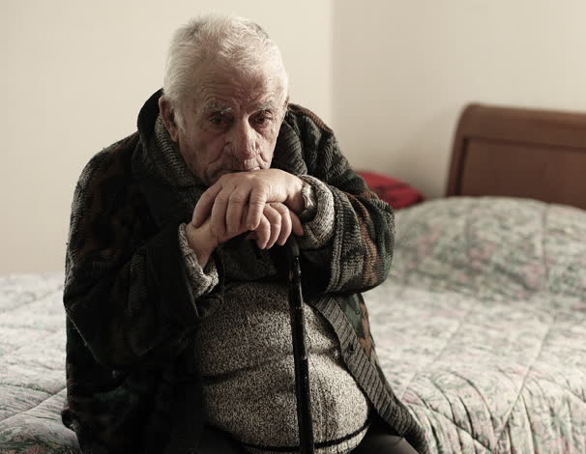
#1 Cause of Death in Nursing Homes?
2008 Florida study: Nursing home residents who had daily mouth care provided by nursing assistants whose only job was to provide oral care had much less risk (3 times less risk) of dying from pneumonia than those residents who did not receive the daily care from the nursing assistant designated to do oral care.
Bassim CW, Gibson G, Ward T, Paphides BM, DeNucci DJ. Modification of Risk of Mortality from Pneumonia with Oral Hygiene Care, J Am Ger Soc, 2008, 56 (9): 1601-1607.

Slide 3
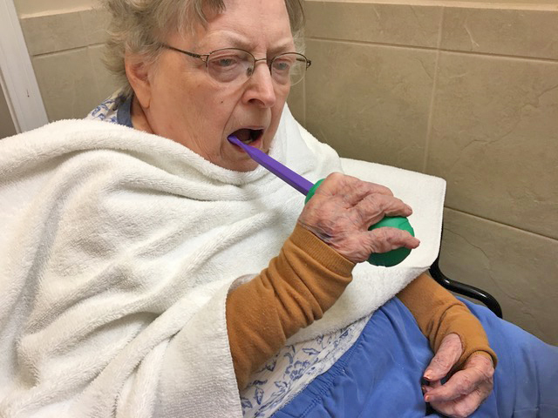
The Necessity of Daily Oral Hygiene in Nursing Homes
Legal requirement
Nursing Home Reform Law
(1987 Omnibus Budget Reconciliation Act, aka OBRA '87)
Prevent other illnesses
Bacteremia—CVD, DM, kidney disease, etc.
Aspiration pneumonia—#1 cause of death
Better diet and quality of life
Strength, balance, longevity, comfort, confidence, and freedom from pain
Notes:
In 1987 the government passed a law requiring nursing care facilities to pay attention to residents oral health. This law must be followed in every nursing facility that has Medicare or Medicaid patients. This law is called the Omnibus Budget Reconciliation Act of 1987 (OBRA '87) -The Nursing Home Reform Law

Slide 4
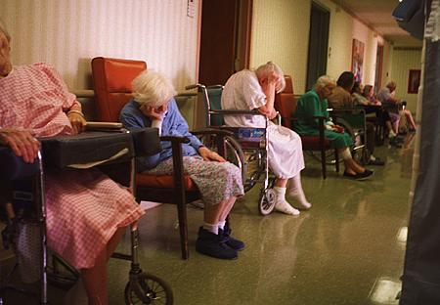

Slide 5
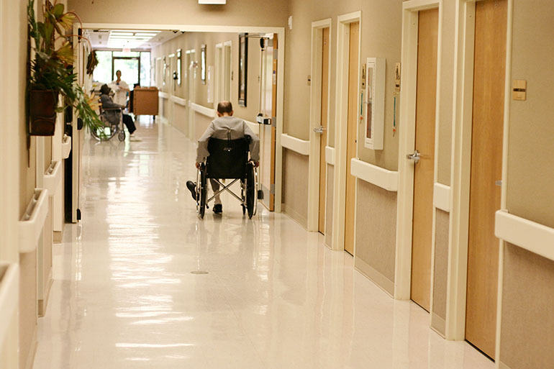

Slide 6
Ohio Department of Health Nurse Aide Guidelines
Need for expanded guidelines
Consulted with Oral Health Ohio and Ohio Department of Health
Old Guidelines vs. New Guidelines
Essential Topics and Resources
Passed by Ohio legislature
Next step—adoption by nursing facilities
Notes:
Older Adults in the U.S.
Today: 45 million (1/7)
2030: 70 million (1/5)
Baby boomers (1946-1964): 76 million
Life expectancy
Birth rate
Older Adult: 65 years and older
Young-old: 65-74 years
Middle-old: 75-84 years
Oldest-old: 85 years and older
Healthy vs. Unhealthy aging
Successful aging: active, high level of function
Usual aging: typical, some decline
Frailty: adverse functioning
Diversity increasing
Susceptibility
stress, infection, disease
Activities of daily living (bathing, feeding, dressing
Instrumental activities of daily living (food preparation, housekeeping, telephone)
1.5 million (3.2%) older adults—institutional settings (2014)
65-74 (1%)
75-84 (3%)
85+ (10%)
Nursing homes medical involvement and complexity
compared to community
compared to 25 years ago
Assisted living facilities: appropriate for IADLs deficiencies but not ADLs

Slide 7
Ohio Department of Health Nurse Aide Guidelines
What is in guidelines?
Objectives
Oral health and disease
Best practices
Special populations
Curriculum
Evaluation
Notes:
Older Adults in the U.S.
Today: 45 million (1/7)
2030: 70 million (1/5)
Baby boomers (1946-1964): 76 million
Life expectancy
Birth rate
Older Adult: 65 years and older
Young-old: 65-74 years
Middle-old: 75-84 years
Oldest-old: 85 years and older
Healthy vs. Unhealthy aging
Successful aging: active, high level of function
Usual aging: typical, some decline
Frailty: adverse functioning
Diversity increasing
Susceptibility
stress, infection, disease
Activities of daily living (bathing, feeding, dressing
Instrumental activities of daily living (food preparation, housekeeping, telephone)
1.5 million (3.2%) older adults—institutional settings (2014)
65-74 (1%)
75-84 (3%)
85+ (10%)
Nursing homes medical involvement and complexity
compared to community
compared to 25 years ago
Assisted living facilities: appropriate for IADLs deficiencies but not ADLs

Slide 8
Original GUidelines
Notes:
Older Adults in the U.S.
Today: 45 million (1/7)
2030: 70 million (1/5)
Baby boomers (1946-1964): 76 million
Life expectancy
Birth rate
Older Adult: 65 years and older
Young-old: 65-74 years
Middle-old: 75-84 years
Oldest-old: 85 years and older
Healthy vs. Unhealthy aging
Successful aging: active, high level of function
Usual aging: typical, some decline
Frailty: adverse functioning
Diversity increasing
Susceptibility
stress, infection, disease
Activities of daily living (bathing, feeding, dressing
Instrumental activities of daily living (food preparation, housekeeping, telephone)
1.5 million (3.2%) older adults—institutional settings (2014)
65-74 (1%)
75-84 (3%)
85+ (10%)
Nursing homes medical involvement and complexity
compared to community
compared to 25 years ago
Assisted living facilities: appropriate for IADLs deficiencies but not ADLs

Slide 9
Revised Guidelines
Notes:
Older Adults in the U.S.
Today: 45 million (1/7)
2030: 70 million (1/5)
Baby boomers (1946-1964): 76 million
Life expectancy
Birth rate
Older Adult: 65 years and older
Young-old: 65-74 years
Middle-old: 75-84 years
Oldest-old: 85 years and older
Healthy vs. Unhealthy aging
Successful aging: active, high level of function
Usual aging: typical, some decline
Frailty: adverse functioning
Diversity increasing
Susceptibility
stress, infection, disease
Activities of daily living (bathing, feeding, dressing
Instrumental activities of daily living (food preparation, housekeeping, telephone)
1.5 million (3.2%) older adults—institutional settings (2014)
65-74 (1%)
75-84 (3%)
85+ (10%)
Nursing homes medical involvement and complexity
compared to community
compared to 25 years ago
Assisted living facilities: appropriate for IADLs deficiencies but not ADLs

Slide 10
Revised Guidelines
Notes:
Older Adults in the U.S.
Today: 45 million (1/7)
2030: 70 million (1/5)
Baby boomers (1946-1964): 76 million
Life expectancy
Birth rate
Older Adult: 65 years and older
Young-old: 65-74 years
Middle-old: 75-84 years
Oldest-old: 85 years and older
Healthy vs. Unhealthy aging
Successful aging: active, high level of function
Usual aging: typical, some decline
Frailty: adverse functioning
Diversity increasing
Susceptibility
stress, infection, disease
Activities of daily living (bathing, feeding, dressing
Instrumental activities of daily living (food preparation, housekeeping, telephone)
1.5 million (3.2%) older adults—institutional settings (2014)
65-74 (1%)
75-84 (3%)
85+ (10%)
Nursing homes medical involvement and complexity
compared to community
compared to 25 years ago
Assisted living facilities: appropriate for IADLs deficiencies but not ADLs

Slide 11
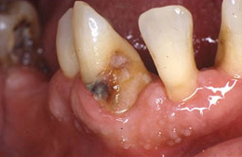
Common Issues
Tooth Loss (QOL)
Dental Caries (untreated and root)
Peridontal Disease (without intervention)
Hyposalivation (multiple consequences)
Oral Cancer (lack surveillance)
Pain and Infections
Notes:
Tooth Loss
Impacts QOL
Causes: new/recurrent caries, periodontal disease, trauma, neglect.
increased caries and periodontal disease risk in Oas
Improved: 31% (1988-94), 25% (1998-2004) 19% (2011-12) in 65+
average remaining teeth: 19
The World Health Organization—minimum adequate functional dentition: 20 teeth
complete and partial dentures
30-40% as efficient as natural dentition
tooth damage
risk for dental caries and periodontal disease
implants—successful but costly
Healthy People 2020 goal—health equity, eliminate disparities
Oral health for older adults falls short
variation across US
WV—42%, CA—13%
age 65-74 below poverty level (34% edentulous)
above poverty level (13% edentulous)

Slide 12
Find and Report Problems
Face and Neck—swelling, sores, pain
Lips—changes, won’t heal, herpes, cheilitis
Inside lips and cheeks—swelling, discoloration, sores
Roof of mouth—swelling, sores, discoloration
Tongue—pathology (cancer, candida) vs normal
Floor of mouth—cancer
Gums—bleeding, inflammation, infection, recession
Teeth—decay, fractures, loose, plaque, tartar
Saliva—signs of dry mouth, problems, products
Dentures—damage, ill-fitting

Slide 13
Original GUidelines
Notes:
Older Adults in the U.S.
Today: 45 million (1/7)
2030: 70 million (1/5)
Baby boomers (1946-1964): 76 million
Life expectancy
Birth rate
Older Adult: 65 years and older
Young-old: 65-74 years
Middle-old: 75-84 years
Oldest-old: 85 years and older
Healthy vs. Unhealthy aging
Successful aging: active, high level of function
Usual aging: typical, some decline
Frailty: adverse functioning
Diversity increasing
Susceptibility
stress, infection, disease
Activities of daily living (bathing, feeding, dressing
Instrumental activities of daily living (food preparation, housekeeping, telephone)
1.5 million (3.2%) older adults—institutional settings (2014)
65-74 (1%)
75-84 (3%)
85+ (10%)
Nursing homes medical involvement and complexity
compared to community
compared to 25 years ago
Assisted living facilities: appropriate for IADLs deficiencies but not ADLs

Slide 14
Revised Guidelines
Notes:
Older Adults in the U.S.
Today: 45 million (1/7)
2030: 70 million (1/5)
Baby boomers (1946-1964): 76 million
Life expectancy
Birth rate
Older Adult: 65 years and older
Young-old: 65-74 years
Middle-old: 75-84 years
Oldest-old: 85 years and older
Healthy vs. Unhealthy aging
Successful aging: active, high level of function
Usual aging: typical, some decline
Frailty: adverse functioning
Diversity increasing
Susceptibility
stress, infection, disease
Activities of daily living (bathing, feeding, dressing
Instrumental activities of daily living (food preparation, housekeeping, telephone)
1.5 million (3.2%) older adults—institutional settings (2014)
65-74 (1%)
75-84 (3%)
85+ (10%)
Nursing homes medical involvement and complexity
compared to community
compared to 25 years ago
Assisted living facilities: appropriate for IADLs deficiencies but not ADLs

Slide 16
Revised Guidelines (New Addition)
Notes:
Older Adults in the U.S.
Today: 45 million (1/7)
2030: 70 million (1/5)
Baby boomers (1946-1964): 76 million
Life expectancy
Birth rate
Older Adult: 65 years and older
Young-old: 65-74 years
Middle-old: 75-84 years
Oldest-old: 85 years and older
Healthy vs. Unhealthy aging
Successful aging: active, high level of function
Usual aging: typical, some decline
Frailty: adverse functioning
Diversity increasing
Susceptibility
stress, infection, disease
Activities of daily living (bathing, feeding, dressing
Instrumental activities of daily living (food preparation, housekeeping, telephone)
1.5 million (3.2%) older adults—institutional settings (2014)
65-74 (1%)
75-84 (3%)
85+ (10%)
Nursing homes medical involvement and complexity
compared to community
compared to 25 years ago
Assisted living facilities: appropriate for IADLs deficiencies but not ADLs

Slide 18
Original GUidelines
Notes:
Older Adults in the U.S.
Today: 45 million (1/7)
2030: 70 million (1/5)
Baby boomers (1946-1964): 76 million
Life expectancy
Birth rate
Older Adult: 65 years and older
Young-old: 65-74 years
Middle-old: 75-84 years
Oldest-old: 85 years and older
Healthy vs. Unhealthy aging
Successful aging: active, high level of function
Usual aging: typical, some decline
Frailty: adverse functioning
Diversity increasing
Susceptibility
stress, infection, disease
Activities of daily living (bathing, feeding, dressing
Instrumental activities of daily living (food preparation, housekeeping, telephone)
1.5 million (3.2%) older adults—institutional settings (2014)
65-74 (1%)
75-84 (3%)
85+ (10%)
Nursing homes medical involvement and complexity
compared to community
compared to 25 years ago
Assisted living facilities: appropriate for IADLs deficiencies but not ADLs

Slide 19
Revised Guidelines
Notes:
Older Adults in the U.S.
Today: 45 million (1/7)
2030: 70 million (1/5)
Baby boomers (1946-1964): 76 million
Life expectancy
Birth rate
Older Adult: 65 years and older
Young-old: 65-74 years
Middle-old: 75-84 years
Oldest-old: 85 years and older
Healthy vs. Unhealthy aging
Successful aging: active, high level of function
Usual aging: typical, some decline
Frailty: adverse functioning
Diversity increasing
Susceptibility
stress, infection, disease
Activities of daily living (bathing, feeding, dressing
Instrumental activities of daily living (food preparation, housekeeping, telephone)
1.5 million (3.2%) older adults—institutional settings (2014)
65-74 (1%)
75-84 (3%)
85+ (10%)
Nursing homes medical involvement and complexity
compared to community
compared to 25 years ago
Assisted living facilities: appropriate for IADLs deficiencies but not ADLs

Slide 20
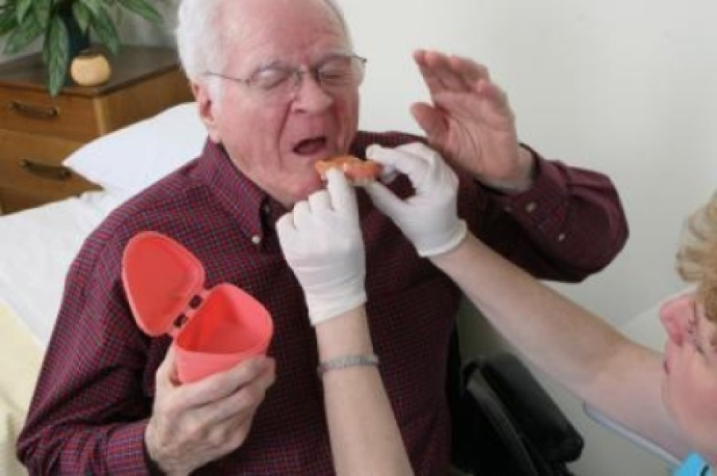
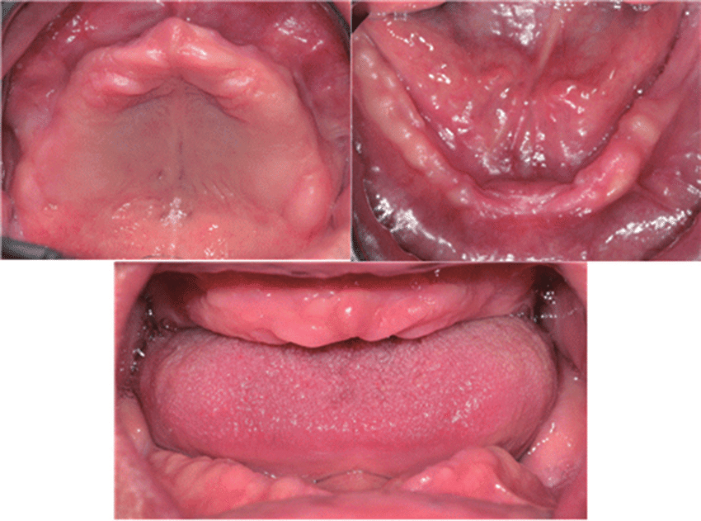
Residents with Dentures and Partials
Hygiene Instruction
Appliance
Natural teeth
Examination
cracks, edges, missing/broken teeth
Storage

Slide 21
Original GUidelines
Notes:
Older Adults in the U.S.
Today: 45 million (1/7)
2030: 70 million (1/5)
Baby boomers (1946-1964): 76 million
Life expectancy
Birth rate
Older Adult: 65 years and older
Young-old: 65-74 years
Middle-old: 75-84 years
Oldest-old: 85 years and older
Healthy vs. Unhealthy aging
Successful aging: active, high level of function
Usual aging: typical, some decline
Frailty: adverse functioning
Diversity increasing
Susceptibility
stress, infection, disease
Activities of daily living (bathing, feeding, dressing
Instrumental activities of daily living (food preparation, housekeeping, telephone)
1.5 million (3.2%) older adults—institutional settings (2014)
65-74 (1%)
75-84 (3%)
85+ (10%)
Nursing homes medical involvement and complexity
compared to community
compared to 25 years ago
Assisted living facilities: appropriate for IADLs deficiencies but not ADLs

Slide 22
Revised Guidelines
Notes:
Older Adults in the U.S.
Today: 45 million (1/7)
2030: 70 million (1/5)
Baby boomers (1946-1964): 76 million
Life expectancy
Birth rate
Older Adult: 65 years and older
Young-old: 65-74 years
Middle-old: 75-84 years
Oldest-old: 85 years and older
Healthy vs. Unhealthy aging
Successful aging: active, high level of function
Usual aging: typical, some decline
Frailty: adverse functioning
Diversity increasing
Susceptibility
stress, infection, disease
Activities of daily living (bathing, feeding, dressing
Instrumental activities of daily living (food preparation, housekeeping, telephone)
1.5 million (3.2%) older adults—institutional settings (2014)
65-74 (1%)
75-84 (3%)
85+ (10%)
Nursing homes medical involvement and complexity
compared to community
compared to 25 years ago
Assisted living facilities: appropriate for IADLs deficiencies but not ADLs

Slide 23
Revised Guidelines (New Addition)
Notes:
Older Adults in the U.S.
Today: 45 million (1/7)
2030: 70 million (1/5)
Baby boomers (1946-1964): 76 million
Life expectancy
Birth rate
Older Adult: 65 years and older
Young-old: 65-74 years
Middle-old: 75-84 years
Oldest-old: 85 years and older
Healthy vs. Unhealthy aging
Successful aging: active, high level of function
Usual aging: typical, some decline
Frailty: adverse functioning
Diversity increasing
Susceptibility
stress, infection, disease
Activities of daily living (bathing, feeding, dressing
Instrumental activities of daily living (food preparation, housekeeping, telephone)
1.5 million (3.2%) older adults—institutional settings (2014)
65-74 (1%)
75-84 (3%)
85+ (10%)
Nursing homes medical involvement and complexity
compared to community
compared to 25 years ago
Assisted living facilities: appropriate for IADLs deficiencies but not ADLs

Slide 24
Revised Guidelines (New Addition)
Notes:
Older Adults in the U.S.
Today: 45 million (1/7)
2030: 70 million (1/5)
Baby boomers (1946-1964): 76 million
Life expectancy
Birth rate
Older Adult: 65 years and older
Young-old: 65-74 years
Middle-old: 75-84 years
Oldest-old: 85 years and older
Healthy vs. Unhealthy aging
Successful aging: active, high level of function
Usual aging: typical, some decline
Frailty: adverse functioning
Diversity increasing
Susceptibility
stress, infection, disease
Activities of daily living (bathing, feeding, dressing
Instrumental activities of daily living (food preparation, housekeeping, telephone)
1.5 million (3.2%) older adults—institutional settings (2014)
65-74 (1%)
75-84 (3%)
85+ (10%)
Nursing homes medical involvement and complexity
compared to community
compared to 25 years ago
Assisted living facilities: appropriate for IADLs deficiencies but not ADLs

Slide 25
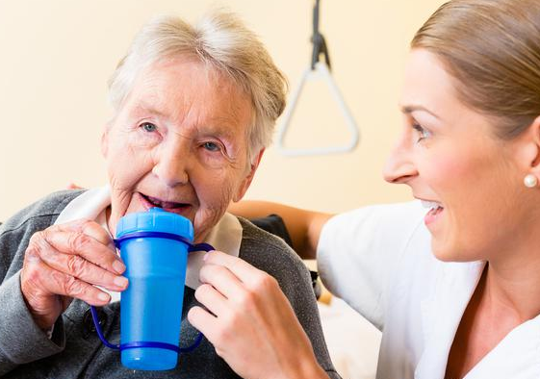
Residents after Stroke
Blood flow interruption
Part of brain dies
Paralysis on one side
motor and sensory
Face and mouth
Swallowing difficulty and one-sided
Denture—retention and sores

Slide 26
Revised Guidelines (New Addition)
https://www.mouthcarewithoutabattle.org/hifi/files/best-practices/MCWB_Behavior_Strategies.pdf
Notes:
Older Adults in the U.S.
Today: 45 million (1/7)
2030: 70 million (1/5)
Baby boomers (1946-1964): 76 million
Life expectancy
Birth rate
Older Adult: 65 years and older
Young-old: 65-74 years
Middle-old: 75-84 years
Oldest-old: 85 years and older
Healthy vs. Unhealthy aging
Successful aging: active, high level of function
Usual aging: typical, some decline
Frailty: adverse functioning
Diversity increasing
Susceptibility
stress, infection, disease
Activities of daily living (bathing, feeding, dressing
Instrumental activities of daily living (food preparation, housekeeping, telephone)
1.5 million (3.2%) older adults—institutional settings (2014)
65-74 (1%)
75-84 (3%)
85+ (10%)
Nursing homes medical involvement and complexity
compared to community
compared to 25 years ago
Assisted living facilities: appropriate for IADLs deficiencies but not ADLs

Slide 27
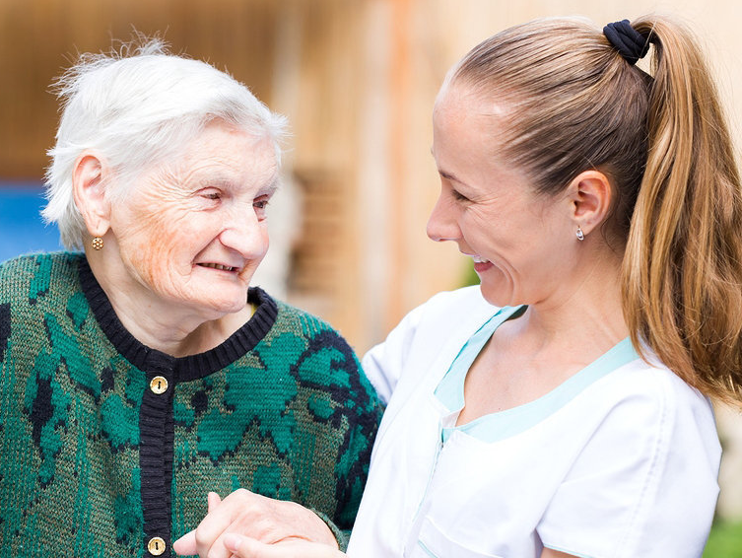
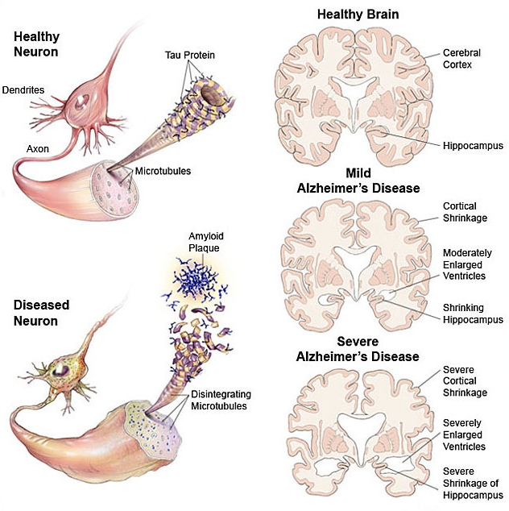
Residents with Dementia
Forgetfulness
Confusion
Repeating stories
Impaired hygiene
Less energy and interest
Restless and anxious
Easy to anger

Slide 28
Barriers—Geriatric Dental Education
National Institute on Aging (1987)—need by 2000 (never achieved)
1,500 geriatric dental teachers and 7,500 dental practitioners
Clinical geriatric training in dental programs—23%
CODA: “Graduates must be competent in providing oral health care within the scope of general dentistry to patients in all stages of life.”
Mini-residency in Nursing Home and Long-Term Care for the Dental Team (University of Minnesota)
Notes:
4. Geriatric Dental Education
needs different from younger
1987—National Institute on Aging (NIA): need 1,500 geriatric dental teachers and 7,500 dental practitioners by 2000 (never achieved)
Few providers get advanced geriatrics training—focus now on pre-doctoral programs (this has improved)
all dental programs-classroom, 23%k—clinical training
Commission on Dental Accreditation’s Accreditation Standards for Predoctoral Dental Education Standard 2-22 states: “Graduates must be competent in providing oral health care within the scope of general dentistry to patients in all stages of life.”
American Dental Education Association (ADEA) Foundation Knowledge and Skills for the New General Dentist, Section 3.2, “Graduates must be competent to apply psychosocial and behavioral principles in patient-centered health care” which specifically mentions geriatrics.
Curriculum varies, clinical experience lacking
Exposure of to older adults impacts attitude and likelihood to provide care
Education for dental hygienists—less known
scope of practice: some states-no supervision in alternative settings, some states reimbursement from Medicaid
all schools have content (half self-assess as inadequate)
Mini-residency in Nursing Home and Long-Term Care for the Dental Team (University of Minnesota)
well-attended, filled 6 months in advance
ADA: on-line CE on oral health in LTC
part of ADA’s “Action for Dental Health” Campaign
Other online courses: Special Care Dentistry Association webpage

Slide 29
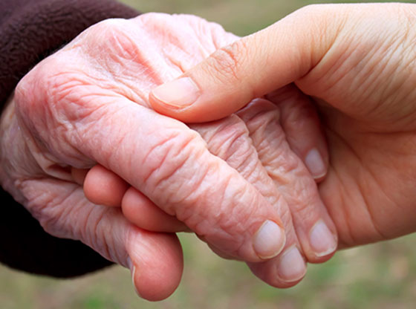
Questions?
Contact Info…
Molly Mihlbachler
mihlbama@ucmail.uc.edu
Luke Burroughs
burrouls@ucmail.uc.edu

