Slide 1
Nursing Assistant Career Advancement Program

Slide 2
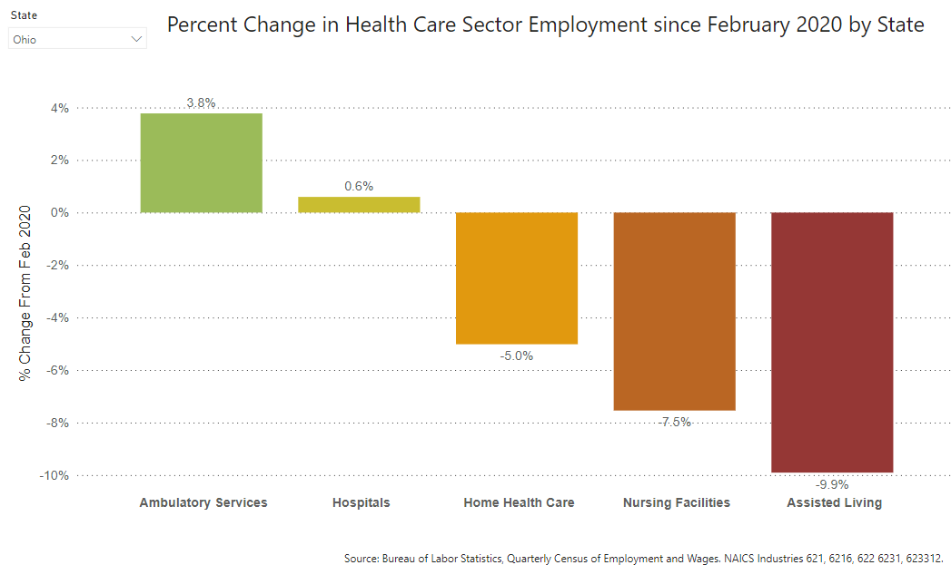
Ohio Workforce Metrics
According to the Bureau of Labor Statistics, for a period from February 2020 to June 2023:
Notes:
We are in a crisis. The silver tsunami is coming, and we have just experienced the largest exodus of post-acute and long term care workers in our history. (review data on slide on workforce reductions),
Compounding this issue is the ever rising costs of workers due to inflation and smaller market of workers to choose from. What these figures amount to is that we are spending more than we ever have on fewer workers than we have had since the 1990s.
It is becoming harder and harder to attract and retain workers. OHCA is working hard to create funding opportunities so that we can compete in the workforce market, as well as reduce regulatory barriers and foster partnerships to build future pipelines for our workforce.

Slide 3
CMS Proposed Minimum Staffing Rule

Slide 4
Overview
SNF
Career Exploration
Medication Aide
RCF
Career Exploration
Complex Medical Model
Medication Aide
STNA Medication Aide

Slide 5
Definitions: SNF
Job Title | Defined
RCA | Patient Care Assistant or Resident Care Assistant in a Residential Care Facility
STNA 1 | State-tested Nursing Assistant
STNA 2 | STNA 1 with at least 6 months experience and at least 1 specialization in a certification determined by the facility
STNA 3 | STNA 2 with at least 1 year experience as an STNA and certified as a Preceptor
STNA 4A (PCT) | At least an STNA 2 with at least 1 year experience as an STNA and certified as a Patient Care Technician (EKG and Phlebotomy)
STNA 4B (MA-C) | At least an STNA 2 with at least 1 year experience as an STNA and certified as a Medication Aide
Notes:
How many of you have your own in house NATCEP course?

Slide 6
Definitions: RCF
Job Title | Defined
RCA 1 | Patient Care Assistant or Resident Care Assistant in a Residential Care Facility
RCA 2 | RCA with at least 6 months experience and at least 1 specialization in a certification determined by the facility
RCA 3 | RCA 2 with at least 1 year experience as an RCA and certified as a Preceptor
MA-C | RCA 2 with at least 1 year experience as an RCA and certified as a Medication Aide
Notes:
How many of you have your own in house NATCEP course?

Slide 7
Specializations
Mental/Behavioral Health
Dementia
End-of-Life
Restorative Nursing
Technology
Notes:
We discussed tying in my discussion about social barriers to your use of the program for your staff and real life uses and getting into “The need”

Slide 8
Specializations
Approved Certification lists
Collaboration with NAHCA, Centers of Excellence, Metro Health
Provider led certifications must be at least 7 hours didactic content and meet program requirements
Approved by OHCA
Notes:
We discussed tying in my discussion about social barriers to your use of the program for your staff and real life uses and getting into “The need”

Slide 9
SNF Career Pathways
Career Exploration
RCA*
STNA 1
Complex Medical Model
RCA*
STNA 1
Medication Aide
RCA*
STNA 2
STNA 3
STNA 2
STNA 3
STNA 4A
STNA 1
STNA 2
STNA 3
STNA 4B
Notes:
We discussed you describing how you developed the program

Slide 10
RCF Career Pathways
Career Exploration
RCA 1
RCF Medication Aide
RCA 1
STNA Medication Aide
RCA
RCA 2
RCA 3
RCA 2
RCA 3
MA-C
STNA 1
STNA 2
STNA 3
STNA 4B
Notes:
We discussed you describing how you developed the program

Slide 11
Measurable Outcomes
Tracking costs of turnover for STNAs and LPNs
Tracking LPN hours for medication aide and complex medical models
Tracking patient satisfaction outcomes
Tracking Agency Staffing hours
Notes:
Also perhaps discuss the barriers you encountered as well

Slide 12
Expected Impacts
Moral boost amongst staff
Reduction of agency hours
Increased patient satisfaction
Improved quality
Increase of applicants
Notes:
Impacts on your agency use, staff morale, continuity of staff, resident satisfaction

Slide 13
Employer Obligations
Promotion of program to all STNAs/RCAs in good standing
Provide certifications free of charge
Agree to salary increases for each level obtained of at least $1 an hour
Agree to recognize STNA/RCA designations from other EFOHCA NACAP participating facilities
Notes:
Impacts on your agency use, staff morale, continuity of staff, resident satisfaction

Slide 14
ROI
Reduced agency staffing costs
Reduction in LPN hours for medication aide and complex medical model
Reduced turnover costs/increased retention
Potential impacts on quality outcomes from specializations
Notes:
Impacts on your agency use, staff morale, continuity of staff, resident satisfaction

Slide 15
Potential Funding
State
Office of Workforce Transformation
Advocacy for MedCred program creation and reimbursement
Ohio Department of Aging
Federal
HRSA Workforce Innovation Grant
Notes:
I am happy to do this slide if you want to discuss the STNA Upskilling protocol?

Slide 16
Launch
Official Launch for OHCA members is scheduled for June 1
Finalized COE Behavioral Health Certification
Finalize QMA Online program for Ohio
Market CNA Online for RCA to STNA certification
Secure funding for certifications
Notes:
I am happy to do this slide if you want to discuss the STNA Upskilling protocol?

Slide 17
Pilot
Currently there are 3 providers piloting the SNF Complex Medical Model and/or SNF Medication Aide Pathways
Recruiting additional pilot participants for the RCF and Career Exploration pathways
Contact Erin Hart to schedule a more in-depth review of the program to participate.
Notes:
I am happy to do this slide if you want to discuss the STNA Upskilling protocol?

Slide 18
In Development
Home Health/Hospice Aide Upskilling Model
Potential creation of a home based medication aide certification
Collaboration with the Ohio Council for Home Care and Hospice underway
Notes:
I am happy to do this slide if you want to discuss the STNA Upskilling protocol?

Slide 19
Collaborators and Supporting Organizations
Ohman Family Living
Caring Place Health Care Group
Wayside Farms
Health Care Management Group
Care Core Health
Windsor House
Guardant
Holland Management
Carmelite Senior Living
Oak Creek Terrace
Moving Forward Coalition
National Association of Health Care Assistants
Centers of Excellence for Nursing Facilities Behavioral Health

