Slide 1
OSHA’s Current Inspection Initiative Are You Ready?
Presented by:
Brad Hunt, Chief Risk Officer
Leverity Insurance Solutions (Acrisure)
www.acrisure.com
330-301-3262 | brad@leverity.com

Slide 2
Thank you, Sedgwick!
On March 2, 2022, OSHA announced a new COVID-19 focused healthcare inspection initiative running from March 9 and June 9, 2022.
OSHA’s inspections will verify and assess compliance efforts, including readiness to address any ongoing or future airborne pathogen surges.
Through the generosity of Sedgwick, OHCA’s preferred vendor and long-time administrator of the OHCA Workers’ Compensation group rating programs, Brad Hunt from Leverity Insurance (Acrisure) has performed mock OSHA audits for OHCA Members at no cost to them. Members with prior OSHA inspections will be targeted and were given preference.
Over 40+ members are participating and have been very satisfied with the experience and focused preparation! In this webinar we will share their experience and help prepare your organization.

Slide 3
Agenda
The mock audit exercises – OSHA’s focus
Examples of typical audit findings
Examples of best practices
Free forms and templates!
Q&A
Considering the continuum of care, who should be concerned about OSHA?
If any of your employees have the potential to provide services or care to a person with suspected or confirmed Covid or other airborne infectious disease, OSHA can enforce standards on your organization. This may include residential facilities where residents isolate or quarantine in place, home health, and others. Facilities that remove suspected or confirmed cases may have standards apply in a different way or not at all.

Slide 4
Exercise #1: The COVID-19 Plan
Secure the latest version of your OSHA written plan and hazard analysis originally developed for the Healthcare Emergency Temporary Standard (ETS) - now known as the 1910.502 Standard and submit.
OSHA wants to ensure you have a plan that includes preparedness, response, and control measures for the SARS-CoV-2 virus and may use Section 5(a)(1), General Duty Clause of the OSH Act to enforce the standard.
OSHA is finalizing an airborne pathogens standard later this year that will require a written plan that will likely replace this plan.

Slide 5
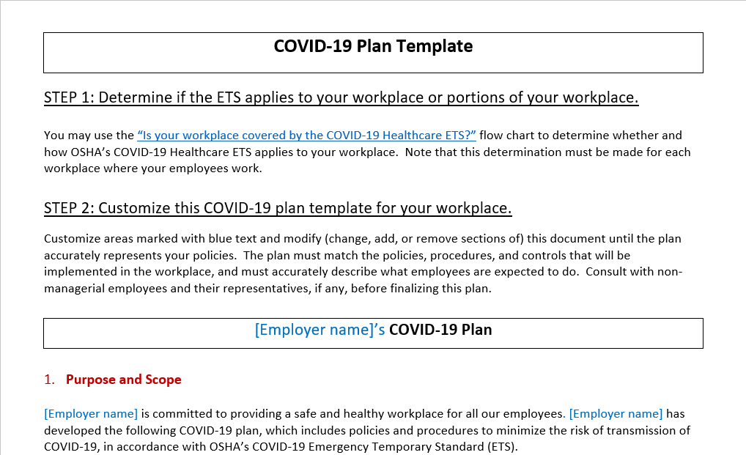
Example OSHA COVID-19 Written Plan
See Handout

Slide 6
Example OSHA COVID-19 Hazard Analysis
See Handout

Slide 7
Exercise #1.A: Reporting fatalities and hospitalizations
When making your submission for Exercise #1, make sure your written plan includes a process regarding how you will notify OSHA within 8 hours of learning about a fatality and 24 hours of learning about a work-related in-patient hospitalization.
If your reporting process is documented in another written policy, please submit with the plan requested in Exercise #1.
Common Finding
Requirements could be more specific such as who calls and the contact information they use.
Work-related determinations play an integral role. More on that topic coming later.

Slide 8
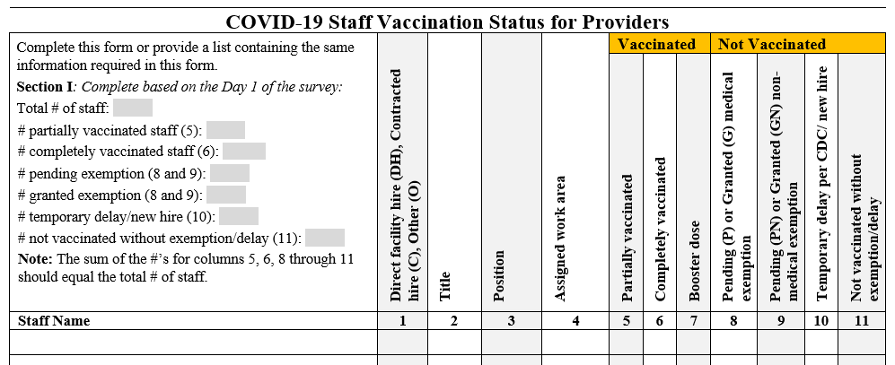
Exercise #2: The Vaccination Matrix or Equivalent
Secure the latest version of the vaccination matrix or equivalent as required by CMS QSO 22-09-All and submit.
OSHA is coordinating with CMS/ODH
Show them what they are expecting
EXCEL Sheets without proper headers…..cause confusion.

Slide 9
Exercise #3: COVID 19 Log & OSHA 300 Log
For 2021, secure the COVID 19 Log and the OSHA 300 Log. Also secure the latest versions of both logs for 2022. Submit both 2021 and 2022 logs.
There is confusion about the two logs
COVID Log – All employee cases, work-related or not
OSHA 300 Log – All employee cases that ARE work-related
A case on the COVID 19 Log that is not on the OSHA 300 log implies the case is not work-related. Documentation is needed to support that the case is not work-related.
Remember having to report hospitalizations and deaths? That needs to happen fast. Calling when a case is not work-related brings an unnecessary inspection
Not calling brings an inspection and fine
Reporting work-related cases on time, helps an inspection go better
Again, EXCEL Sheets without proper headers…..cause confusion.

Slide 10
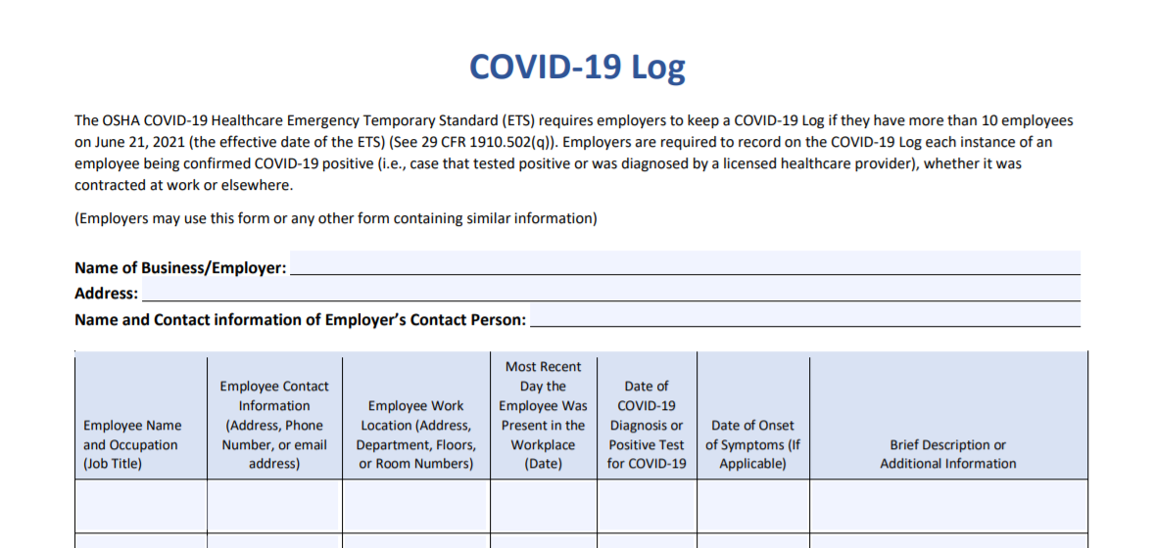
Example Covid Log
See Handout

Slide 11
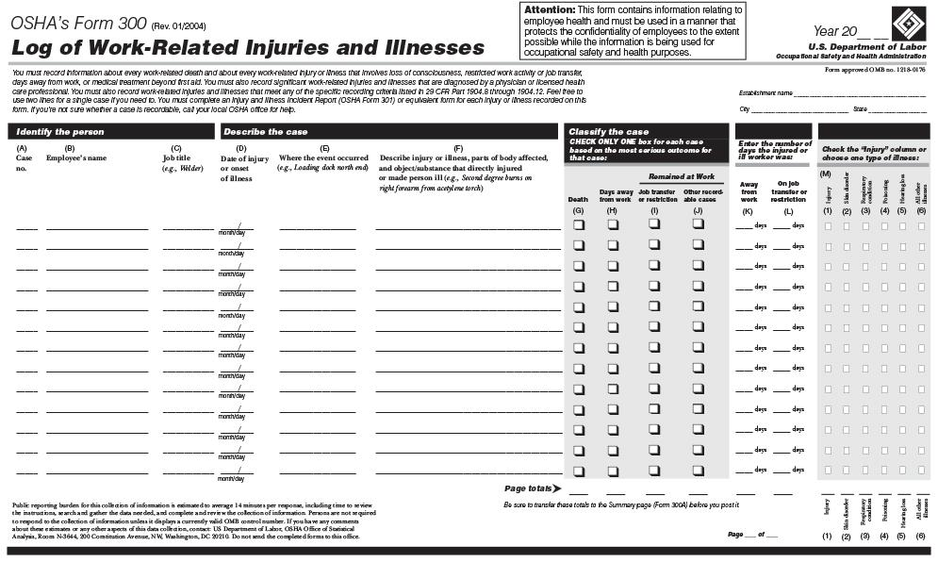
OSHA 300 Log
See Handout

Slide 12
Exercise #3.A: Work-Related Determinations
On your 2021 COVID 19 Log, identify two (2) cases that are not included on your 2021 OSHA 300 Log.
A case on the COVID 19 Log that is not on the OSHA 300 log implies the case is not work-related. For the two cases identified, provide documents indicating why the cases were not deemed work-related.
The documents should have been created at the onset of the case and be dated as such. Do not develop new documents now to respond to this exercise. If work-related determination documents do not exist for the cases selected, please indicate in your reply.
Consider forming a small committee. The work-related determination decision should not be put on one person. Remember, it needs to happen fast!

Slide 13
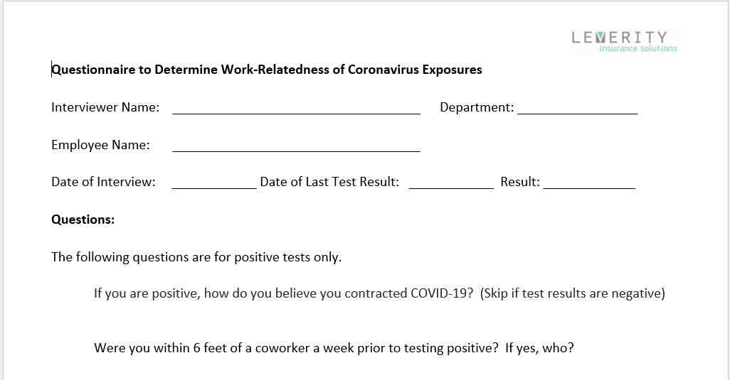
Example Work-Related Determination Form
See Handout

Slide 14
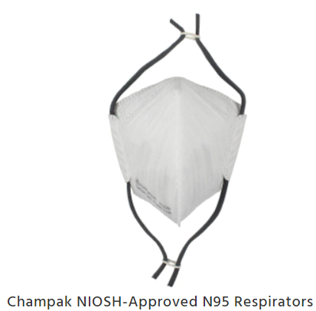
The rest is N95!
My favorite!
(not a paid spokes person! But I get asked a lot).

Slide 15
Exercise #4: Essential Elements
For your three (3) most recent new hires, required to wear N95, please provide the following documents.
Medical Questionnaire
Medical Determination Form from the Physician or Licensed Healthcare Professional
Fit Testing Form
Employee Training Confirmation (in addition to fit testing exercise)
Common Finding
Due to community spread reducing, members are stopping. OSHA wants to ensure you are ready for the next crisis and not doing questionnaires and fit testing during an outbreak.
Finding many breakdowns in the 4 items above!
Sorry, can’t give example forms and programs.
We did in 2020 during the mayhem to help many members!
(Another Common Finding is I’m being sent that template with no updates! See Exercise 5.)

Slide 16
Exercise #5: Written Program
Secure the latest version of your written Respiratory Protection Program and submit
Common Finding
Most programs were written in the summer of 2020 and have not been revised.
Not understanding this policy is a living document and must be reviewed to determine if it is effective, frequently, annually and as outbreaks occur.
A Test of Your Program
Compare your cases on your COVID Log to your “work-related” cases on your OSHA 300 Log for the same year (2021).
If 20% or less of your cases make it to the OSHA 300 Log, that generally indicates your N95 Program is effective. Higher percentages indicate you may not be doing work-related determinations, or your N95 program is not working! Most of your cases are not from community spread but from worker and patient interactions. At least that is what the data says…..

Slide 17
Exercise #6: Employee Engagement
Using the N95 Program - Employee Engagement Form from Leverity, interview at least three (3) employees currently or recently required to wear an N95 and complete the questions. You may interview more than three (3) employees if you need additional feedback. Ensure employee interviewed are from different departments.
Compliance Note
1910.134(l)(2) The employer shall regularly consult employees required to use respirators to assess the employees' views on program effectiveness and to identify any problems. Any problems that are identified during this assessment shall be corrected.

Slide 18
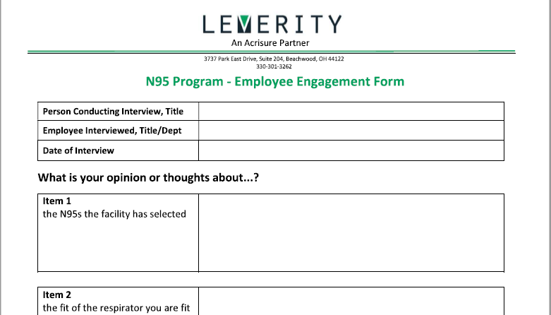
N95 Program - Employee Engagement Form
See Handout

Slide 19
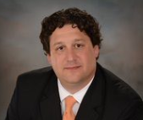
Exercise #7: Virtual Meeting
Attend a Zoom meeting hosted by Brad Hunt to review your report and discuss any compliance concerns.
Presented by:
Brad Hunt, Chief Risk Officer
Leverity Insurance Solutions (Acrisure)
www.acrisure.com
330-301-3262 | brad@leverity.com

Slide 20
Q & A

