Slide 1
Projected Impact of New Survey Scoring Methodology on Five-Star
Jun 27, 2025
Lucille Xiang - lxiang@ahca.org ; Valerie Williams - vwilliams@ahca.org; Kiran Sreenivas – ksreenivas@ahca.org

Slide 2
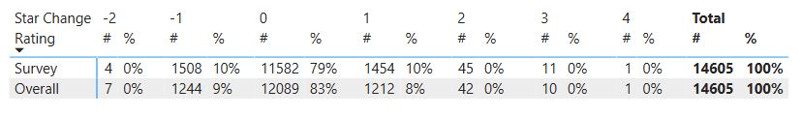
Executive Summary
On June 18, 2025, CMS announced two upcoming changes to Five-Star in 2025
  On July 30^{th,} CMS will drop the third most recent standard survey from the Survey Rating. Three years of complaint surveys will still be used alongside the two most recent standard surveys.
  On October 29th, CMS will release a modified antipsychotic measure to replace the current Long-Stay Antipsychotic measure. A total of fifteen measures will continue to determine the Quality Rating
Using the latest Care Compare survey data from June 25th, we have projected the impact of the new survey score method in July.
  At the national-level, the vast majority (79%) will see no change to their Survey Rating. For those that see a change, it most often will be a change of only one star.
  Likewise, the Overall Rating will remain the same for a majority (83%) assuming no change in Staffing and Quality
  Projected Change in Rating:

Slide 3
New Survey Cycle Definitions and Weights
Current Cycle 3 Complaint and Infection Control Deficiencies (25-36 months ago) will be combined with Cycle 2 deficiencies and increase slightly in weight (16.7% to 25%)
Under the new methodology, more recent surveys (i.e. Cycle 1) are increasing in weight from 50% to 75%. Some older surveys (Cycle 2) are decreasing in weight (33.3% to 25%)
In our projections, the national average survey score increased from 78.4 to 85.0 points. The state-level fixed star distributions will remain minimizing the impact of increased survey scores.
 | Current |  | Starting July 30, 2025
 | Surveys Included | Weight | Surveys Included | Weight
Cycle 1 | Standard – Most recent Complaint – Past 12 Months | 50% | Standard – Most Recent Complaint – Past 12 Months | 75%
Cycle 2 | Standard – Second most recent Complaint – 13-24 Months ago | 33.3% | Standard – Second Most Recent Complaint –13-36 Months Ago | 25%
Cycle 3 | Standard – Third most recent Complaint – 25-36 Months ago | 16.7%
Note: Infection Control Surveys count as Complaint currently and in the new methodology

Slide 4
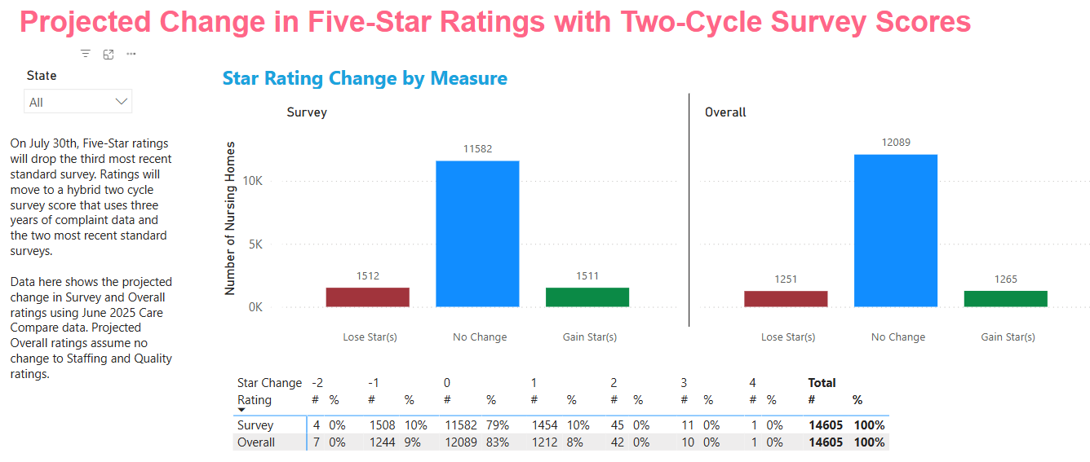
The fixed state-level distribution of Survey ratings remain (i.e. 10% receive 5 Star, 20% receive 1 Star, and an even split amongst 2-4 stars)

Slide 5
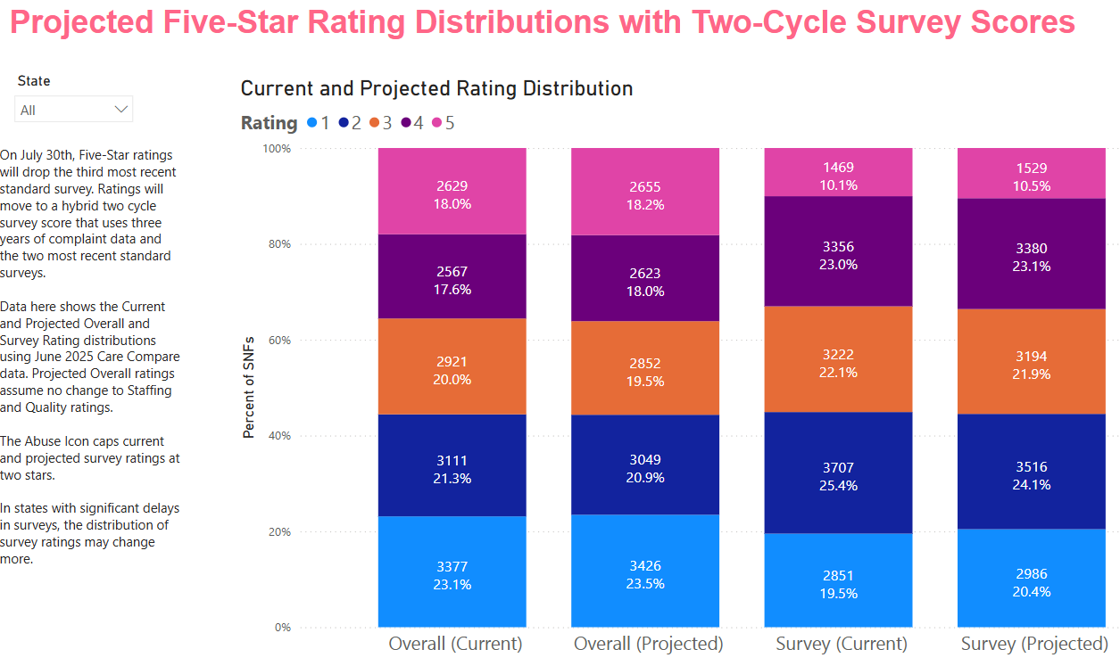

Slide 6
Projection Limitations
The actual ratings on July 30th may differ from these projections for two reasons
  Newer survey data will become available and some older survey data will roll off
  Newer PBJ staffing data (2025q1) and Quality measure data will also be released on July 30th, which can impact Overall ratings.

Slide 7
Impact of New Antipsychotic Measure in October Should be Low
CMS plans to rebase the scoring cut points with the new measure.
The new measure incorporates Part D prescription drug claims. CMS says the new measure has a national average rate or 16.98%, which is slightly greater than the current national average of 14.64% under the existing MDS measure.
We are still awaiting more details on the measure. We will provide more data and projections, when we can.

Slide 8
Resources for Providers

Slide 9
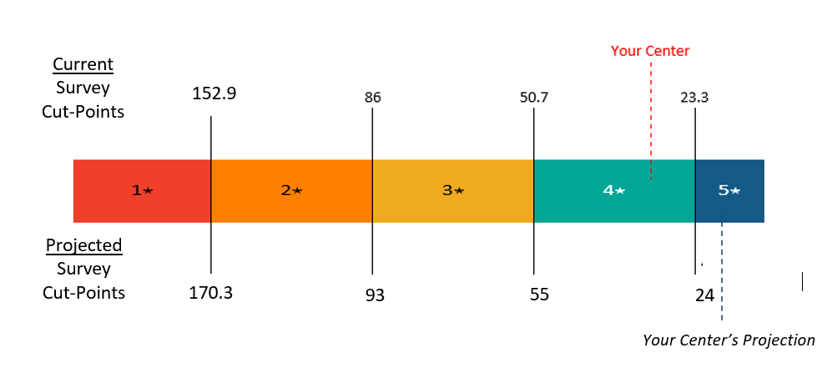
Individual Center Projections Coming to Your Top-Line
We will be re-releasing the 2025-Q2 Top-Line in the coming week with an individual center’s projected survey score and rating using the new methodology.
The 2025-Q3 Top-Line to be released in early August will contain the new survey scoring when it is released on July 30th
Example of Center-Level Projection Coming to Your Top-Line

Slide 10


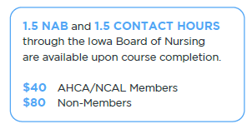
AHCA’s Five-Star Quality Rating System Education Program has been updated to reflect these changes.

