Slide 1
March 30-31, 2022

Slide 2
Module 2: Leadership & Human Resources

Slide 3
Speakers

Slide 4
Leadership
Class Activity /Chat
Take 2-5 minutes
Think about an influential leader in your life.
World leaders
Corporate leaders
Teachers
Sports/Entertainment Stars
What was their mark of distinction as a Great Leader
Type in chat what qualities made her or him a great leader.
What will you do to emulate these qualities?

Slide 5
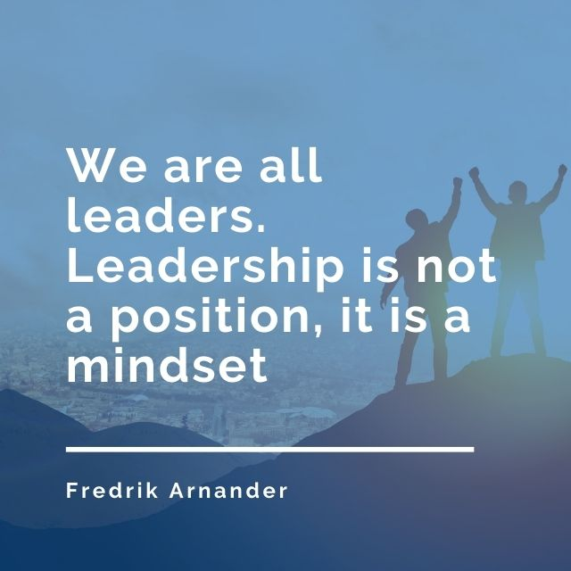
Role of Leadership in Long Term Care

Slide 6
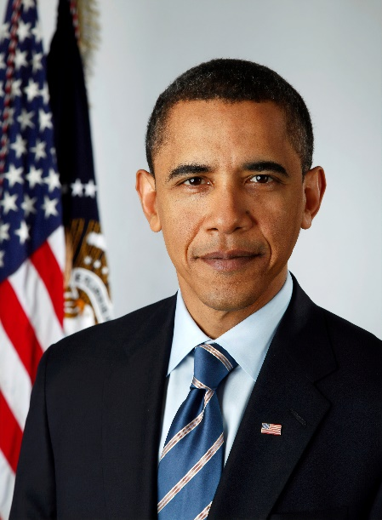
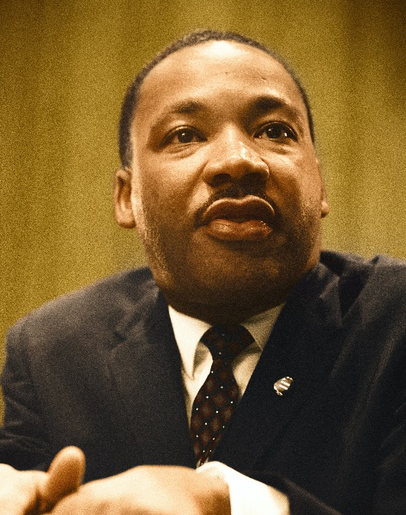
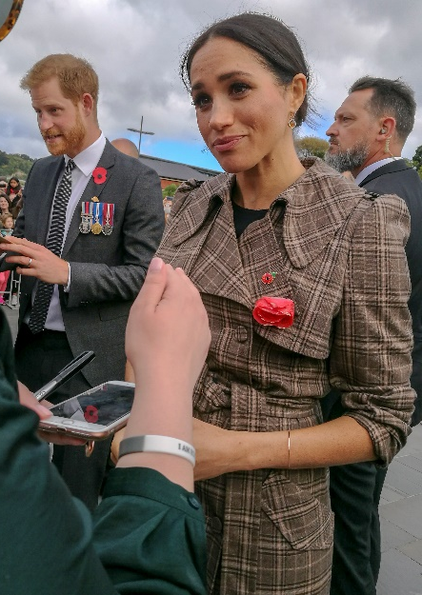
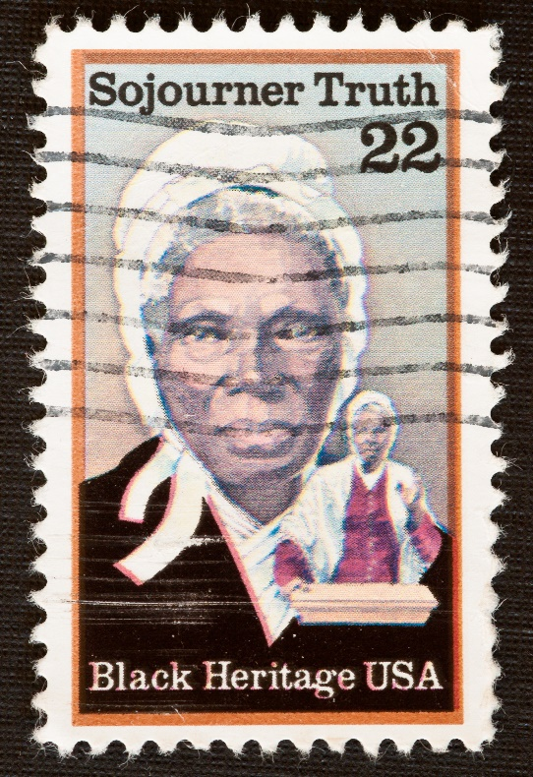

Slide 7
LEADERSHIP IS A PROCESS
INTERACTIVE IN NATURE
INVOLVES INFLUENCING OTHERS
OCCURS IN GROUPS
INVOLVES ATTAINING GOALS
Notes:
4 Components are necessary for leadership to occur (p.68 NAB)
1. Leadership is a process. It is interactive in nature
2. Leadership involves influencing others
3. Leadership occurs in groups
4. Leadership involves attaining goals

Slide 8
Leadership
Who Am I as a leader?
What kind of Leader do I want to be??
What are your leadership strengths
Let’s do a Leadership Self Assessment

Slide 9
Role of Leadership in LTC
List Leadership Characteristics
Spend 5 minutes thinking of each of the following character traits. Then select 4 that others have affirmed in you or that that resonate with you (don't limit yourself to the list).
Write down those 4 traits and define why they define you as a leader.

Slide 10
Role of Leadership in Long Term Care
Honest
Delegator
Communicator
Confident
Committed
Optimistic
Intuition
Future oriented
Visionary
Learner
Connection
Inspiring
Intelligent
Fair-minded
Broad-minded
Courageous
Straightforward
Imaginative
Example
Agile
Curious
Complex-Simple
Team Builder

Slide 11
Leadership Attributes
FOCUSED VISION
STRATEGIC MANAGEMENT
CARING LEADERSHIP
CLEAR COMMUNICATION
SUPPORTING CHANGE
Notes:
25% of employees would fire their boss if they could.
We aren’t experts in all areas so you need to lead those who are to be effective.
Few managers walk into their position with good leadership skills. As a leader, you are always learning new things. Tell how you got started as a manager.
5 Leadership Attributes that drive success.
Focused Vision
Strategic Management
Caring Leadership
Communication
Supporting Change
How do you influence your staff?
What are some tools that you have?
You will have problems that arise. Do you manage them properly?

Slide 12
Leadership
Remember the difference between a boss and a leader
-A Boss says “Go”; A Leader says “Let’s Go”
A good leader takes a little more than his share of the blame, a little less than his share of the credit
The Little Book of Leadership- a free e-book from www.theleadershiphub.com

Slide 13
What Can We Learn from Geese???

Slide 14
What Can We Learn From Geese?
Leaders Show the Way
Create a clear vision
This is where we want to be…and this is how we are going to get there!

Slide 15
What Can We Learn from Geese?
Leaders Do Not Work Solo
Working Together to Achieve Goals
Know your role
Support others
The brick mason
Outstanding leaders go out of their way to boost the self-esteem of their personnel. If people believe in themselves, it’s amazing what they can accomplish. -Sam Walton

Slide 16
What Can We Learn From Geese?
When You Fall out of Formation, Get Back
Importance of sharing
Keep self-pride far away
Give and receive support

Slide 17
What Can We Learn from Geese
Take Care of Your People
“In order for it to be a good place to live it has to be a good place to work”, Lloyd Lewis
Take care of your people, always be respectful, no one is expendable, and your people will take care of you and your community

Slide 18
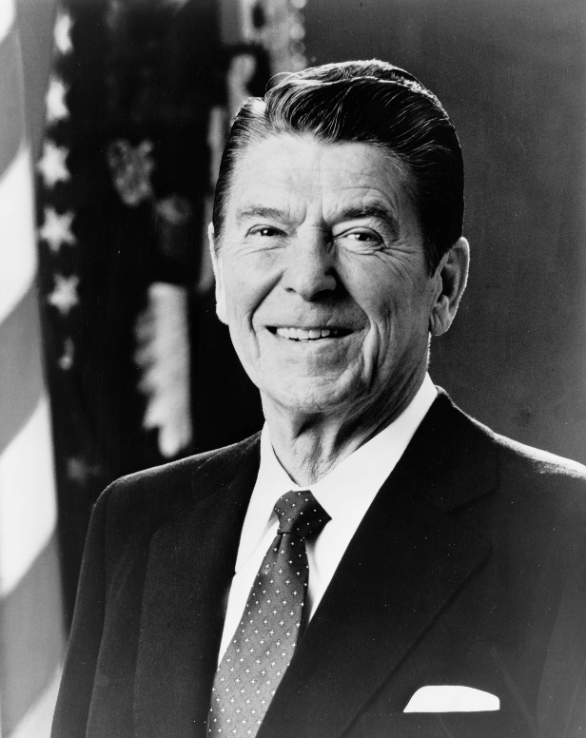
What Can We Learn from Geese?
Leaders Encourage Their People
They enable and get out of the way
They empathize
The Greatest leader is not necessarily the one who does the greatest things. He is the one that gets the people to do the greatest things. –Ronald Reagan

Slide 19
Leaders Encourage
Before you are a leader, success is all about growing yourself. When you become a leader, success is all about growing others. - Jack Welch

Slide 20
Stay Connected to the Joy of Service
WHY ARE YOU IN THIS FIELD OF WORK???
Continually help your caregivers remember the why

Slide 21
Joy in Serving!!
We have the honor and privilege of serving the elders of our communities…
ensuring that they have voice and choice in how they are served…
and that they are treated with the upmost respect and dignity at all times…
in a safe and loving environment.

Slide 22
LEADERSHIP STYLES
AUTHORITARIAN (Dictatorial)
DEMOCRACY
FREE REIGN (Laissez Faire)
PATERNAL
Notes:
AUTHORITARIAN - An autocratic leader centralizes power and decision-making in himself. He gives orders, assigns tasks and duties without consulting the employees. The leader takes full authority and assumes full responsibility.
Example during a fire or disaster.
DEMOCRACY-Participative or democratic leaders decentralize authority. It is characterized by consultation with the subordinates and their participation in the formulation of plans and policies. He encourages participation in decision-making. Leader maintains final decision making authority.
Example day to day getting input from staff.
FREE REIGN-Free-rein leaders avoid power and responsibility. The laissez-faire or non-interfering type of leader passes on the responsibility for decision-making to his subordinates and takes a minimum of initiative in administration. He gives no direction and allows the group to establish its own goals and work out its own problems. This type of leader must have full confidence in staff subordinate to them.
Example motivated knowledgeable department head such as an experienced Dietary Manager who has been with the company for 20 years.
At different times you may be different types of leader depending on who you are managing etc.

Slide 23
Leadership Versus Management
Leadership and management are terms that are frequently confused by those unfamiliar with what each means.
Are leaders always managers?
Are managers always leaders?
Boss vs. Leader– Who is better?
https://www.youtube.com/watch?v=wddzwzumOAE&feature=youtu.be
Notes:
LEADERSHIP MANAGEMENT EXERCISE

Slide 24
Leadership vs Manager- Activity-Take 5 minutes!
Leader
Manager

Slide 25
LEADERSHIP GROWTH
How do you grow as a leader?
How long have you been in management?
If new to management, how have you seen others grow?
Notes:
Growth of staff as leaders.
Many people think that the way to grow in their job is through training. In reality, training plays only a minor role in professional
growth. Research shows that growth is:
• 70% from stretch assignments.
• 20% from people (mentors, coaches, etc.).
• 10% from training.
This means that 70% of growth comes from stretch assignments
in your current work or personal life. A smaller amount of growth
comes from people mentoring or coaching you, and the final piece from
formal training and/or coursework.
What books have you read?

Slide 26
Six Elements of Leadership Growth
1. Full-time job. Your full-time job serves as your “classroom” or laboratory.
2. Part-time assignments. Part-time assignments such as a taskforce, special project, etc., help with growth.
3. Feedback. Getting feedback from a supervisor, colleague, or staff member will help you learn new skills and improve your skills.
4. Coaching/counseling/mentoring. Finding a person with expertise in the areas where you need to grow is important.
5. Self-development. This includes anything you can do independently such as reading a book, article, setting goals, reviewing goals, writing a development plan, etc.
6. Courses/workshops/seminars. Enroll in coursework that will help improve skills.

Slide 27
Types of Management
Total Quality Management (TQM)-participative management
Should result in Continuous Quality Improvement (CQI) when done properly
Builds employee inter-relationships through teams
Open communication, trust, mutual respect among employees and management
Developed by W. Edward Demming
Management by Walking Around (MBWA)
Making rounds
Sends strong message to staff, families, residents

Slide 28
Functions/Traits of Leadership applied by Deep Patel--Forbes
Notes:
Traditionally, the term management refers to the activities of planning, decision making, organizing, staffing, directing, and controlling.

Slide 29
Leadership Traits/Functions-Forbes/Deep Patel
Self Managing
Time, Attention and Emotion
Undivided attention
Honesty and Integrity
Bedrock to your character and can you be trusted

Slide 30
Leadership Traits/Functions-Forbes/Deep Patel
Acting Strategically
Being curious and genuinely interested in your company and wider business environment
Being flexible in your mindset and trying new approaches and ideas

Slide 31
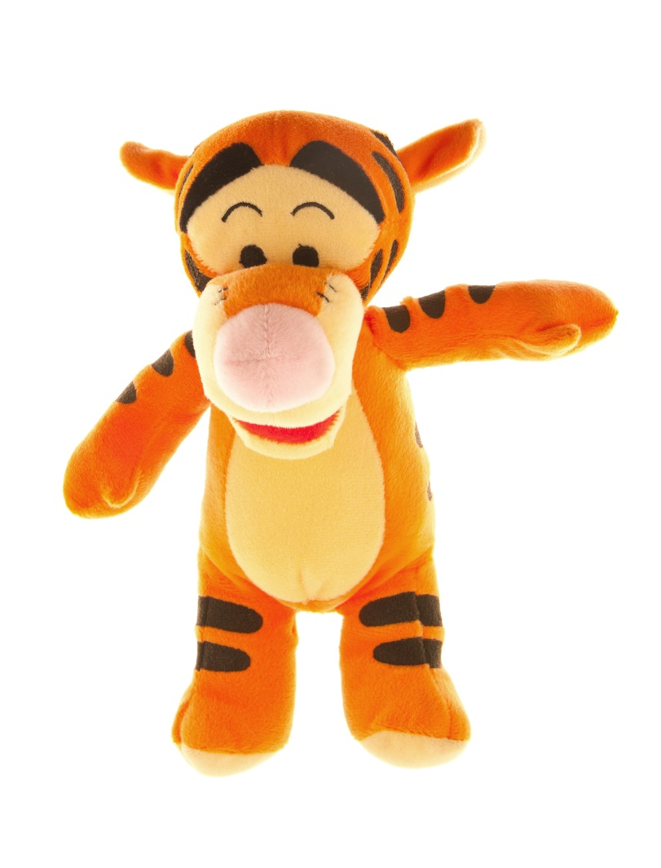
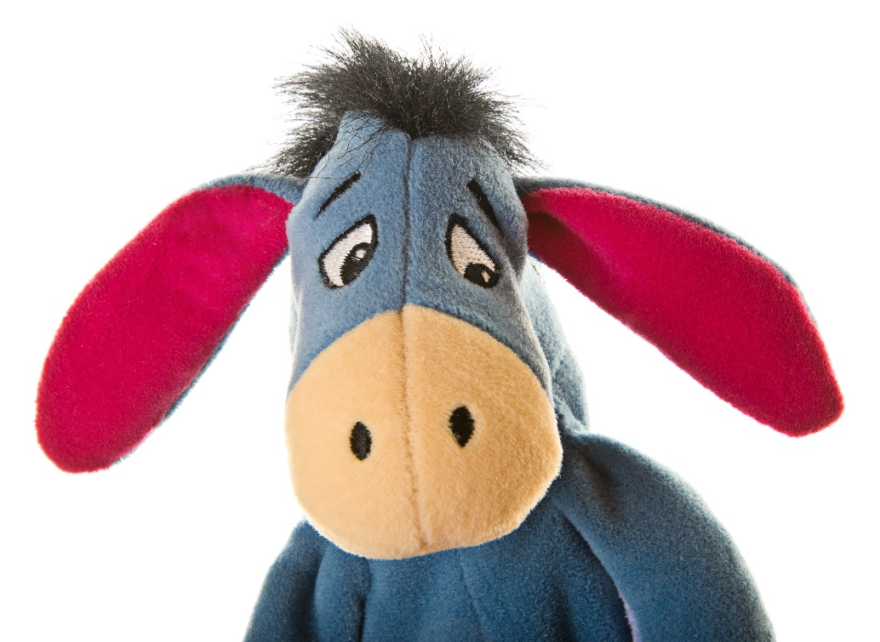
Leadership Traits/Functions-Forbes/Deep Patel
Acting Strategically
Focusing on the future and thinking about your company’s operational conditions, and
Maintaining a positive outlook.
Are you a Tigger or an Eeyore?

Slide 32
Leadership Traits/Functions-Forbes/Deep Patel
What do we need to do to have our future outcome?
Mission
Vision- Incorporate new approaches without getting distracted from the main goals. Practice being adaptable and agile as you implement new strategies and allow your business model to evolve over time.
Notes:
MIISSION - defines purpose - The mission statement articulates principles and actions needed to achieve the goals of the company (Question on Practice Exam)
VISION - future desired position - The purpose of the vision statement is to articulate principles and actions needed to achieve the goals of the company (Question on Practice Exam)
GOAL - specific, measureable, realistic, have timeline-The ultimate goal of the administrator is to achieve organizational effectiveness-(Question on Practice Exam)
Write on Black Board SMART laterally-
Has anyone heard of SMART Goals? (Give Example of how to use SMART Goals)
S-Specific
M-Measureable
A-Attainable
R-Relevant
T-Time Based
OBJECTIVE - specify what needs to be done, how much is to be done, and by when-measureable and time specific
ACTION - very specific as to what needs to be done to accomplish the goals and objectives
POLICIES & PROCEDURES – (guides actions) POLICY - expression of what and why; PROCEDURE - describes how
EVALUATION – Goals and Objectives should be reviewed at least annually. How do you eval?
Ask your stakeholders. Stakeholders are employees, residents, families, board of directors, etc. (Anyone with interest in your facility and its success.)

Slide 33
Leadership Traits/Functions-Forbes/Deep Patel
Values- Radiate enthusiasm/be truly excited and people will be drawn to you
Setting clear goals and persisting in achieving them
Short range/long range
Smart
Radiate enthusiasm/be truly excited

Slide 34
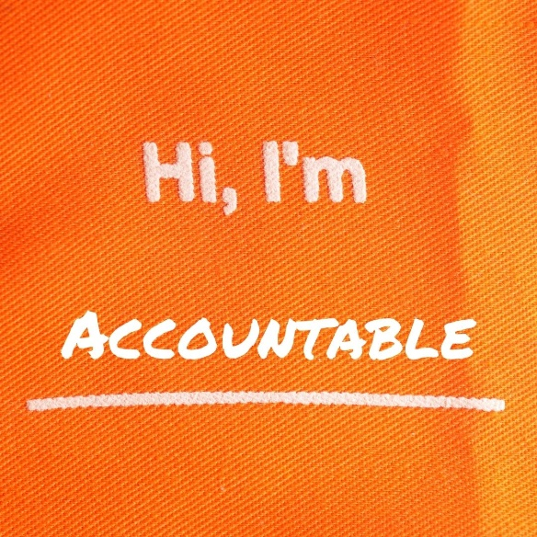
Leadership Traits/Functions-Forbes/Deep Patel
Objectives
Action
Policy & Procedure
Evaluation
Regularly Ask “How are we doing?”
Being Accountable and Responsible
Own mistakes and learn from them.
Follow rules and expectations.

Slide 35
Leadership Traits/Functions-Forbes/Deep Patel
Managing Complexity
According to a Harvard Business Publishing report, that means being able to scan the environment in search of subtle trends and indicators of disruptive change, and establish practices that allow your organization to respond swiftly.

Slide 36
Leadership Traits/Functions-Forbes/Deep Patel
Learning Agility
Leaders know that the strength of their leadership is built on their ability to adapt to suddenly changing circumstances and when to seize on opportunities.

Slide 37
Leadership Traits/Functions-Forbes/Deep Patel
Learning Agility
Having an insatiable curiosity will fuel your desire to constantly learn and grow. Developing critical thinking skills, being accepting of uncertainty, having social and emotional intelligence and always having the desire and determination to push forward.

Slide 38
Leadership Traits/Functions-Forbes/Deep Patel
Fostering Creativity and Innovation
Leaders must have the courage to risk experimentation and encourage creativity. Doing this will foster the innovation that will steer your organization to new destinations and around the twists and turns of a changing business landscape.

Slide 39
Leadership Traits/Functions-Forbes/Deep Patel
Team Building and Promoting Team Work
Successful leadership is built on the people around you. Team building is essential to leading a diverse and unique group of people with distinct personalities, motivations and skills. Recruitment and retention are key.

Slide 40
Leadership Traits/Functions-Forbes/Deep Patel
Creating Lasting Relationships
Compelling leaders know how to motivate their employees to strive wholeheartedly. Employees who feel appreciated, who feel like what they do makes a difference, will push harder to achieve success for their company.
Leaders need to be effective at networking, for the benefit of their organization. By creating a vast and varied network of people, leaders establish impactful relationships.

Slide 41
Relations/Communications
Management/employee relations
Ask Your Staff Questions Often i.e.:
What do you need?
How satisfied are you with your organization as a place to work?
Are we living up to our mission?
What would make this a better place to work?
Would you to refer a good friend or family member to work here?
How often do you think about looking for a new job with another organization?

Slide 42
Grievance Procedures for Residents and Families
Daily Management and Operations
Grievance Procedures for Residents and Families
Set realistic expectations from the beginning
Develop relationships of trust
Open and honest communication
Resolve concerns as PROMPTLY as possible!
Care and Abuse Concerns Require IMMEDIATE ATTENTION AND ACTION
Written and verbal complaints not resolved by staff receiving are a Grievance
Have a Grievance Committee for those not satisfied with resolutions

Slide 43
Relations/Communications
Ask Your Residents and Families Questions Often i.e.:
What do you need?
How we meeting your expectations?
Are we living up to our mission?
What would you change it you could?
What would make this a better place to live?
Would you to refer a good friend or family member to live here?

Slide 44
Leadership Traits/Functions-Forbes/Deep Patel
Be an Effective Communicator
One on one, group, whole team, different constituencies.
Verbal and non-verbal.
Personally, letter, email, social media…

Slide 45
Relations/Communications
Communication Process (Pg 338 in Townsend Book)
Understanding on receiver end is final step
Listening
Barriers
Most important rule is to put message in language of receiver
Many of us can relate to this with children, different generations working together

Slide 46
Duties vs. Responsibilities
Responsibility is the obligation of the employee to perform the duty as assigned.
Responsibility CANNOT be delegated.
Duties-tasks or activities
You can delegate a task but you are still responsible for it.

Slide 47
Leaders must Create Balance
Intensely regulated environment
Constant changes and expectations
We certainly can feel this “constant change” right now
Purposefully plan and manage issues and concerns
Provide visionary leadership to create change and improvement

Slide 48
Leadership in LTC
Caring and Nurturing Self and Others
Self-knowledge and self awareness
Know what you stand for…know your strengths
Know what is important to you and the organization…remain consistent and confident
Take Good Care of Yourself!
Let’s Chat--- Any best practices???

Slide 49
Taking Care of You!!!

Slide 50
Leadership in LTC
Never Underestimate What Those We Serve (and those who serve) Can Do!!!

Slide 51
Recruiting and Interviewing

Slide 52
Objectives:
Understand the importance of staffing
Discuss standard recruiting strategies
Discuss consistent interview practices to identify quality employees
Review lawful interview questions
Discuss attendees’ job search

Slide 53
Have you had experience with recruiting or hiring within the past year?

Slide 54
In March and April of 2016, NFP conducted a targeted survey to gather information regarding the turnover and retention of employees in the long term care industry.

Slide 55
Staffing/Recruiting Basics:
Payroll/Overhead makes up 60-70% of your expense
Conduct standard (daily and weekly) staffing meetings to understand the vacancies and recruiting strategies.
Develop a Recruiting Action Plan to establish consistent recruiting strategies.

Slide 56
Based on your experience, what are the top 3 sources for applicants or hires?

Slide 57
To Win the War on Talent- Use a multi-coordinated approach
Job Boards
Search Engines
Cold Calls
Social Networks
Company Website
Career Site
Health Care Association
Employee Referrals
Mobile Recruiting
Advertisement
Email Campaigns
College Recruiting
Job Fairs

Slide 58
Challenges to Identifying Top Talent
What constitutes a bad hire?
Notes:
Annette:
If you didn’t collect objective information during the interview to make a good decision, perhaps you were not as prepared and focused as you needed to be. Good preparation requires that you carefully determine what you are looking for in terms of the skills, abilities and attributes a person must have to be successful in our position. Then you need to plan the questions you will ask to determine if the candidate has those qualities you are looking for. Without the right preparation and focus, you may make a hiring decision based on the candidate’s likeability. You may make assumption about the person based on his or her education or previous work experience. But a good hiring decision requires you carefully assess the whole package and that requires planning and preparation.
Hiring managers may make a bad hiring decision if they focus on the wrong issues during the interview. I’ve seen this many times. The manager is so sure about what they don’t want that they focus to narrowly and fail to assess other critical attributes. Maybe the last person who filled our open position, didn’t get along with his or her team mates. There were personality conflicts or maybe there were absenteeism or tardiness issues. So, in the interview, you make sure you don’t hire another “Tammy Trouble Maker” or “Tardy Todd” by focusing only the candidate’s personality or work habits. You fail to also assess for skills, abilities or other equally critical attributes.
And the worst mistake we can make in the interview process is asking the wrong questions. The key to identifying top talent is asking the right questions. A candidate’s past performance is the best predictor of future performance. So the right questions are open, behavior-based questions that ask the candidate to tell you about their actual experiences in situations similar to what they will experience on the job and what they did in those situations.
Think about the skills, behaviors, attitudes and characteristics required to be successful in the position and then ask questions that get the candidate to talk about a time when they demonstrated those behaviors or traits. For example, our open position requires someone who will be good with customer service. So we could ask our candidate to “Tell me about a time when you went the extra mile to help a patient/customer. Describe the situation, what you did and how it turned out.” If they can relate how they have been successful in past customer interactions, we can better predict if they can be successful in customer situations on our environment.

Slide 59
Challenges to Identifying Top Talent
Why do we make bad hiring decisions?
Warm body syndrome
Hearing what you want to hear
Bias
Not prepared and focused
Asking the wrong questions
Notes:
Annette:
If you didn’t collect objective information during the interview to make a good decision, perhaps you were not as prepared and focused as you needed to be. Good preparation requires that you carefully determine what you are looking for in terms of the skills, abilities and attributes a person must have to be successful in our position. Then you need to plan the questions you will ask to determine if the candidate has those qualities you are looking for. Without the right preparation and focus, you may make a hiring decision based on the candidate’s likeability. You may make assumption about the person based on his or her education or previous work experience. But a good hiring decision requires you carefully assess the whole package and that requires planning and preparation.
Hiring managers may make a bad hiring decision if they focus on the wrong issues during the interview. I’ve seen this many times. The manager is so sure about what they don’t want that they focus to narrowly and fail to assess other critical attributes. Maybe the last person who filled our open position, didn’t get along with his or her team mates. There were personality conflicts or maybe there were absenteeism or tardiness issues. So, in the interview, you make sure you don’t hire another “Tammy Trouble Maker” or “Tardy Todd” by focusing only the candidate’s personality or work habits. You fail to also assess for skills, abilities or other equally critical attributes.
And the worst mistake we can make in the interview process is asking the wrong questions. The key to identifying top talent is asking the right questions. A candidate’s past performance is the best predictor of future performance. So the right questions are open, behavior-based questions that ask the candidate to tell you about their actual experiences in situations similar to what they will experience on the job and what they did in those situations.
Think about the skills, behaviors, attitudes and characteristics required to be successful in the position and then ask questions that get the candidate to talk about a time when they demonstrated those behaviors or traits. For example, our open position requires someone who will be good with customer service. So we could ask our candidate to “Tell me about a time when you went the extra mile to help a patient/customer. Describe the situation, what you did and how it turned out.” If they can relate how they have been successful in past customer interactions, we can better predict if they can be successful in customer situations on our environment.

Slide 60
Interview Process
Pre-Interview
Assess job
Prepare questions and interview guide
Interview
Assess candidate
Post- Interview
Evaluate objective data
Make hiring decision
Promote opportunity
Notes:
Marilyn: There are samples of interview guides in your handout for this session. Let’s take a look at the interview as a process. There are three steps in our process, the pre-interview, interview and the post-interview steps. First we focus and prepare for the interview by assessing the job and preparing our questions and interview guide, then we conduct the interview and promote the job opportunity to the candidate. Then we evaluate the data we collected and make our decision about the candidate.

Slide 61
Consistent assessment of candidates:
Develop Skill Assessment interview questions-
These questions should assist you assessing the applicants skills, experience, education, and work history
Develop Behavior-based interview questions-
Utilizes past behavior as a more reliable indicator of future job performance
The single best predictor of an applicant’s future job performance is his/her past job behavior.
Uses open-ended questions that ask for specific examples of past job behavior.

Slide 62
Assess the Position
Job Functions and tasks – Can Do?
Knowledge, skills and abilities
Prior work experience
Success Factors - Will Do?
Qualities and attributes
Motivation
Habits
Work Environment - How Fit?
Culture
Team
Notes:
Marilyn: We have an opening for an Admissions Director and we need your help first to determine what we are looking for in a candidate.
The first thing we need to do is assess the most important qualities needed to be successful in our admission director job. Annette how do you suggest we approach this analysis of our open position?
Annette: Well we might start with the job description and clarify the essential functions and tasks our candidate will be required to perform on the job. We need to determine what skills, knowledge and abilities are needed to perform those essential functions. We will want to explore the candidates past performance to assess if they can they do this job?
Then we need to dig a bit deeper and clarify what it takes to be successful in the job. We can start by identifying the top five to ten key tasks that will determine success for this position. What does the person selected need to do to be successful in three months, six months and one year? These should be action-oriented, specific and measurable. Then determine what qualities the candidate needs to be able to demonstrate in terms of motivation, work style, energy etc, to achieve success. For example, our admission director needs to drive census. They need to call on referral sources, development relationships, resolve customer complaints and sell the services of your center. Qualities that make a person successful with those objectives may include taking initiative, creativity, perseverance and persuasiveness. To identify what attributes contribute to success, we might want to think about people who have held the position in the past. What qualities contributed to past successes in the role. What qualities, or lack there of, created challenges for others in the role. What does it take to do this job successfully?
And finally, we need to assess the work environment and recognize the type of individual who will likely thrive in our environment. How would you describe the work environment – is it fast paced, patient-focused, team oriented? Consider the other members of the team. What type of individual will likely fit in? What type may struggle in our environment? To illustrate what I mean by fit and why fit is important, consider the following examples of mismatches between the culture/work environment and a person’s preferences or temperament. A department head with a authoritarian an autocratic leadership style in a culture that values teamwork and team problem-solving. A highly sociable person in a window less office in the basement with very little contact of others. A person with a very methodical, and purposeful approach to work in an fast-paced environment that demands rapid decisions, and improvising to respond quickly to problems. Fit is an important factor to consider since a person who can’t tolerate the pace, culture and work environment likely won’t stick around for long.

Slide 63
Behavior-based questions
Situation
Action
Result
Tell me about a time…
Describe for me a situation…
Give me an example of a situation…
Notes:
Annette: Instead of asking hypothetical questions about how the candidate might handle some future task, we want to ask specifically how the candidate handled something similar in his or her past jobs. The best way to do this is to asks the candidate to recall a situation, describe the actions he or she took and explain the result of those actions.
For example, “Tell me about a recent situation in which you had to deal with a very upset customer or coworker.”
Often candidates don’t clearly answer all three parts of that type of question. So you need to ask follow up questions to help the candidate provide a complete answer. Ask for detail of the situation. Ask them to explain what they did and how it turned out. Ask probing questions – how, what, when, where, why?

Slide 64
Can do - Admissions Director
Job Functions and Tasks
Knowledge
Skills
Abilities
Sales process
Relationship building
Assessment and goal planning
What can we ask?
Notes:
Annette: Okay so let’s practice writing behavior-based questions. Starting with job functions. What questions can we ask to determine if the candidate can do the essential functions of the job. These are the questions that assess if the candidate possesses the specific skills, knowledge, abilities and experiences needed to be effective in the role. Listed here is a short list. What open, behavior based-question can we ask to assess skills and abilities in these areas?
Respond to chat comments..
You may find you don’t have a lot of time to ask a number of different questions. Perhaps you could come up with one really good question that gets at all of these things. For example, “Tell me about a time when you did not meet your sales goals.”
Depending on how they answer the question, you will also ask probing questions to dig deeper in the story. “How did you handle that? What would you do differently? How long until you were able to meet goals?” -- Throughout these probing questions, you will be able to asses abilities but also, do they make excuses, are they able to accept responsibility and learn from their mistakes.

Slide 65
Will do - Admissions Director
Qualities
Attributes
Motivation
Habits
Knowledge
Skills
Abilities
Problem-solving
Persuasive
Initiative and follow-through
What can we ask?
Notes:
Annette: Okay so let’s practice writing behavior-based questions. Starting with job functions. What questions can we ask to determine if the candidate can do the essential functions of the job. These are the questions that assess if the candidate possesses the specific skills, knowledge, abilities and experiences needed to be effective in the role. Listed here is a short list. What open, behavior based-question can we ask to assess skills and abilities in these areas?
Respond to chat comments..
You may find you don’t have a lot of time to ask a number of different questions. Perhaps you could come up with one really good question that gets at all of these things. For example, “Tell me about a time when you did not meet your sales goals.”
Depending on how they answer the question, you will also ask probing questions to dig deeper in the story. “How did you handle that? What would you do differently? How long until you were able to meet goals?” -- Throughout these probing questions, you will be able to asses abilities but also, do they make excuses, are they able to accept responsibility and learn from their mistakes.

Slide 66
How fit - Admissions Director
Work Environment
Culture
Team
Stress
Working effectively with others
Customer orientation
What can we ask?
Notes:
Annette: Okay so let’s practice writing behavior-based questions. Starting with job functions. What questions can we ask to determine if the candidate can do the essential functions of the job. These are the questions that assess if the candidate possesses the specific skills, knowledge, abilities and experiences needed to be effective in the role. Listed here is a short list. What open, behavior based-question can we ask to assess skills and abilities in these areas?
Respond to chat comments..
You may find you don’t have a lot of time to ask a number of different questions. Perhaps you could come up with one really good question that gets at all of these things. For example, “Tell me about a time when you did not meet your sales goals.”
Depending on how they answer the question, you will also ask probing questions to dig deeper in the story. “How did you handle that? What would you do differently? How long until you were able to meet goals?” -- Throughout these probing questions, you will be able to asses abilities but also, do they make excuses, are they able to accept responsibility and learn from their mistakes.

Slide 67
Plan the Interview Process
Consistent with all candidates
Interview Guide
Objective criteria
Number of interviews
Number of interviewers
Time frame
Scheduling and coordination
Notes:
Annette: We will ask for your questions is just a moment. But first let’s talk about some final considerations while planning an interview. We have discussed today how to develop appropriate behavior-based interview questions based on the can do, will do, how fit needs of the position and your location. We recommend that you take these interview questions and develop an interview guide that you consistently use for all the applicants for this position. Additionally, there are other factors to consider like :
Number of interviews- technically we require 2 interviews prior to hire however you may want to consider your position and the interviews or interviewers that are necessary to accurately assessing the candidates. In our next webinar, we will be discussing the interview process and will expand on recommendations for Number of interviewers, Time Frame, and Scheduling and coordination.

Slide 68
Unlawful Questions
Questions must be job related.
Don’t ask about:
Age
Gender
Race
Religion
National Origin
Disability
Salary (some states and cities)
Ask all candidates the same questions.
Notes:
Annette: Absolutely. There are various federal, state and local laws regulating the questions a prospective employer can ask job candidates. Our questions must be related to the job the candidate is seeking. The focus needs to be “what do I need to know to decide whether this person can perform the functions of the job. So, yes, you can break the ice by asking some easy questions about information on their resume or application but be careful not to ask anything directly or indirectly to identify the candidates age, gender, race, color, religion, national origin or disability.
It is illegal to discriminate when you hire, fire, promote or provide benefits to employees. Its unfair to base employment decisions on reasons that have nothing to with their ability to do the job. Its unfair to apply different standards or to apply standards differently to different individuals. Equal employment opportunity requires keeping an open mind about individuals and basing employment decisions on objective documented criteria. Use an interview guide, and ask everyone the same questions and DON’T stop the interview early if you feel the candidate isn’t right for the job. You need to continue and give each candidate the same opportunity as everyone else.

Slide 69
Unlawful Questions
Is this a lawful or unlawful question? Why?
Are you married?
Do you plan to have a family?
Notes:
Annette: Let’s test our understanding of these legal issues. In the chat tell us if you think this is a lawful or unlawful question and why?
Is it lawful or unlawful to ask “Are you married?” or “Do you plan to have a family?”
(Comment on chat)
Both these questions are unlawful. While you may intend this a friendly question and it may naturally come up in conversation, marital status is a protected category under federal and state employment laws. You are also not entitled to discriminate against someone on the basis of whether the person has or will have children.

Slide 70
Unlawful Questions
Is this a lawful or unlawful question? Why?
What year did you graduate from high school?
Notes:
Annette: “What year did you graduate from high school? Is this lawful or unlawful and why?
(Wait for responses and make comments about the chat)
This question is unlawful because you could use a high school graduation date to estimate how old a person is. You can’t discriminate against a person because of his or her age. In regards to age, you can ask “Are you 18 years or older?” but only if being at least 18 is a necessary condition of employment.

Slide 71
Unlawful Questions
Is this a lawful or unlawful question? Why?
Are you able to provide proof of the right to work in the U.S?
Notes:
Annette: How about this one. Is it lawful or unlawful to ask “Are you able to provide proof of the right to work in the U.S?”
(Comment on chat)
This is a lawful question. This wording is on our applications and it the right way to ask the question. Don’t ask “Are you a US citizen?” “Where were your parents born?” or. Of what country are you a citizen?”

Slide 72
Unlawful Questions
Is this a lawful or unlawful question? Why?
Do you have a disability?
Notes:
Annette: Lets try one more. Is it lawful or unlawful to ask “Do you have a disability?” Respond in the chat and explain your answer.
(comment on chat)
This question is unlawful. Never ask this question. You can provide all candidates with the job description which lists the essential functions and physical expectations of the job and then ask them “Are you able to perform the essential functions of this job?
Nice job on those questions. Thanks for playing along.

Slide 73
Interviewing Summary:
Avoid “warm body syndrome.”
Use a planned and focused process.
Ask the right questions.
Be fair and non-discriminatory.
Base decision on objective data.

