Slide 1
March 30-31, 2022

Slide 2
Module 1: Regulations & Survey

Slide 3
Speakers
Kim Fair, BA Psychology, ADC
Lydia Raber, ADC, CDP
Chris Shelley

Slide 4
Module 1: Regulations & Survey
Survey & Licensure
Certification
F-Tags
Immediate Jeopardy & Abuse
Music & Movie Licensing
Pet Policies
Social Media
Volunteers
Life Safety Code

Slide 5
Laws Vs. Rules
Laws
Statute
Do not have to be reviewed & require legislation to be changed
Rules
Regulation
5 year rule review
Rule Defined
Just as a statute is law, a rule is a regulation. Whereas statutes are contained within the Ohio Revised Code, rules are contained within the Ohio Administrative Code. Rules have the full force of law, but are usually more detailed. The key difference between a statute and a rule, however, is that whereas the Ohio General Assembly writes legislation, which becomes law, state agencies (like ODH) are tasked with writing rules. The primary purpose of an administrative rule is to flesh-out or implement a statute.
Rule Review
Per Ohio law, existing administrative rules must be reviewed at least once every five years. Rule review entails deciding whether a rule should be amended, rescinded, or kept the same, subject to the CSI (Common Sense Initiative) process pursuant to Senate Bill 2 of the 129th General Assembly, and filing it with JCARR, Legislative Service Commission (LSC), and the Secretary of State.
Rules proposed to be amended, rescinded, adopted as new, or those requiring no change are filed with JCARR, the oversight committee tasked with reviewing rules on behalf of the Ohio General Assembly. Go to JCARR for more information on the JCARR process; however, it is the primary task of JCARR to ensure proposed rule actions do not conflict with the law.
Notes:
Now we are going to talk about laws versus rules. With laws versus rules, laws are statute and rules are regulations. Laws are Ohio Revised Code and rules are Ohio Administrative Code. The laws do not have to be reviewed and require legislation to be changed. Rules go through a five-year rule review process. Under the rule defined -- and I thought this was great, and they had it on another association's Web site, but it is good -- it was under Ohio Department of --ODE, Ohio Department of Education. Just as a statute is a law, a rule is a regulation. Again, whereas statutes are contained within the Ohio Revised Code, rules are contained within the Ohio Administrative Code. Rules have the full force of the law but are usually more detailed. It is not just because it is a rule, it is not law. They have the full force of the law, but they are going in more details. The key difference between a statute and rule, however, is that whereas the Ohio General Assembly writes legislation which becomes law, state associations, like ODH, are tasked with writing rules. Primary purpose of an administrative rule is to flesh out or implement a statute. Even though the statute is written, it is to go into more detail. Then the rule review, which we have every five years, per Ohio law, existing administrative rules must be reviewed every five years, will review deciding whether a rule should be amended. If you remember the process this year, it was more like seven years because it took forever to get it passed. They are now subject to the CSI, common sense initiative process, which Senate Bill 2 put in place. Rules proposed to be amended, rescinded, adopted as new, or those requiring no change are filed with JCARR. Those are basically the things you need to know about those, but when you hear us talk about laws and rules, they are different.

Slide 6
Module 1: Regulations & Survey Ohio Administrative Code/Licensure
Resident Life Enrichment

Slide 7
OHIO ADMINISTRATIVE CODE 3701-17-09 Resident life enrichment
All nursing homes shall provide a comprehensive activity program designed to meet the physical, mental, emotional, psycho-social well-being and personal interests of each resident. Activities shall be provided based on the needs and preferences of each resident as identified on their comprehensive assessment and care plan required by rules 3701-17-10 and 3701-17-14 of the Administrative Code, respectively, and needs and preferences identified during resident's time in the home. Activities shall be implemented and adjusted based on resident input and residents' changes in abilities, physical and mental status. Activities shall be scheduled for daytime, weekend, evening, and include the community to the extent possible.

Slide 8
OHIO ADMINISTRATIVE CODE 3701-17-09 Resident life enrichment Cont.
All nursing homes shall provide social services to:
Meet the medically-related social service needs of each resident;
Meet the physical, mental, and psycho-social well-being of each resident; and
Assist each resident in attaining or maintaining the highest practicable level of functioning.
Residents may receive visitors of their choice at any time. The nursing home may establish reasonable policies to ensure that visits will not unduly disturb other residents or interfere with the operation of the home and shall provide or arrange for private space for visitation.

Slide 9
OHIO ADMINISTRATIVE CODE 3701-17-09 Resident life enrichment Cont.
Residents may keep pets if allowed by facility policy. If a nursing home allows residents to keep animals or pets, or has facility pets, the nursing home shall, in consultation with the medical director and a veterinarian licensed to practice veterinary medicine under Chapter 4741. of the Revised Code, develop and implement a written protocol regarding animals and pets that protects the health and safety and rights of residents. At minimum, the written protocol shall include:
An annual physical examination, including an examination for internal and external parasites;
Vaccinations for common infectious agents, including rabies;
Any other preventive care necessary to protect the health, safety and rights of residents;
Procedure to follow if an animal:
Bites a person; or
Becomes ill or injured;
For resident pets, if the resident is transferred, discharged or otherwise unable to care for the pet, responsibilities for care of the pet until a family member or sponsor can retrieve the pet;
In the case of a facility pet, the name of the designated member or members of the staff responsible for the care of the animal and for maintaining the protocol, including medical records for the animal; and
An evaluation of the medical needs of residents.

Slide 10
OHIO ADMINISTRATIVE CODE 3701-17-09 Resident life enrichment Cont.
Residents shall have reasonable access to various methods of communication. The administrator shall ensure that:
Each resident receives all mail, telegrams, or other communications addressed to the resident unopened and unread immediately upon receipt at the nursing home and opened and read to the resident after delivery if the resident so requests.;
Each resident's outgoing mail shall be delivered unopened and unread to the regular postal channels promptly upon its receipt from the resident except when there is no regularly scheduled postal delivery or pick-up service in which case it shall be placed into the next regularly scheduled delivery or pick-up. The nursing home shall assist a resident in writing a letter or have a letter written for him or her if the resident so requests;
Each resident has access to telephone services that meets the needs of the resident in an area where calls can be made without being overheard; and
Each resident can use his or her cellular phone, computer, or other technological device unless the use of that device is not medically advisable or is disruptive to other residents or the safe and orderly operation of the home.

Slide 11
Module 1: Regulations & Survey Ohio Administrative Code/Licensure
For The Activity Professional

Slide 12
PROFESSIONAL CERTIFICATION LEVELS AND SPECIALIZATIONS
NCCAP has trained and certified over 150,000 individuals in person-centered care using the Social Model of Care since 1986. The certifications are designed to ensure care providers possess the competencies to meet Federal and State regulations.
NCCAP offers 4 levels of Professional Certification:
1. Activity Professional Apprentice Certified (APAC)
2. Activity Professional Certified (APC)
3. Activity Director Certified (ADC)
4. Activity Consultant Certified (ACC)

Slide 14
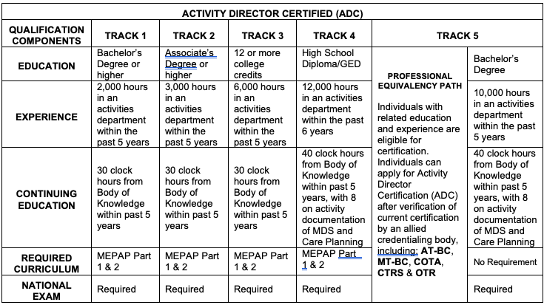

Slide 15
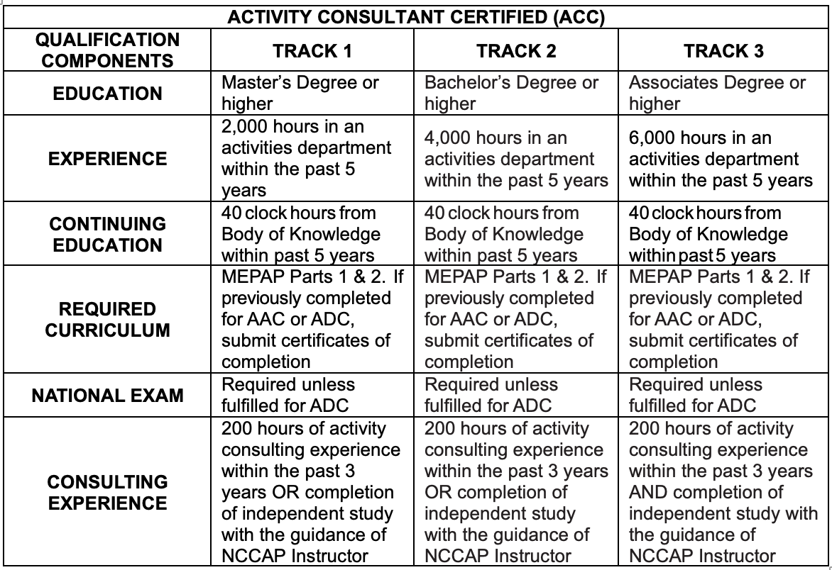

Slide 16
NCCAP SPECIALIZATIONS
NCCAP Certified Professionals can receive specializations that indicate advanced studies related to engagement and person-centered care in the following areas:
ADULT DAY SERVICES
ASSISTED LIVING
EDUCATION
HOME CARE
MEMORY CARE
PERSON-CENTERED CARE
SPECIALIZATION QUALIFICATION COMPONENTS
10 Continuing Education (CE) clock hours within the past 2 years are required in addition to the CE requirements of your certification level (CEs in the past 5 years will be accepted for Initial Application).
Topic of all CE clock hours must be related to those listed in the NCCAP Body of Knowledge. Applicant must submit evidence and description of the CE on the Specialization application.
Specialization designation recognizes competency to understand a team approach, direct an activity team, and carry out an activity program in the Specialization area.
Specialization designations are renewed biennially. Individuals possessing Activity Professional Certification renew their Specialization at the same time of Professional Certification renewal.

Slide 17
Required Renewals
1. Activity Professional Certification renewal is required every 2 years. Late renewal and payment date do not change the 2-year period. To renew, you need to acquire Continuing Education (CE) during the 2 years after initial certification and thereafter. CE requirements:
APC: 20 CEs every 2 years
ADC or ADCP: 30 CEs every 2 years
ACC: 40 hours CEs every 2 years
Each Specialization requires an additional 10 CEs in that Specialization every 2 years
2. Home Care and Montessori Dementia Engagement Certification renewal is required every year. Late renewal and payment date does not change the 1-year period. Renewal requires 5 hours of Continuing Education.
3. Renewal email reminders will be sent 90 days prior to expiration and then monthly thereafter.
4. Renewal information, fee schedule and required application forms can be found on NCCAP.ORG.
5. Renewals can be submitted online through your online profile at NCCAP.ORG, or print, complete and submit by mail.
6. Submit renewal 6 weeks prior to your expiration date for processing. Renewal fees are due at time of renewal submission. Renewals received without appropriate forms or payment are considered incomplete.
7. Notices of incomplete applications are sent by email during initial processing and periodically thereafter up to 1 year from expiration of certification.
8. Processing of renewals can be expedited for an additional Fast Track Fee.
9. Certification status can only be given after review and approval are complete.
10. If your certification has expired for more than 1 year, you must submit a new application rather than a renewal application and comply with all standards in effect.

Slide 18
LEVEL CHANGE IN CERTIFICATION
If you seek a Level Change, you need to complete a new Application that will be reviewed against your most recent application on file. It is not necessary to duplicate information already on file in your most recent application. You only need to add additional information supporting the Level Change and pay the Level Change fee (see website for Fee Schedule). If approved, your certification expiration date remains the same.
NOTE: If you seek a Level Change at the same time you are renewing, you must complete both the Renewal Application and the Level Change Application and pay the required fees.

Slide 19
RETIRED STATUS: ACKNOWLEDGEMENT OF SERVICE AWARD
Starting February 1, 2020, NCCAP provides retiring Activity Professionals with a complementary "thank you" of the "Acknowledgment of Service Award" at no fee.
This is not a certification and indicates you no longer work in the field of Activities.
If you choose to re-enter the field of Activities after your certification has expired, you must reapply for Initial Certification and meet the current NCCAP Certification Standards.

Slide 20
Module 1: Regulations & Survey F-Tags
The Complete List & How They Relate To Activities

Slide 21
Module 1: Regulations & Survey Critical Elements Pathways

Slide 22
Activities Critical Elements Pathway
Review Pathway Handout

Slide 23
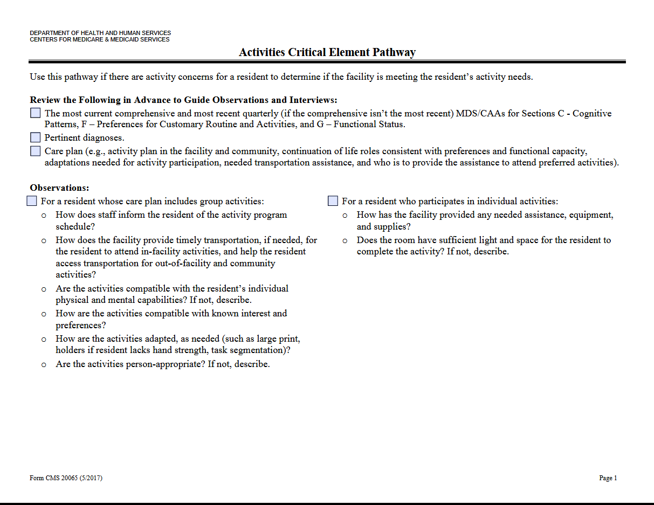

Slide 24
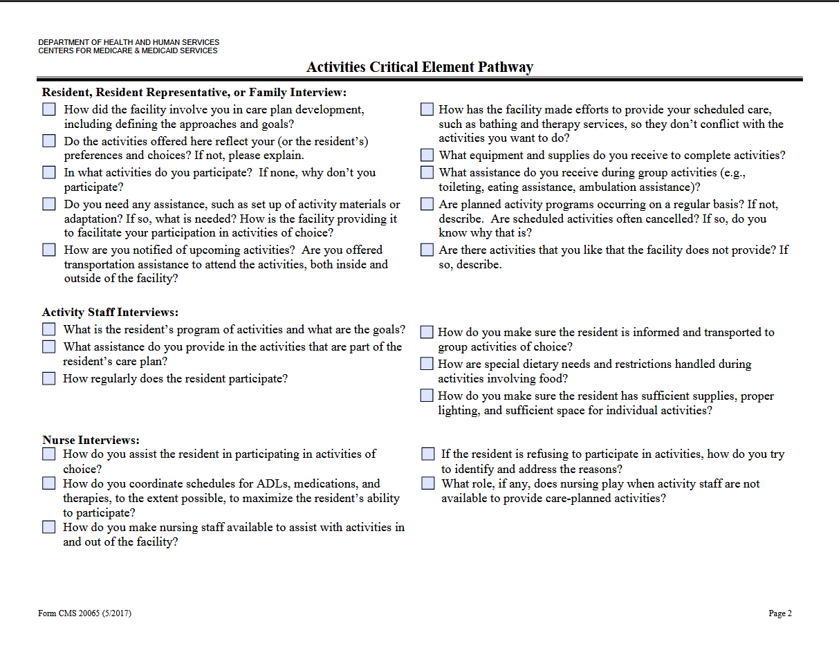

Slide 25
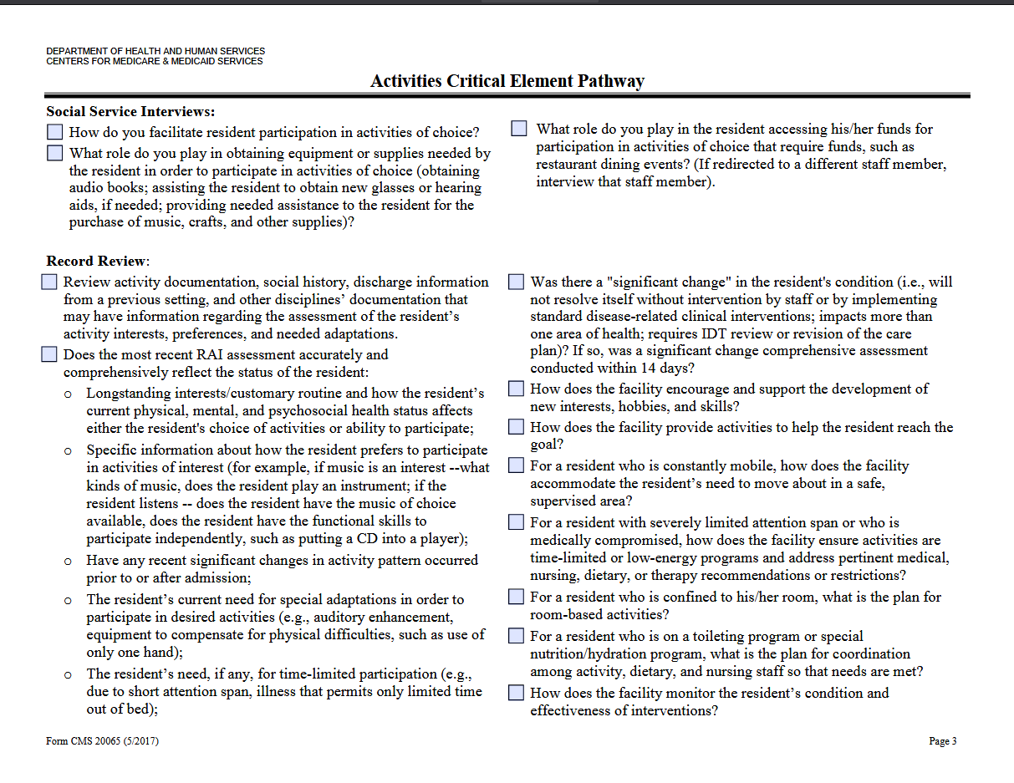

Slide 26
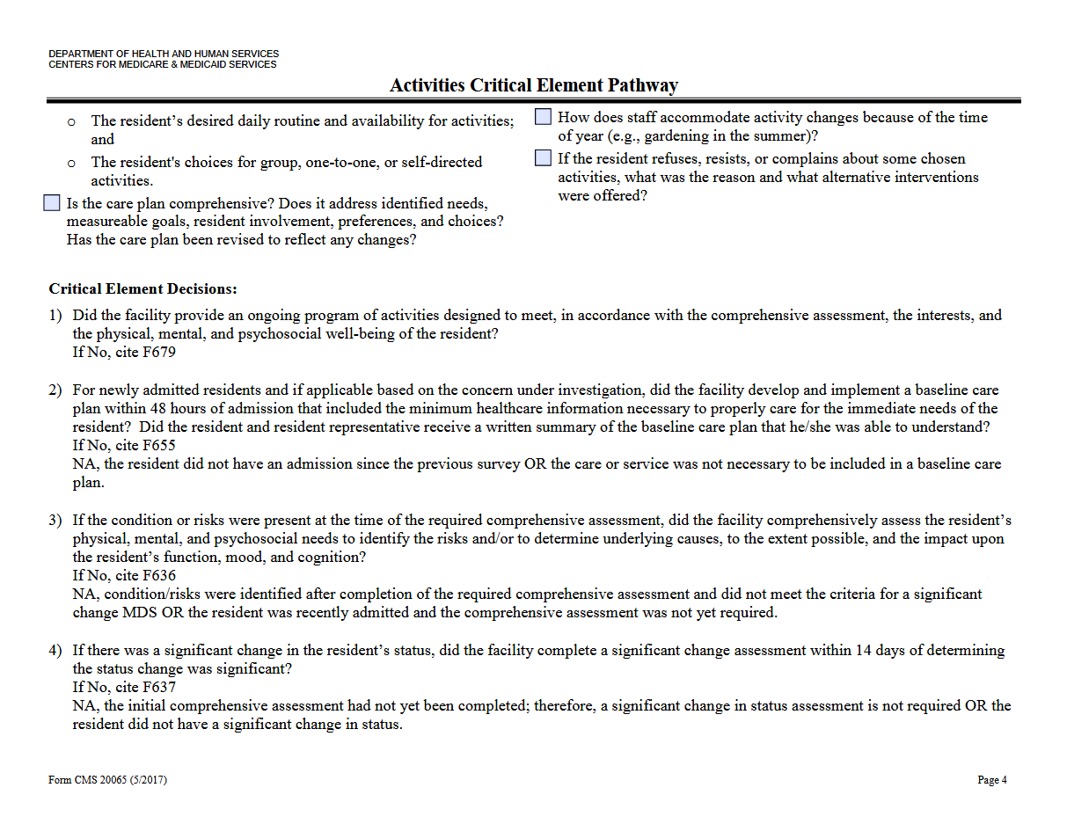

Slide 27
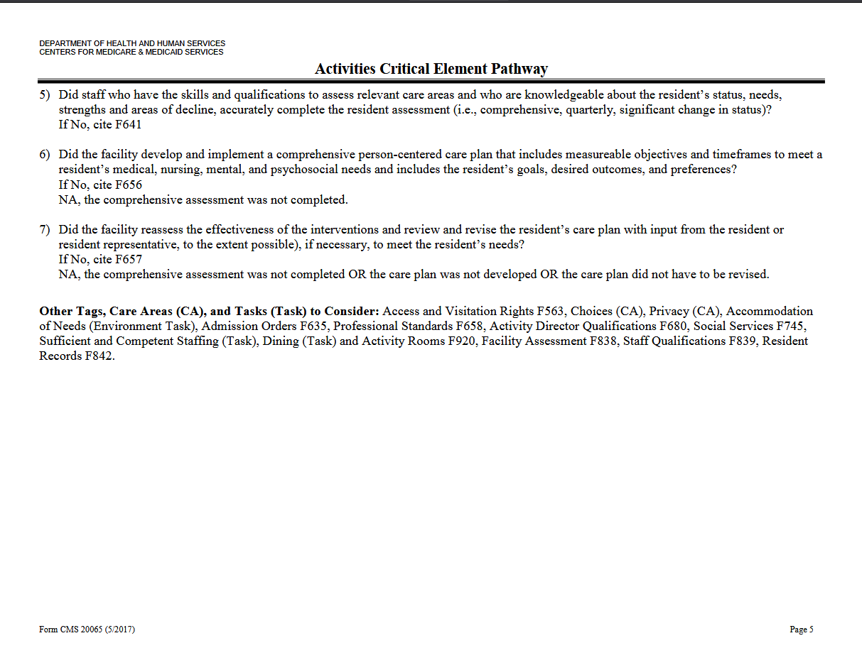

Slide 28
Dementia Care Critical Elements Pathway
Review Pathway Handout

Slide 33
Behavioral and Emotional Status Critical Elements Pathway
Review Pathway Handout

Slide 34
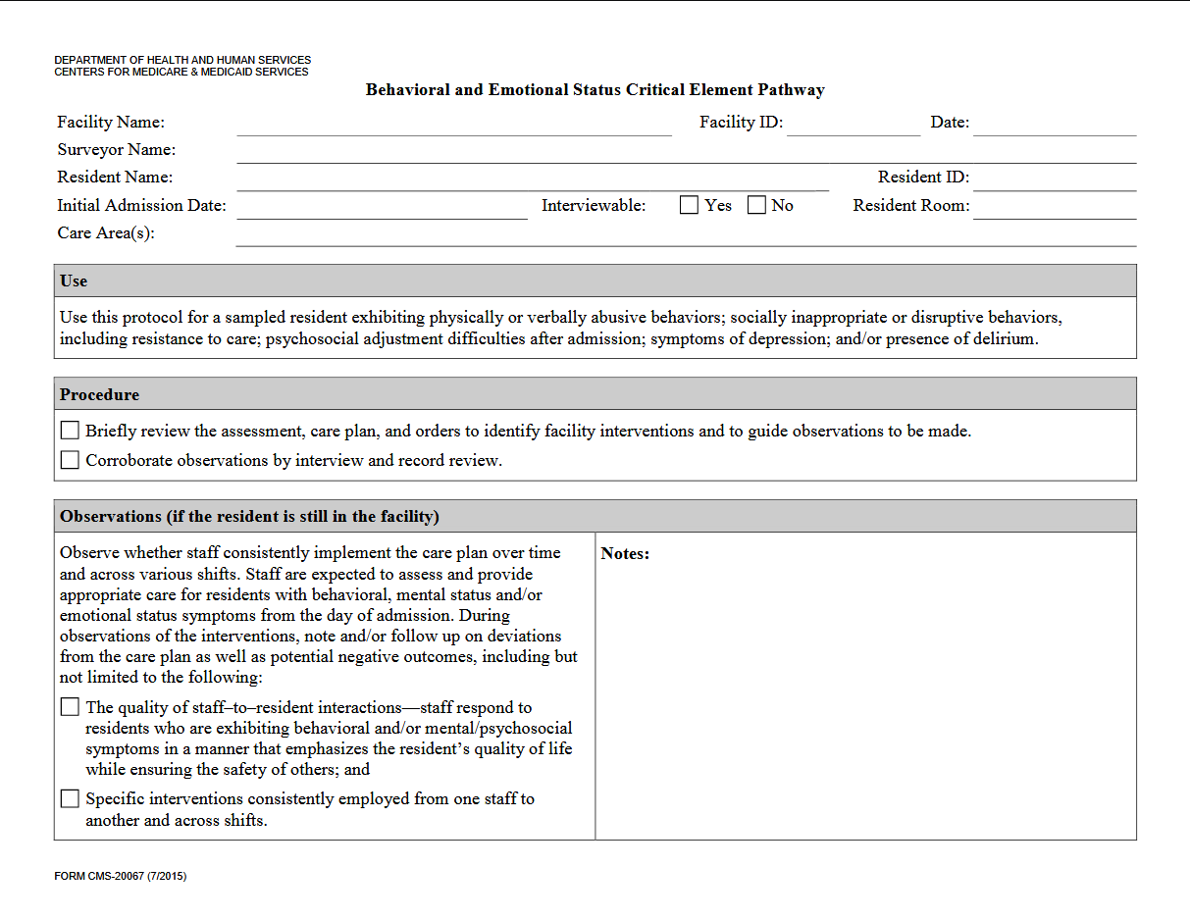

Slide 35
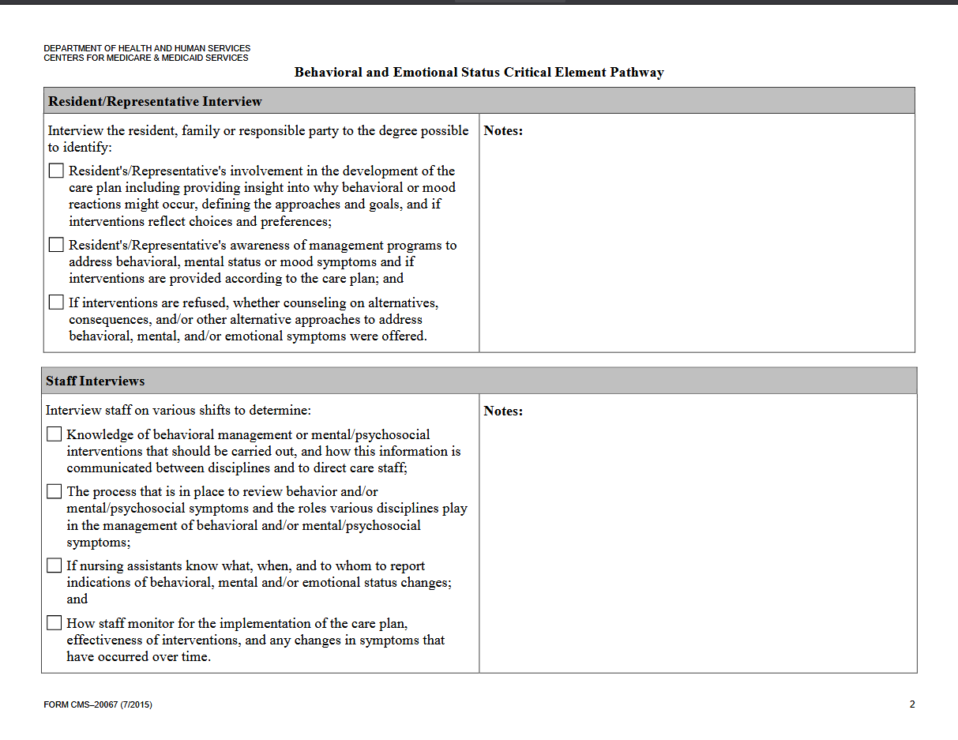

Slide 36
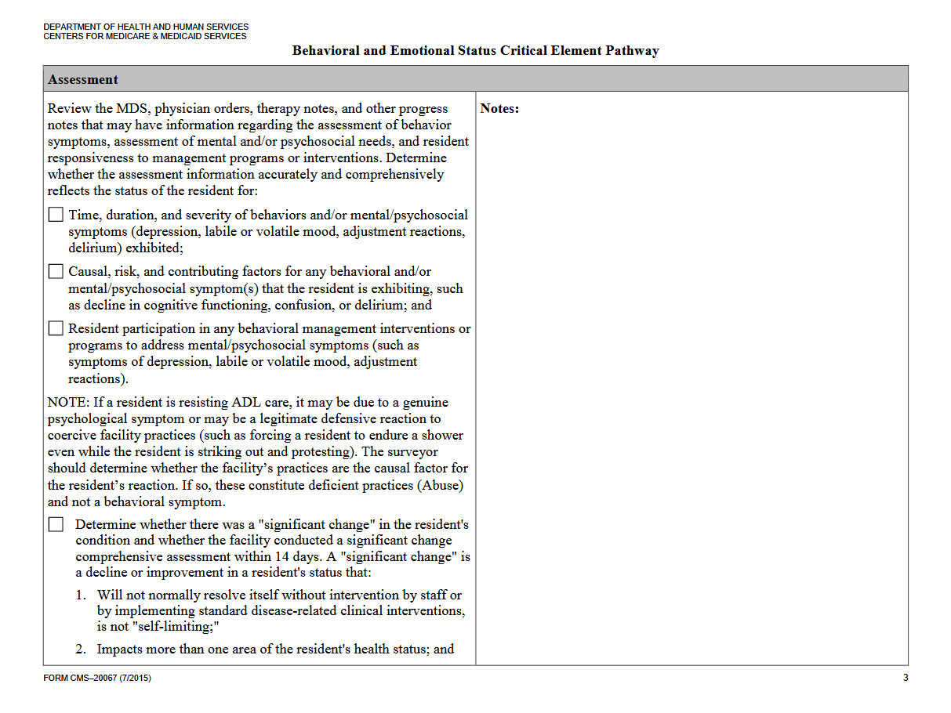

Slide 37
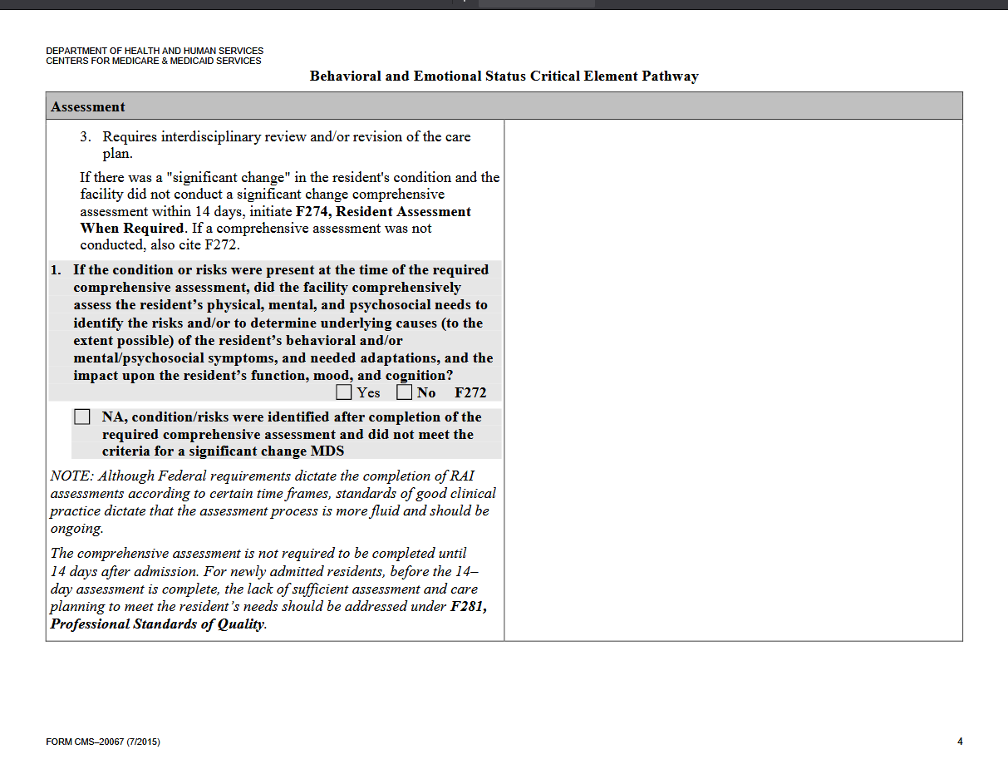

Slide 38
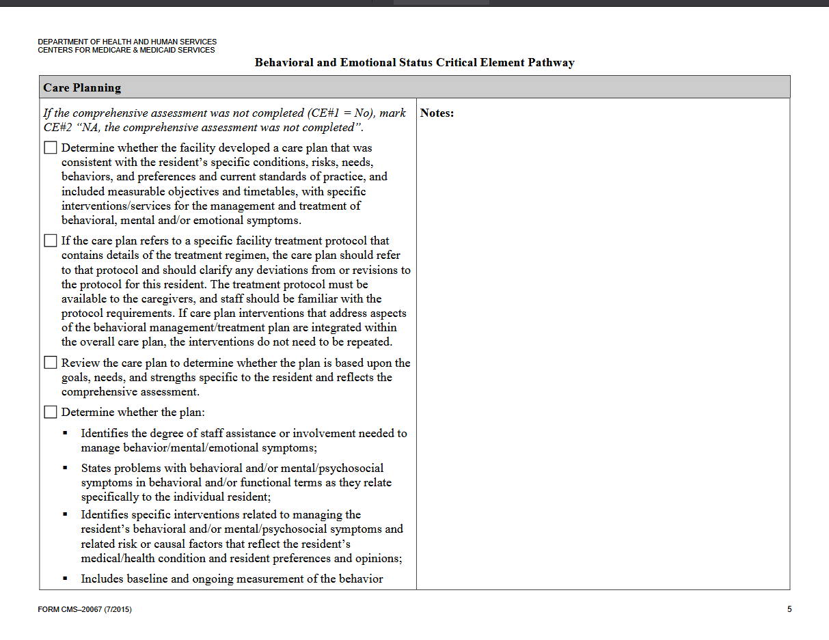

Slide 40
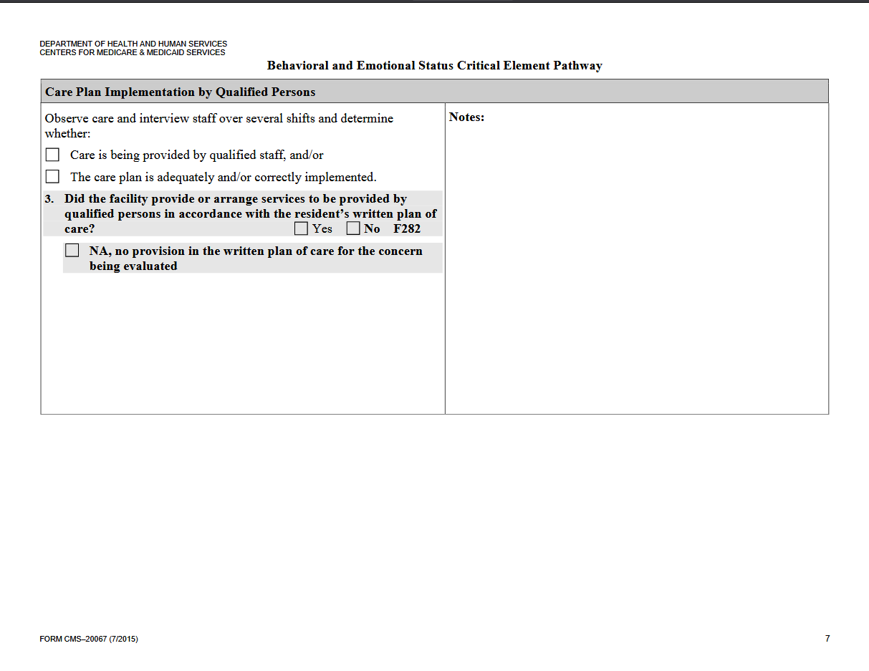

Slide 41
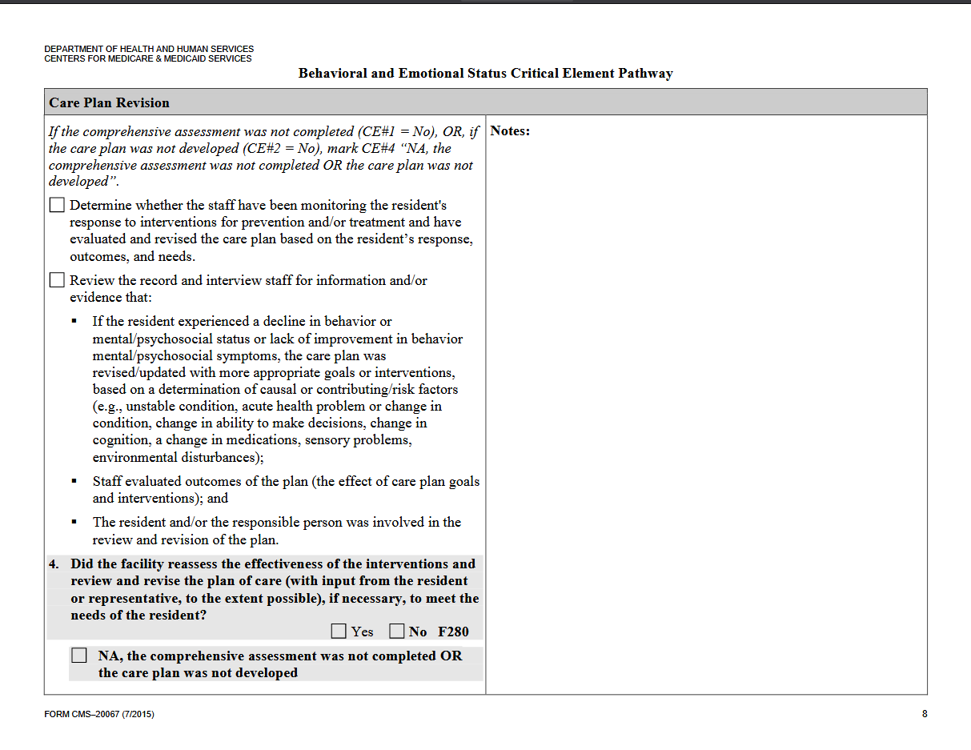

Slide 42
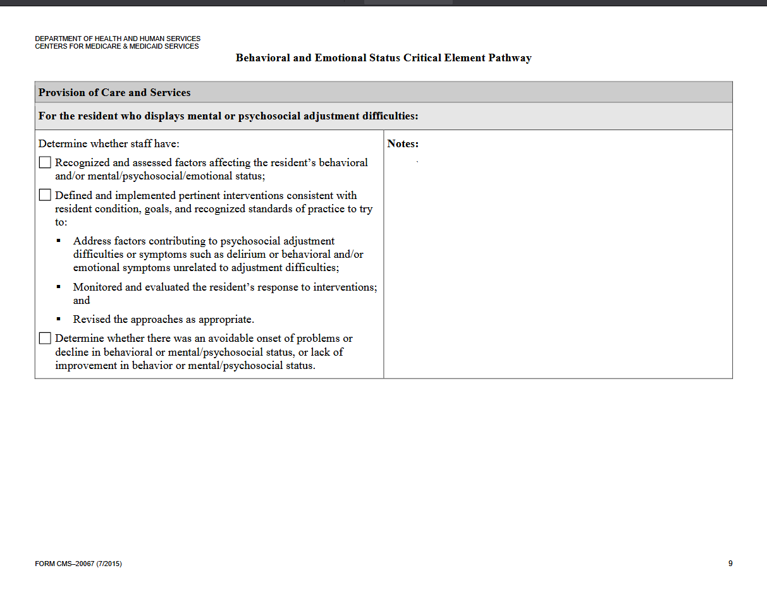

Slide 43
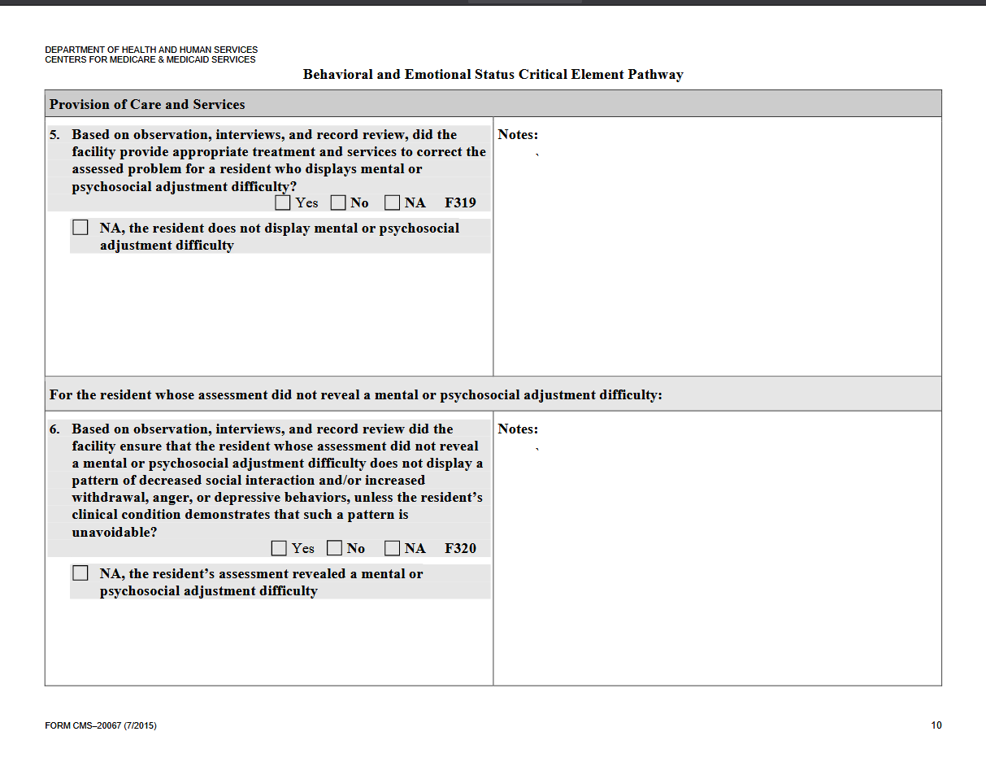

Slide 44
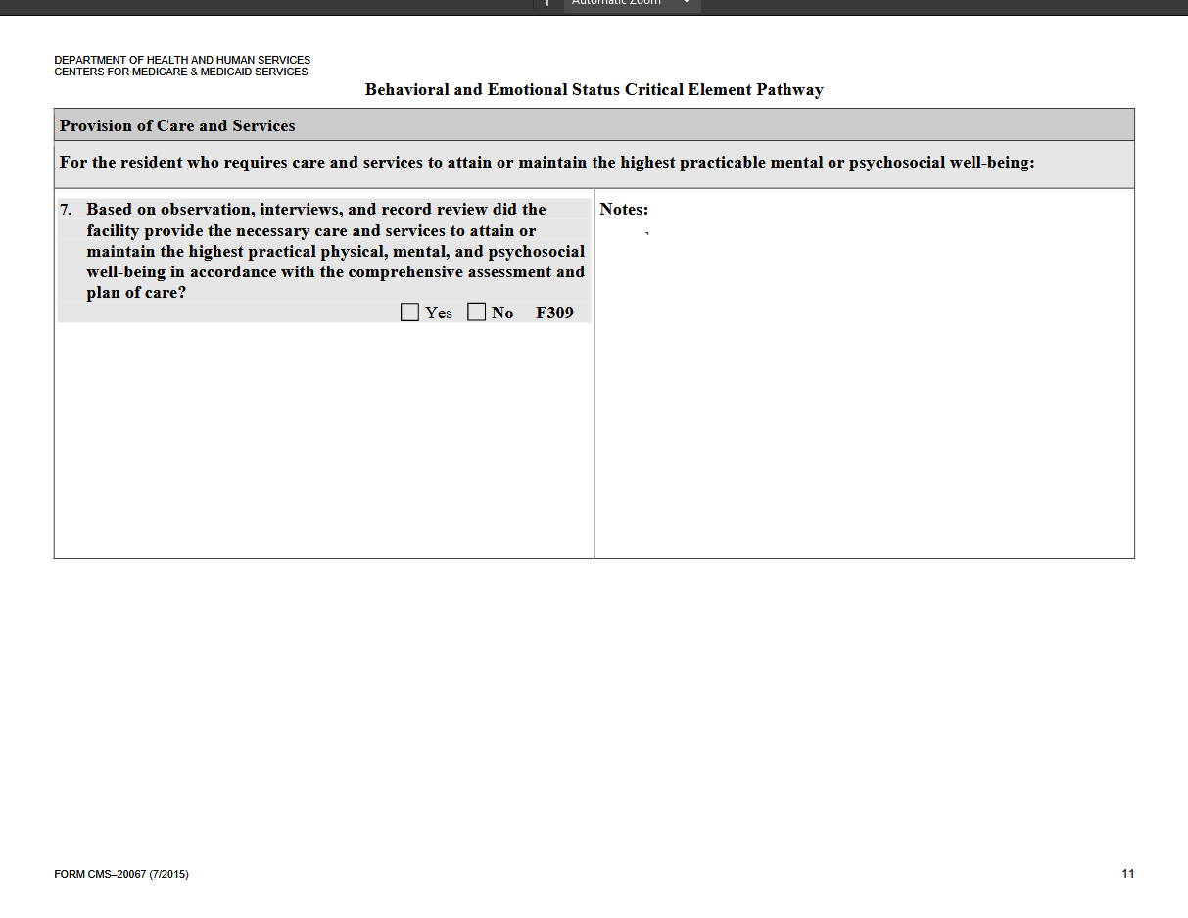

Slide 45
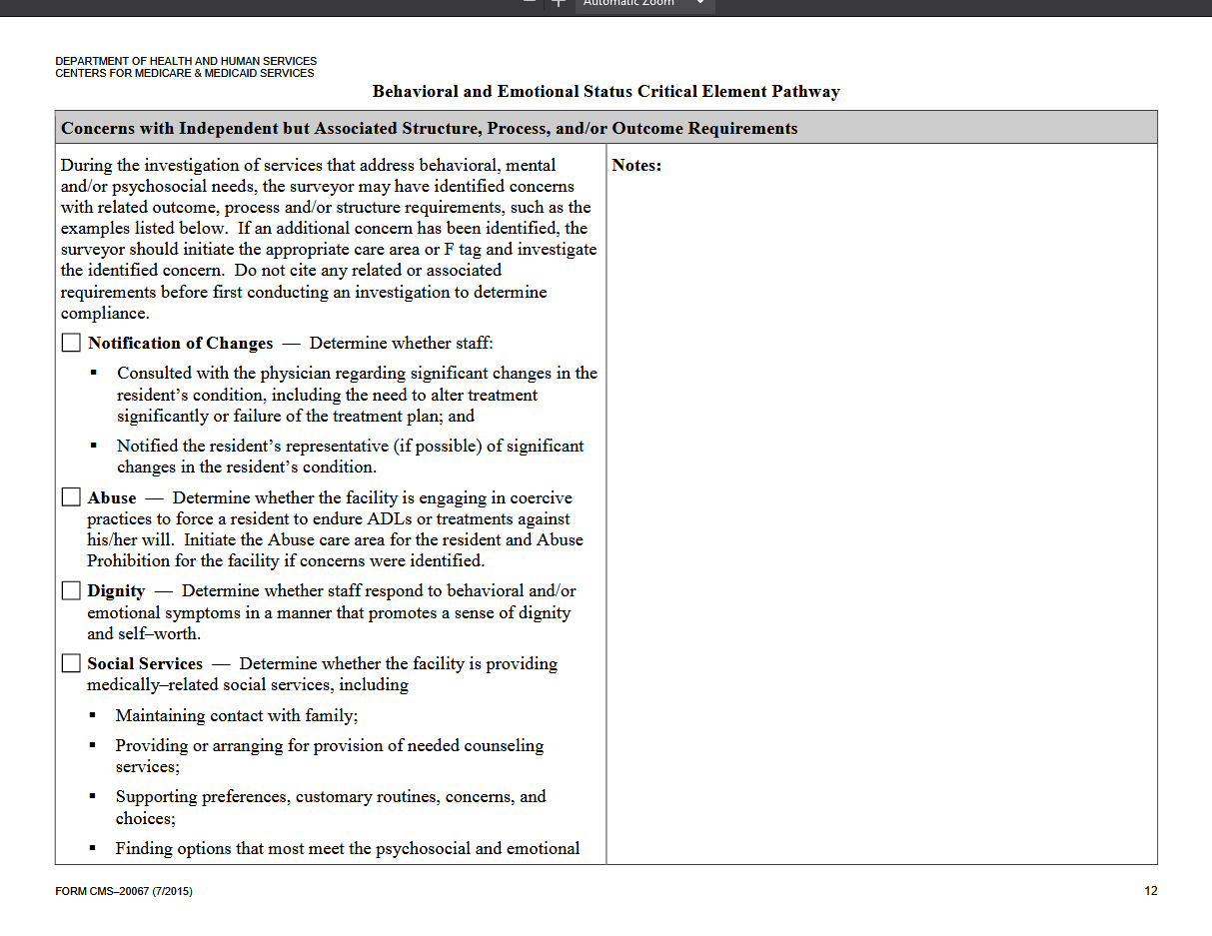

Slide 46
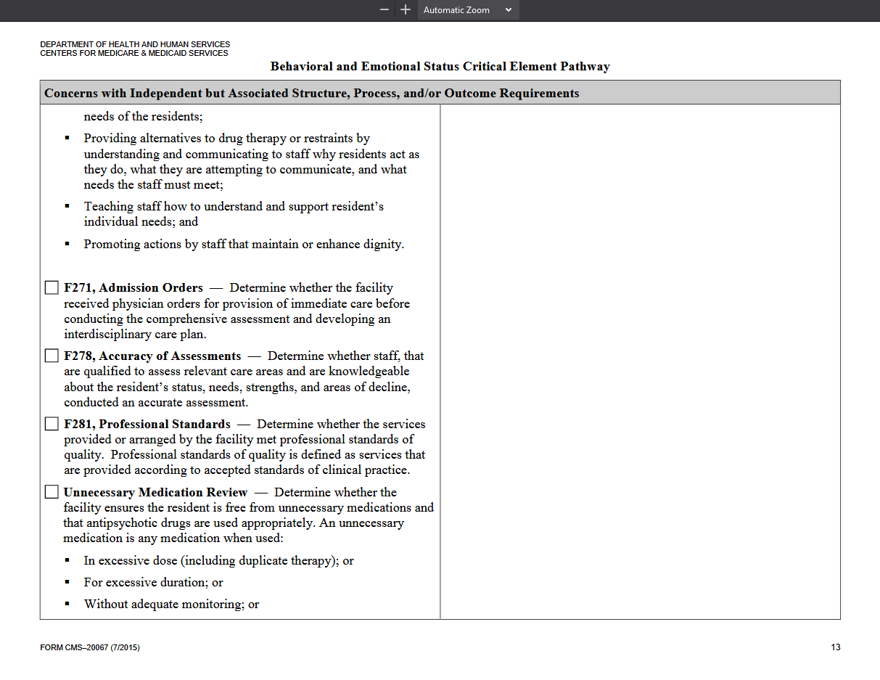

Slide 47
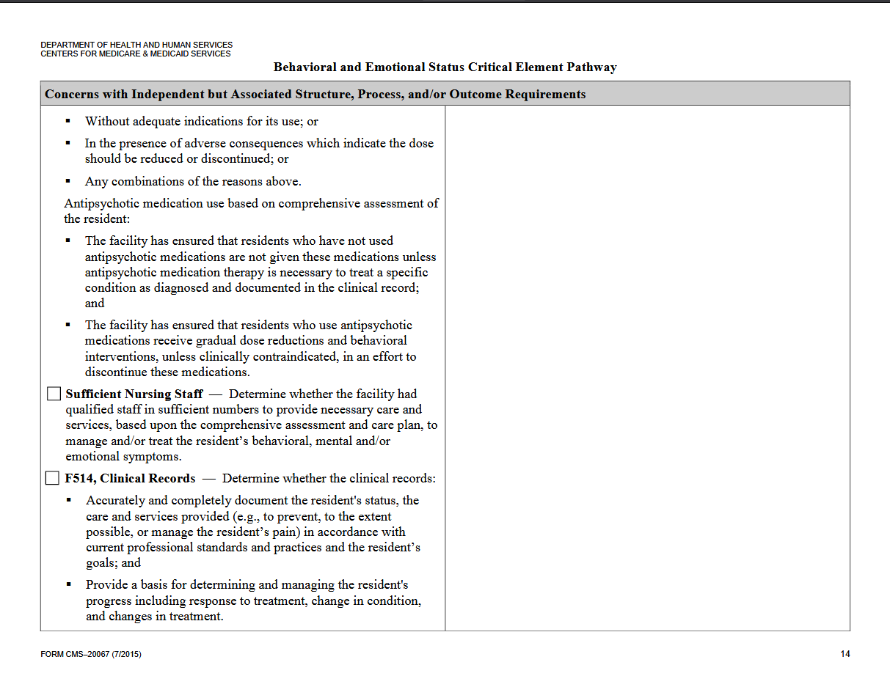

Slide 48
Abuse Critical Elements Pathway
Review Pathway Handout

Slide 49
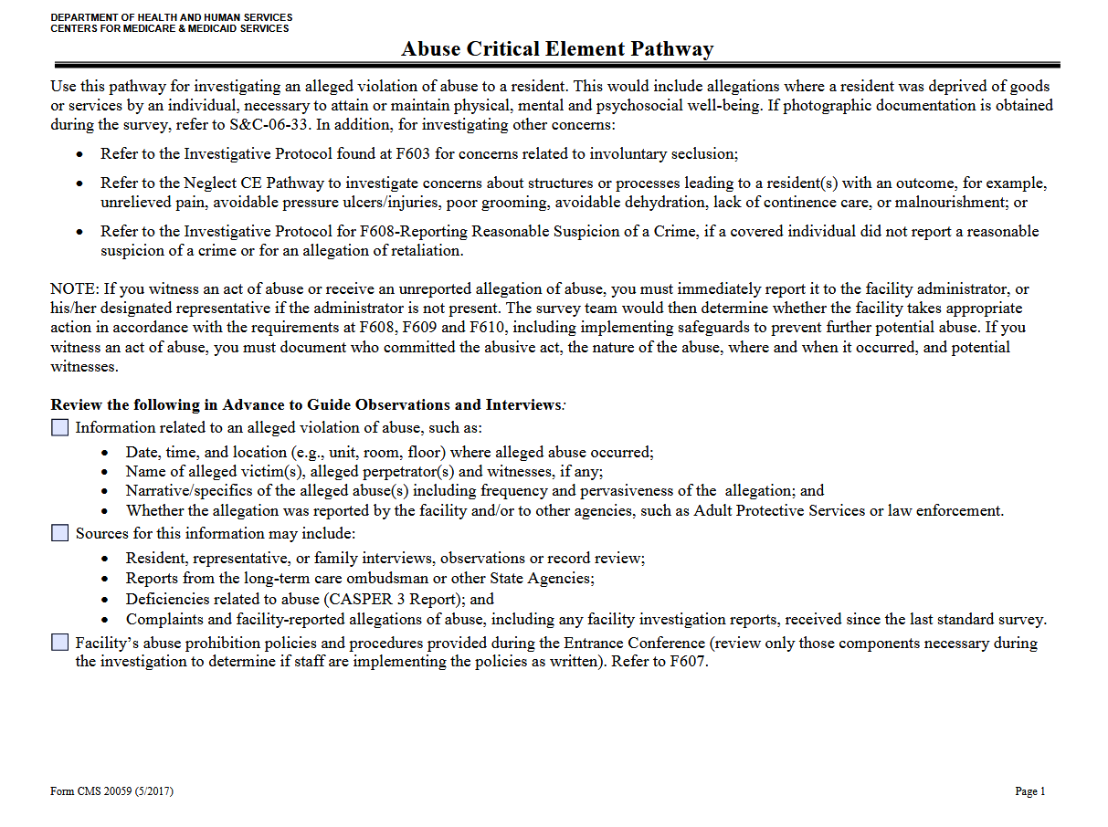

Slide 50
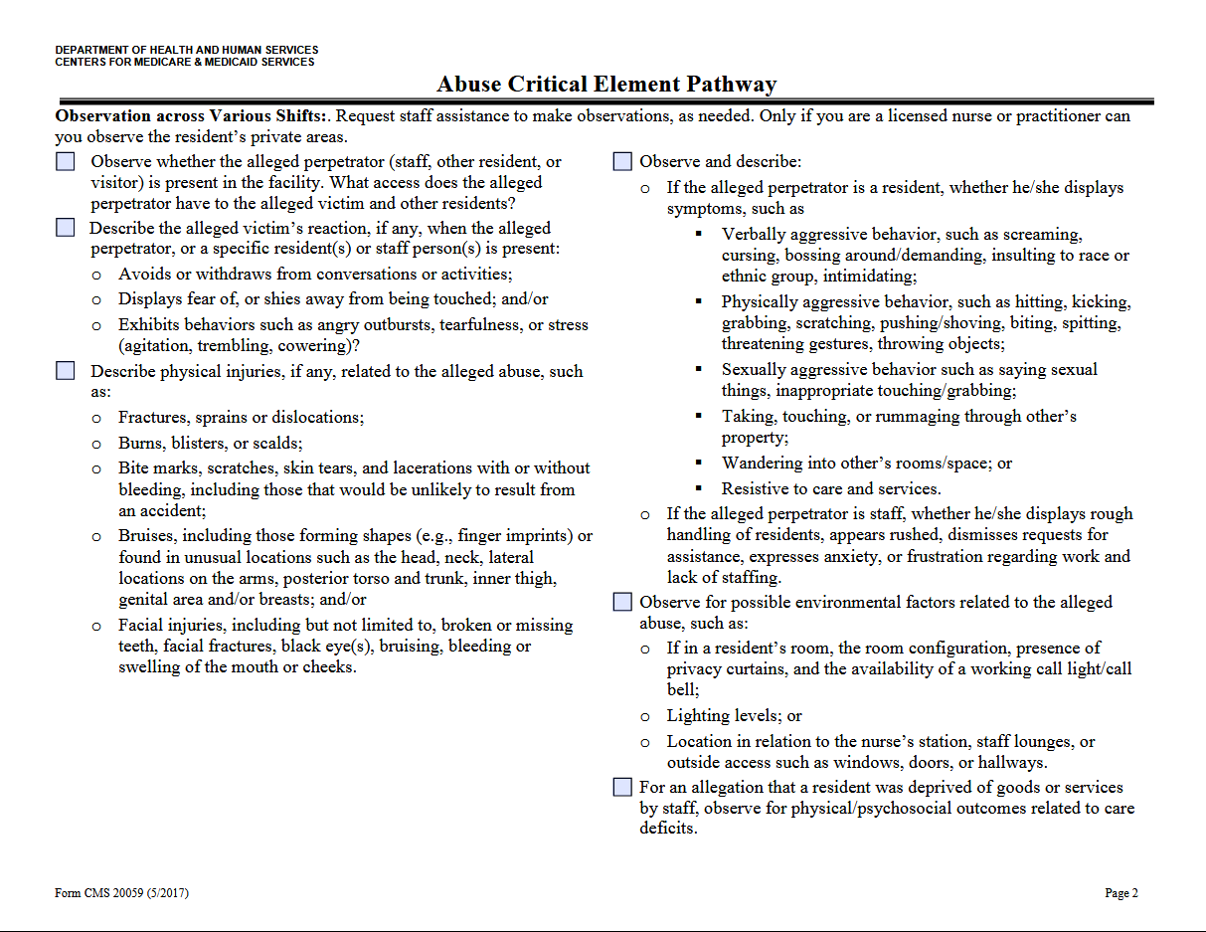

Slide 51
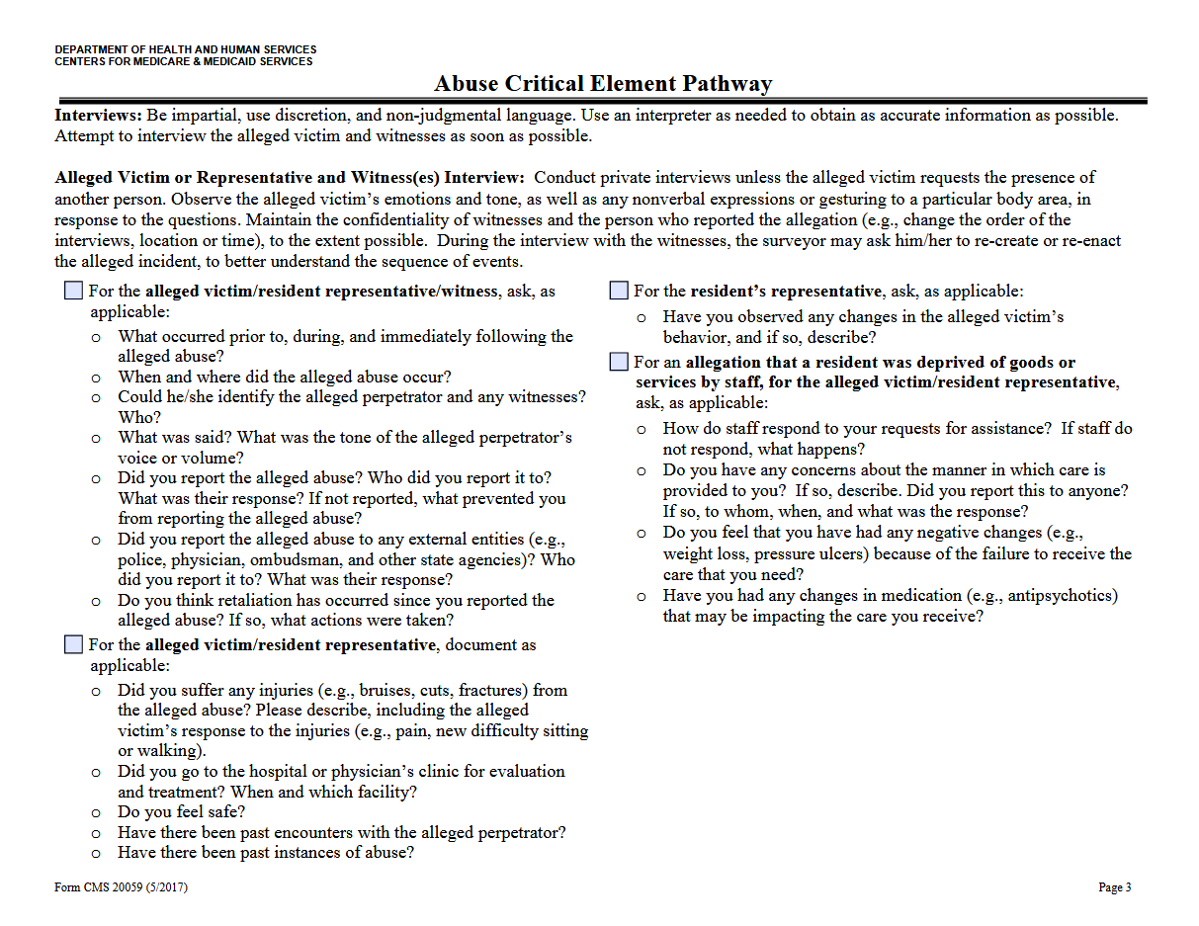

Slide 52
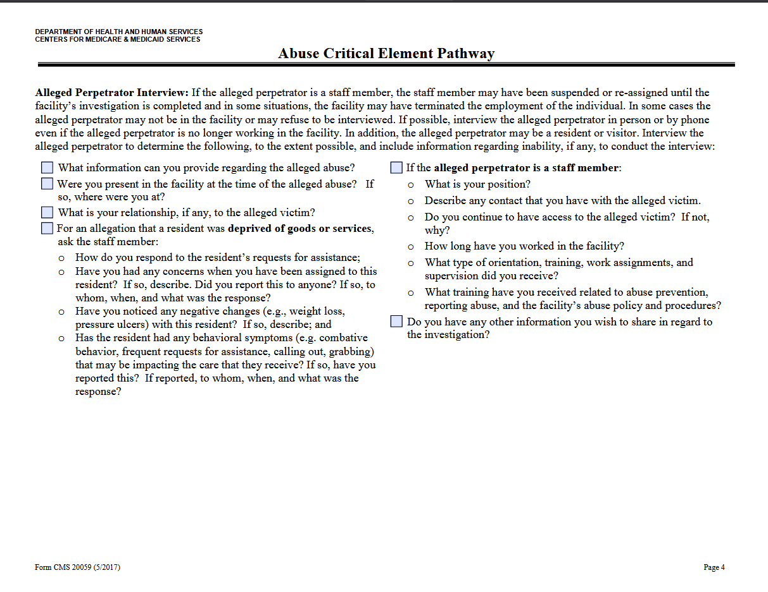

Slide 53
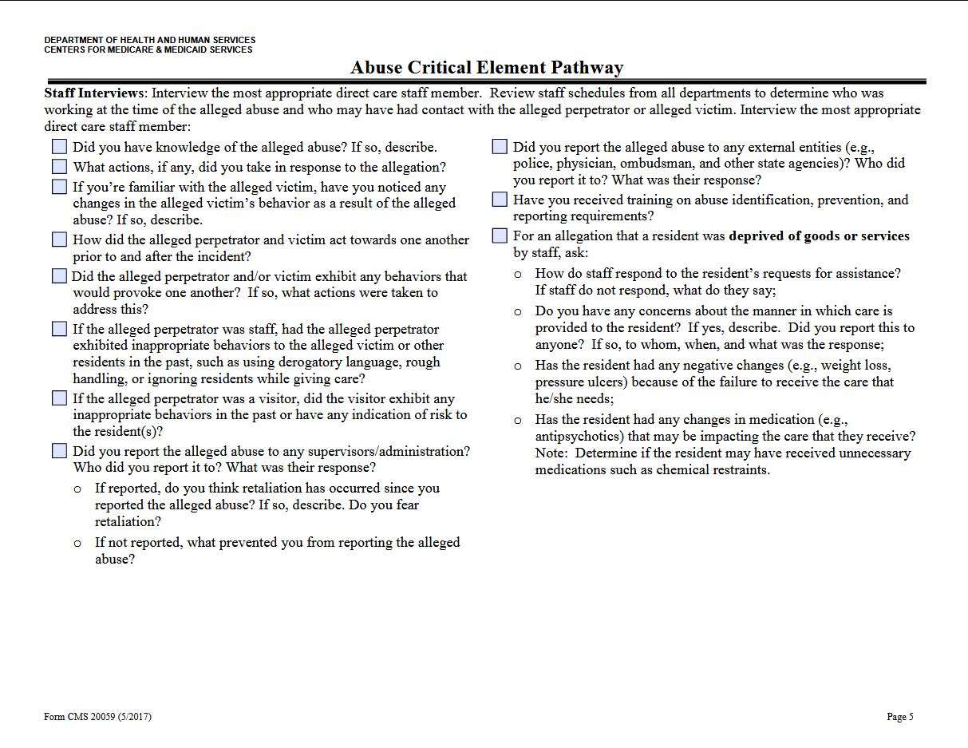

Slide 54
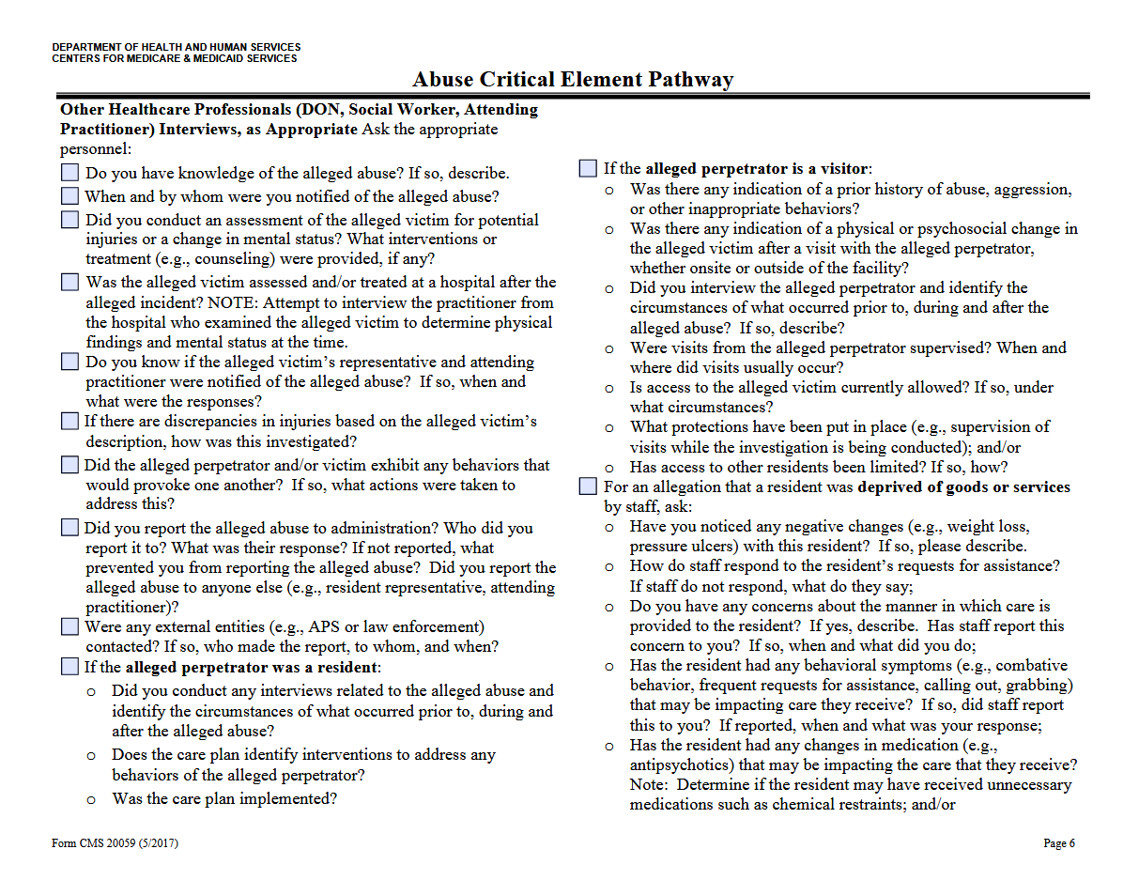

Slide 55
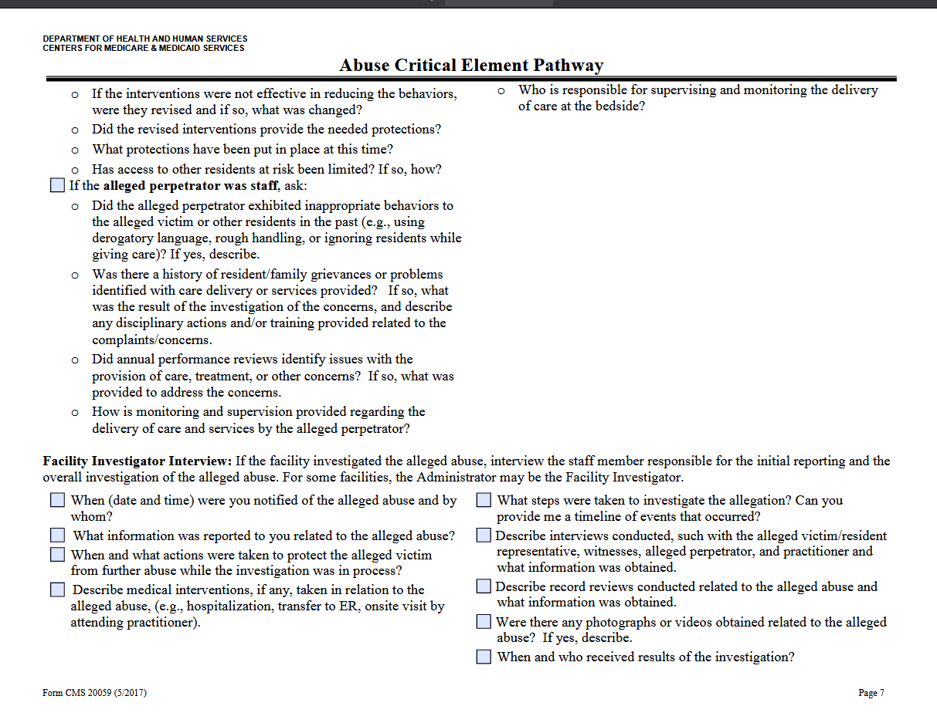

Slide 56
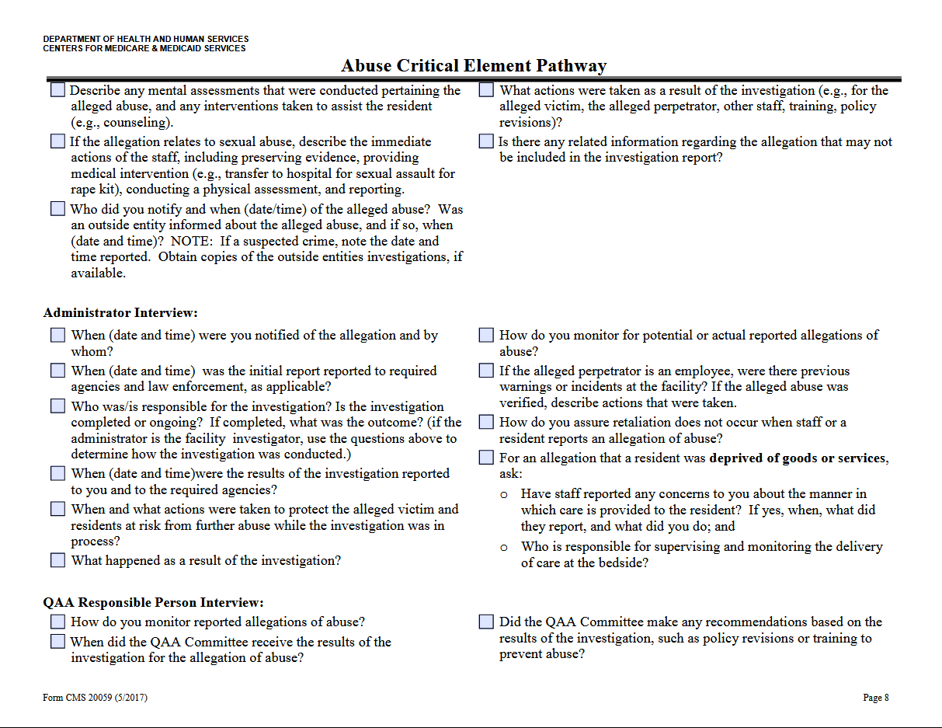

Slide 57
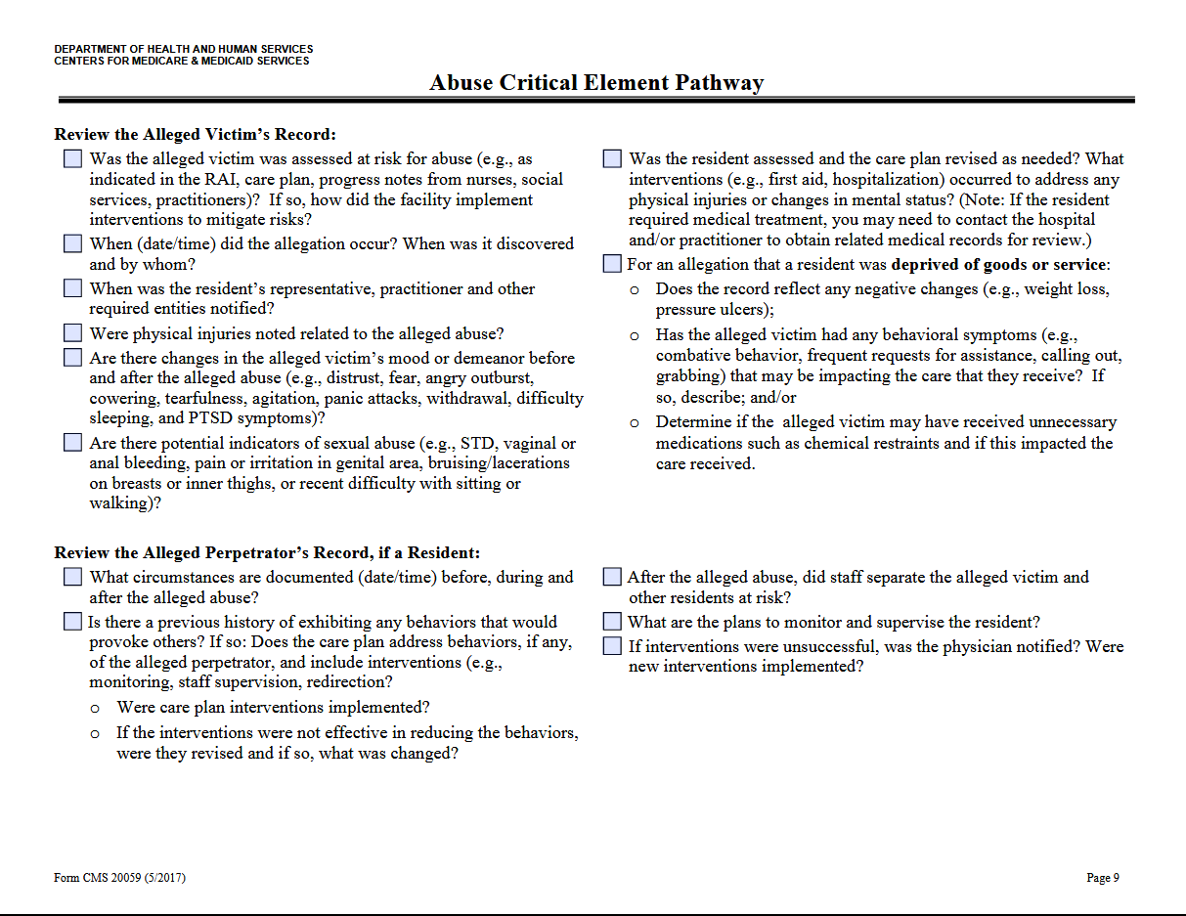

Slide 58
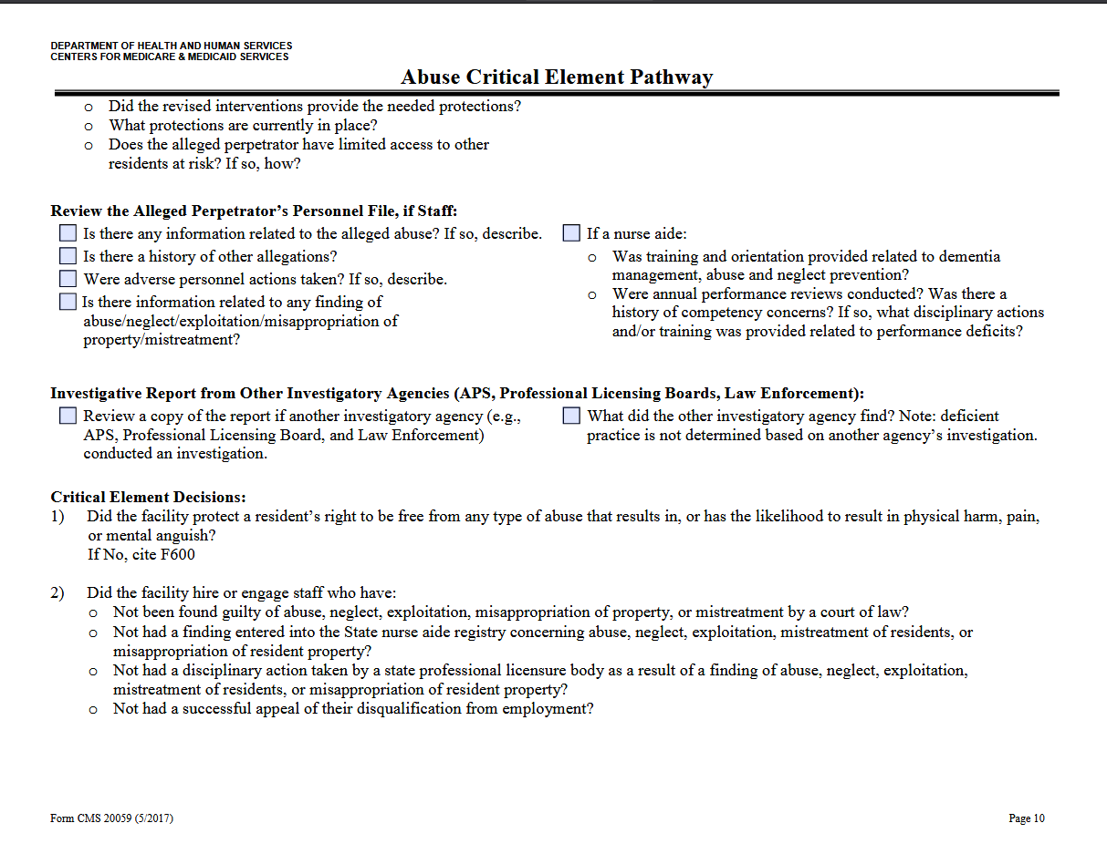

Slide 59
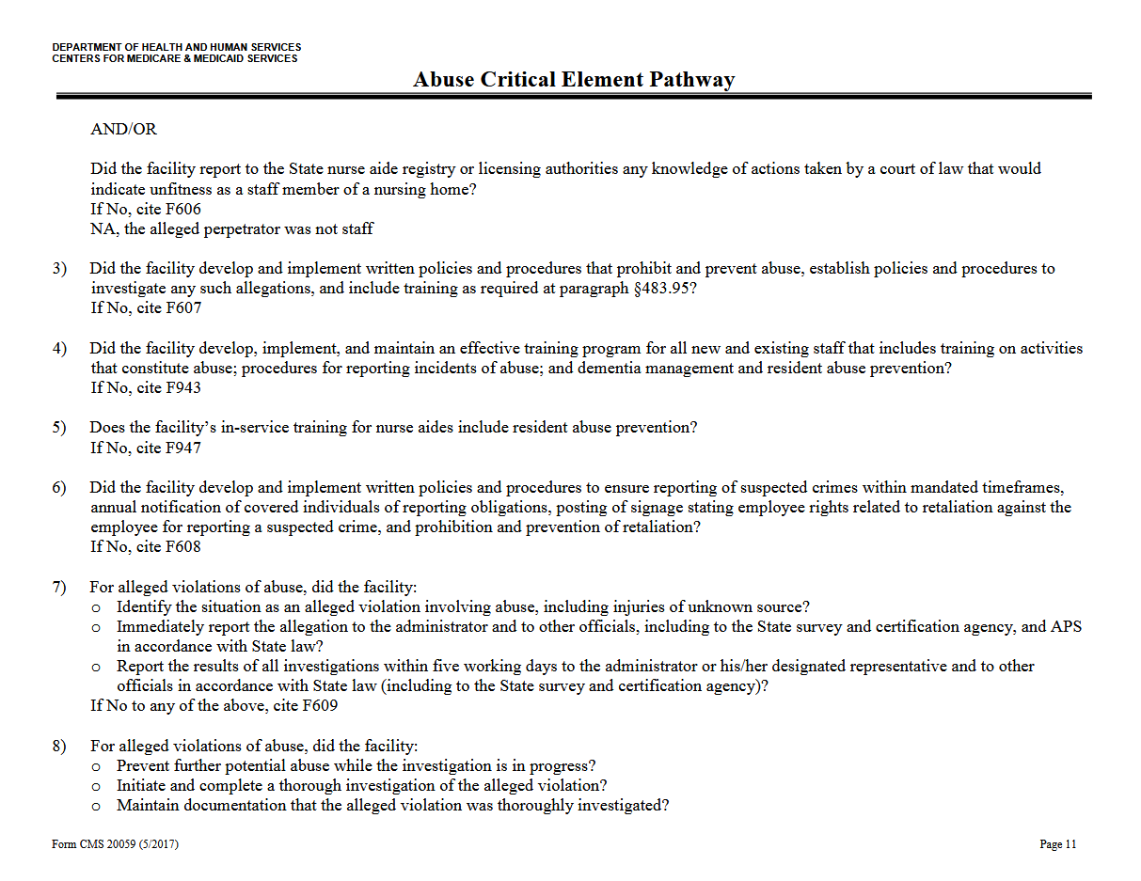

Slide 60
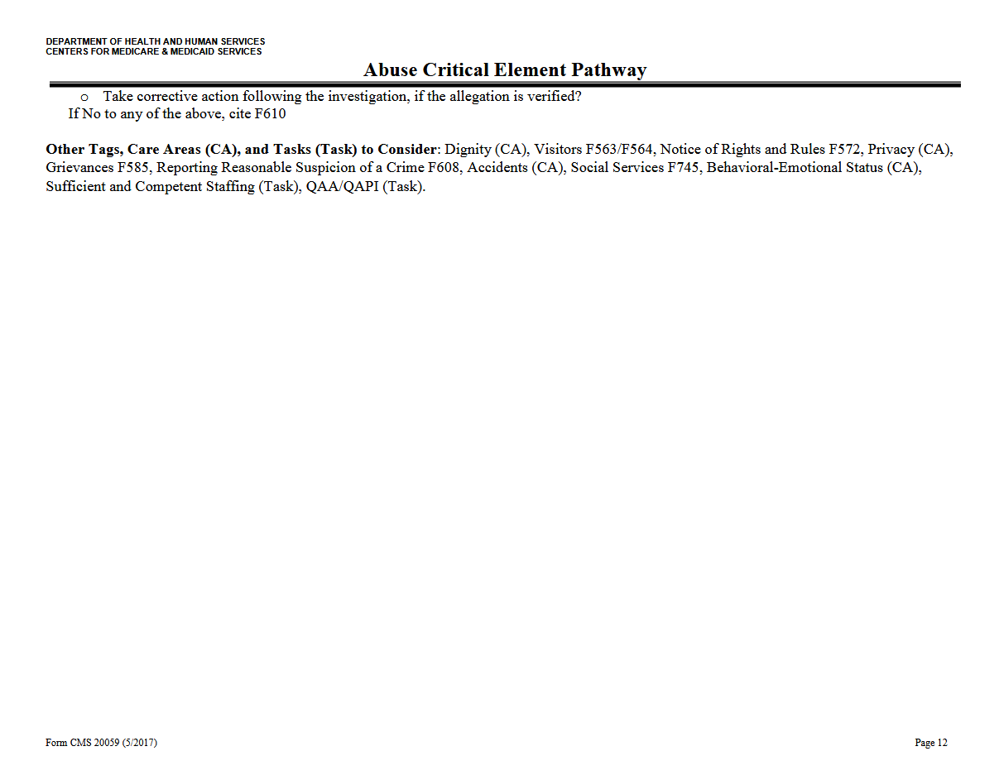

Slide 61
Resident Council Interview
Review Interview Handout
Discuss Hot Topics/Issues

Slide 62
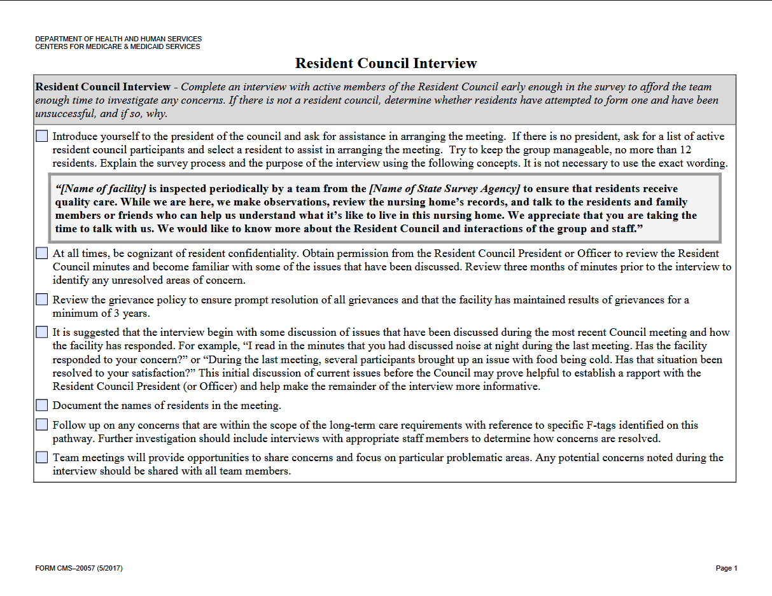

Slide 63
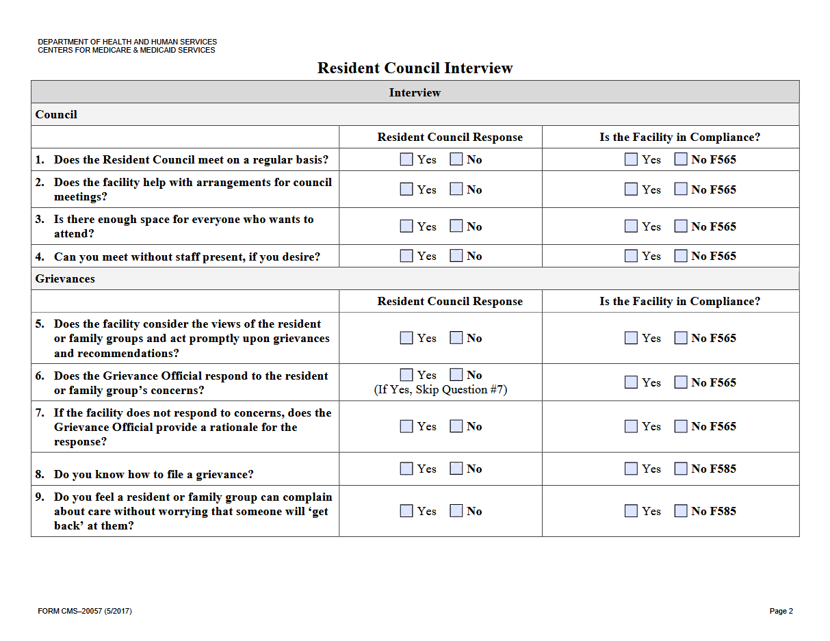

Slide 64
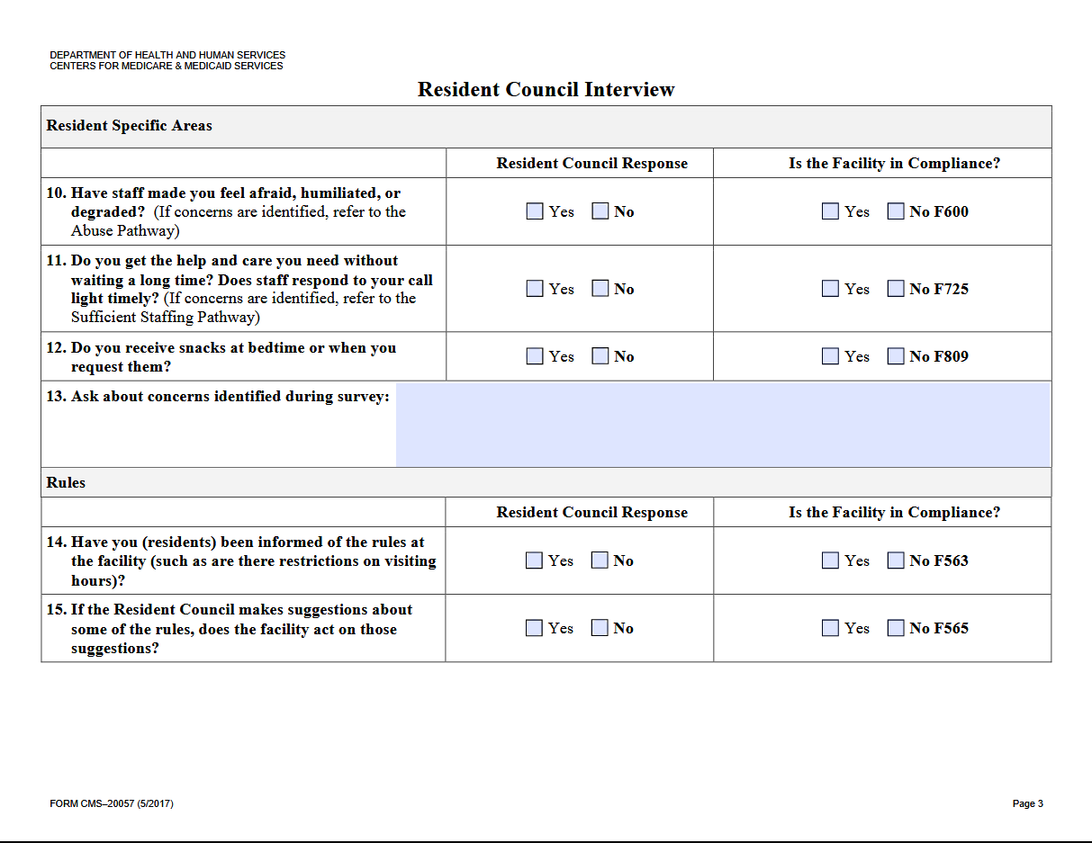

Slide 65
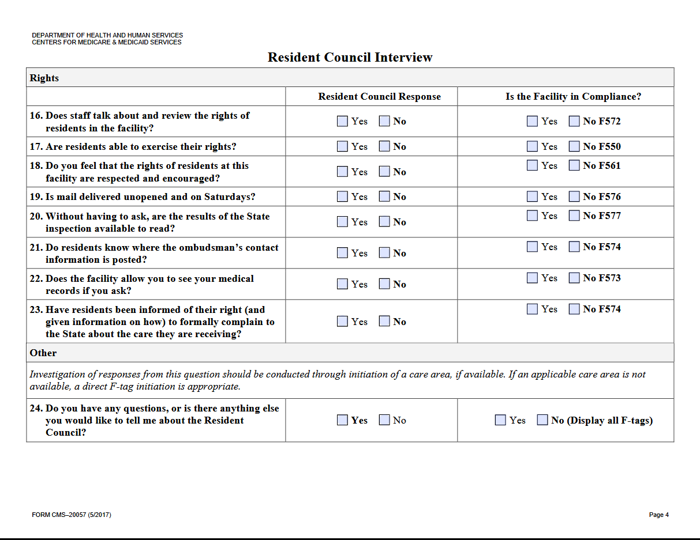

Slide 66
Sample Plan of Correction
Review Sample POC Handout

Slide 67
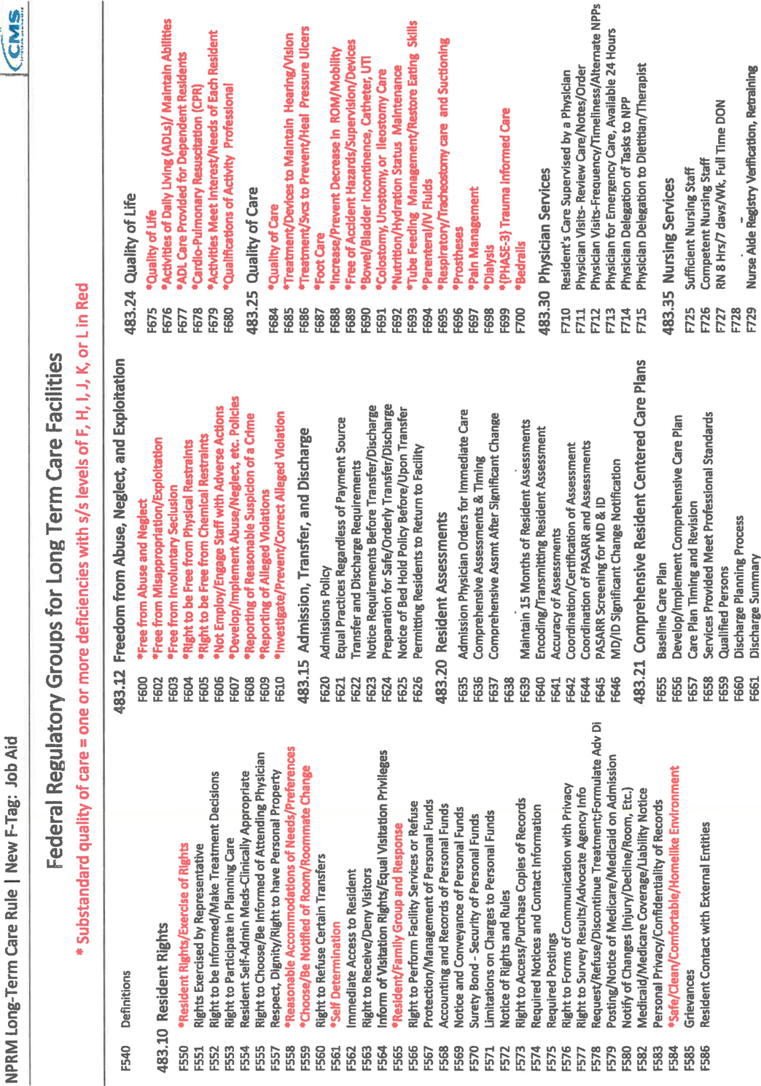

Slide 68
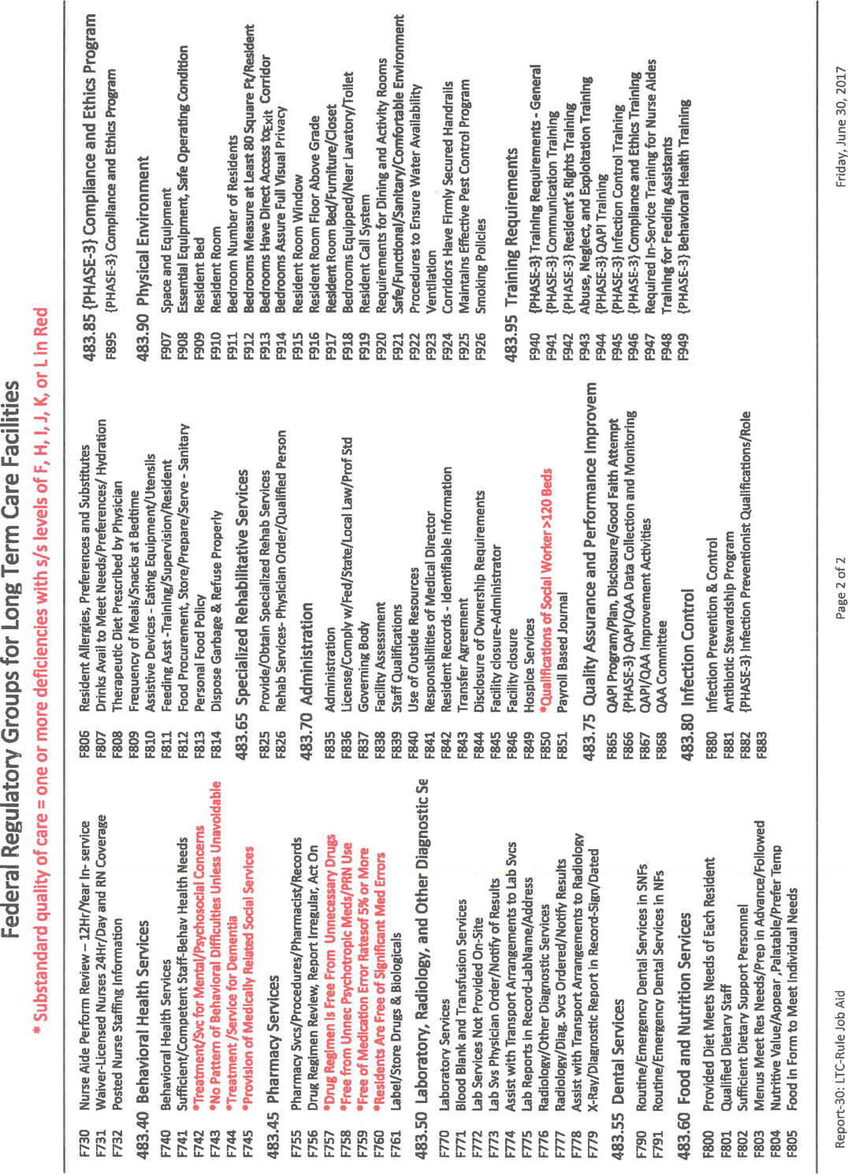

Slide 69
F-TAG 675 - Quality of Life
Quality of life is a fundamental principle that applies to all care and services provided to facility residents. Each resident must receive and the facility must provide the necessary care and services to attain or maintain the highest practicable physical, mental, and psychosocial well-being, consistent with the resident’s comprehensive assessment and plan of care.
INTENT
The intent of this requirement is to specify the facility’s responsibility to create and sustain an environment that humanizes and individualizes each resident’s quality of life by:
Ensuring all staff, across all shifts and departments, understand the principles of quality of life, and honor and support these principles for each resident; and
Ensuring that the care and services provided are person-centered, and honor and support each resident’s preferences, choices, values and beliefs.
DEFINITIONS §483.24
“Person Centered Care” – For the purposes of this subpart, person-centered care means to focus on the resident as the locus of control and support the resident in making their own choices and having control over their daily lives. (Definitions - §483.5)
“Pervasive” For the purposes of this guidance, pervasive means spread through or embedded within every part of something.
“Quality of Life” An individual’s “sense of well-being, level of satisfaction with life and feeling of self-worth and self-esteem. For nursing home residents, this includes a basic sense of satisfaction with oneself, the environment, the care received, the accomplishments of desired goals, and control over one’s life.”

Slide 70
F-TAG 679 ACTIVITIES
§483.24(c)(1) The facility must provide, based on the comprehensive assessment and care plan and the preferences of each resident, an ongoing program to support residents in their choice of activities, both facility-sponsored group and individual activities and independent activities, designed to meet the interests of and support the physical, mental, and psychosocial well-being of each resident, encouraging both independence and interaction in the community.
INTENT §483.24(c)
To ensure that facilities implement an ongoing resident centered activities program that incorporates the resident’s interests, hobbies and cultural preferences which is integral to maintaining and/or improving a resident’s physical, mental, and psychosocial well-being and independence. To create opportunities for each resident to have a meaningful life by supporting his/her domains of wellness (security, autonomy, growth, connectedness, identity, joy and meaning).
DEFINITIONS §483.24(c)
“Activities” refer to any endeavor, other than routine ADLs, in which a resident participates that is intended to enhance her/his sense of well-being and to promote or enhance physical, cognitive, and emotional health. These include, but are not limited to, activities that promote self-esteem, pleasure, comfort, education, creativity, success, and independence.
NOTE: ADL-related activities, such as manicures/pedicures, hair styling, and makeovers, may be considered part of the activities program.

Slide 71
F-TAG 680 QUALIFICATION OF ACTIVITY DIRECTOR
§483.24(c)(2) The activities program must be directed by a qualified professional who is a qualified therapeutic recreation specialist or an activities professional who— (i) Is licensed or registered, if applicable, by the State in which practicing; and (ii) Is: (A) Eligible for certification as a therapeutic recreation specialist or as an activities professional by a recognized accrediting body on or after October 1, 1990; or (B) Has 2 years of experience in a social or recreational program within the last 5 years, one of which was full-time in a therapeutic activities program; or (C) Is a qualified occupational therapist or occupational therapy assistant; or (D) Has completed a training course approved by the State.
INTENT §483.24(c)(2)
The intent of this regulation is to ensure that the activities program is directed by a qualified professional.
DEFINITIONS §483.24(c)(2)
“Recognized accrediting body” refers to those organizations that certify, register, or license therapeutic recreation specialists, activity professionals, or occupational therapists.
Activities Director Responsibilities An activity director is responsible for directing the development, implementation, supervision and ongoing evaluation of the activities program. This includes the completion and/or directing/delegating the completion of the activities component of the comprehensive assessment; and contributing to and/or directing/delegating the contribution to the comprehensive care plan goals and approaches that are individualized to match the skills, abilities, and interests/preferences of each resident.
Directing the activity program includes scheduling of activities, both individual and groups, implementing and/or delegating the implementation of the programs, monitoring the response and/or reviewing/evaluating the response to the programs to determine if the activities meet the assessed needs of the resident, and making revisions as necessary.

Slide 72
Module 1: Regulations & Survey Immediate Jeopardy
How They Relate To Activities

Slide 73
KEY COMPONENTS OF IMMEDIATE JEOPARDY
KEY COMPONENTS OF IMMEDIATE JEOPARDY (Rev. 187, Issued: 03-06-19, Effective: 03-06-19, Implementation: 03-06-19)
The regulatory definitions noted in section II above form the basis for identifying three key components that are essential for surveyors to use in determining the presence of IJ. These components include:
Noncompliance: An entity has failed to meet one or more federal health, safety, and/or quality regulations;
AND
Serious Adverse Outcome or Likely Serious Adverse Outcome: As a result of the identified noncompliance, serious injury, serious harm, serious impairment or death has occurred, is occurring, or is likely to occur to one or more identified recipients at risk;
AND
Need for Immediate Action: The noncompliance creates a need for immediate corrective action by the provider/supplier to prevent serious injury, serious harm, serious impairment or death from occurring or recurring.

Slide 74
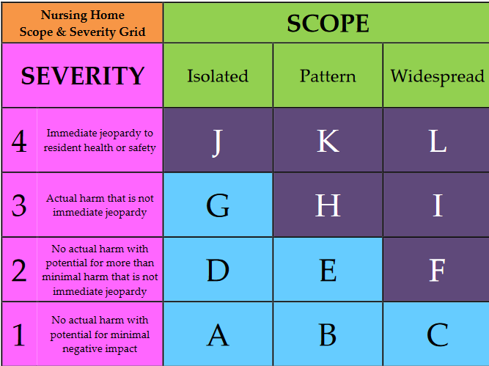

Slide 75
Immediate Jeopardies – References & Resources:
Nursing Home Scope & Severity Grid
http://www.nursinghomepro.com/wp-content/uploads/2009/12/scope-and-severity-grid1.jpg
List of F-Tags
http://www.nursinghomepro.com/wp-content/uploads/2010/01/F-tag-list.pdf
CMS Survey Protocol for Long-Term Care Facilities
https://www.cms.gov/Regulations-and-Guidance/Guidance/Manuals/downloads/som107ap_p_ltcf.pdf
CMS Surveyor Interpretive Guidelines
https://www.cms.gov/Regulations-and-Guidance/Guidance/Manuals/downloads/som107ap_pp_guidelines_ltcf.pdf

Slide 76
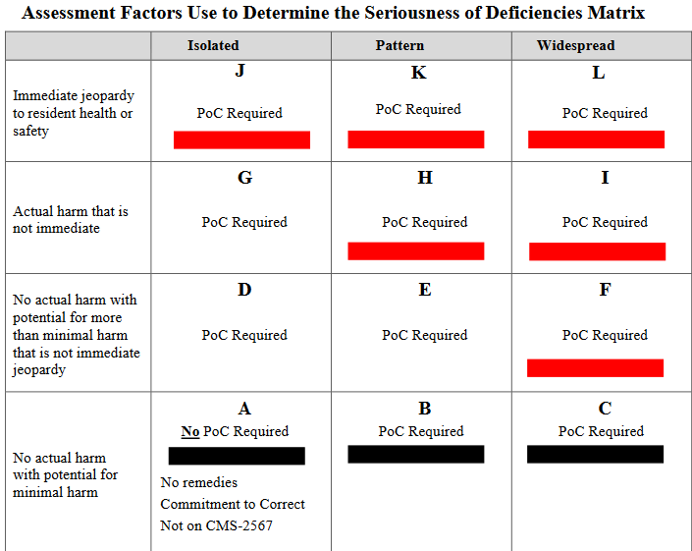

Slide 77
Substandard quality of care
Substandard quality of care means one or more deficiencies related to participation requirements under §483.10 “Resident rights”, paragraphs (a)(1) through (a)(2), (b)(1) through (b)(2), (e) (except for (e)(2), (e)(7), and (e)(8)), (f)(1) through (f)(3), (f)(5) through (f)(8), and (i) of this chapter; §483.12 of this chapter “Freedom from abuse, neglect, and exploitation”; §483.24 of this chapter “Quality of life”; §483.25 of this chapter “Quality of care”; §483.40 “Behavioral health services”, paragraphs (b) and (d) of this chapter; §483.45 “Pharmacy services”, paragraphs (d), (e), and (f) of this chapter; §483.70 “Administration”, paragraph (p) of this chapter, and §483.80 “Infection control”, paragraph (d) of this chapter, which constitute either immediate jeopardy to resident health or safety; a pattern of or widespread actual harm that is not immediate jeopardy; or a widespread potential for more than minimal harm, but less than immediate jeopardy, with no actual harm.

Slide 78
Guidance on Scope Levels
Scope has three levels: isolated; pattern; and widespread. The scope levels are defined accordingly:
Isolated - Scope is isolated when one or a very limited number of residents or employees is/are affected and/or a very limited area or number of locations within the facility are affected.
Pattern - Scope is a pattern when more than a very limited number of residents or employees are affected, and/or the situation has occurred in more than a limited number of locations but the locations are not dispersed throughout the facility.
Widespread - Scope is widespread when the problems causing the deficiency are pervasive (affect many locations) throughout the facility and/or represent a systemic failure that affected, or has the potential to affect, a large portion or all of the residents or employees.

Slide 79
Guidance on Severity Levels
There are four severity levels. Level 1, no actual harm with potential for minimal harm; Level 2, no actual harm with potential for more than minimal harm that is not immediate jeopardy; Level 3, actual harm that is not immediate jeopardy; Level 4, immediate jeopardy to resident health or safety. These four levels are defined accordingly:
Level 1 - No actual harm with potential for minimal harm: A deficiency that has the potential for causing no more than a minor negative impact on the resident(s) or employees.
Level 2 - No actual harm with a potential for more than minimal harm that is not immediate jeopardy: Noncompliance with the requirements of the life safety code that results in the potential for no more than minimal physical, mental, and/or psychosocial harm to the resident or employee and/or that result in minimal discomfort to the residents or employees of the facility, but has the potential to result in more than minimal harm that is not immediate jeopardy.
Level 3 - Actual harm that is not immediate jeopardy: Noncompliance with the requirements of the life safety code that results in actual harm to residents or employees that is not immediate jeopardy.
Level 4 - Immediate jeopardy to resident health or safety: Noncompliance with the requirements of the life safety code that results in immediate jeopardy to resident or employee health or safety in which immediate corrective action is necessary because the provider’s noncompliance with one or more of those life safety code requirements has caused, or is likely to cause, serious injury, harm, impairment or death to a resident receiving care in a facility or an employee of the facility.

Slide 80
IJ Examples
Abuse
Outings
Smoking
CPR
Elopement
LSC

Slide 81
Module 1: Regulations & Survey Motion Picture and Music Licensing
The Complete List & How They Relate To Activities

Slide 82
Movie Licensing
Motion picture showings within senior living and health care communities have always required a public performance license in accordance with the US Copyright Act. As a result, AHCA/NCAL (and all other leading professional associations including LeadingAge, National Association of Activity Professionals [NAAP], American Senior Housing Association [ASHA], and Argentum) has entered into an agreement with Motion Picture Licensing Corporation (MPLC).
The 2016 Agreement better educates our members on the need for copyright compliance when motion pictures (movies) and other audiovisual programs are shown in senior living and health care communities, and secures the greatest possible discount for member facilities on the Umbrella License®.
AHCA/NCAL members can apply for an umbrella license for their freestanding nursing centers and assisted living communities on MPLC’s website. For other types of providers, such as independent living communities, please contact an MPLC Licensing Representative at (800) 462-8855 or online for pricing assistance.

Slide 83
Music Licensing
Under the 1976 Copyright Act, the holder of the copyright or its assigns (BMI, SESAC, or ASCAP) has the exclusive right to reproduce the work and, in the case of a sound recording, to perform the copyrighted work publicly. Broadcast Music Inc. (BMI), SESAC and the American Society of Composers, Authors and Publishers (ASCAP) are the three music licensing companies that each have the rights to different music.
"Perform" has a broad definition and includes singing, playing music, broadcasting, playing a CD or DVD, or turning on a radio or TV.
"Publicly" means to perform any place where a substantial number of persons outside a normal circle of family and social acquaintances hear the music or it is open to the public.
Examples of situations where playing music may be a public performance include live performances; DJs; karaoke; music in common areas; large screen or multiple TVs; background music; resident social gathering/holiday events; and aerobic/dance/fitness classes.
A determination of whether you need a license from BMI, SESAC, and/or ASCAP will depend on the specific circumstances in your community. We recommend you consult an attorney before deciding to apply for a license.
For more background, members can refer to AHCA.

Slide 84
Music Licensing
You can get more information by going to the website of each of the licensing entities:
BMI
SESAC
ASCAP
OHCA nor AHCA/NCAL does not have an agreement with any of these three companies.

Slide 85
Music Licensing
However, Mood Media is the newest company to join the association’s member-only Preferred Provider Program! Mood offers exclusive AHCA/NCAL member pricing on music, messaging, and scent services that will enhance the resident experience in any long term care center. Mood's music solutions are 100% fully licensed for all Mood usage applications and are commercial free.
There are three ways to contact Mood Media:
1. Call 1-800-345-5000 (Select Option 4)
2. Go to http://partner.moodmedia.com/ahcancal/ (password: moodpartner) for FAQs and a price sheet
3. Email: ncalahca@moodmedia.com

Slide 86
Module 1: Regulations & Survey Ohio Administrative Code/Licensure
Pet Policy

Slide 87
OHIO ADMINISTRATIVE CODE 3701-16-11 Resident life enrichment; finances; pets; laundry
Each residential care facility shall encourage residents to participate in social, recreational, and leisure activities. The residential care facility shall, with consideration given to resident preferences, provide or arrange for varied activities of sufficient quantity so that residents' lives may be more meaningful, to stimulate physical and mental capabilities and to assist residents in attaining their optimal social, physical, and emotional well-being. The residential care facility shall provide, at minimum, all of the following:
One local daily newspaper or current community activity brochures and advertisements;
Information about activities in the community and the availability of transportation to community activities; and
An opportunity for residents to engage in a variety of activities which may include, but shall not be limited to, television, crafts, reading, or games.
A residential care facility shall not coerce, induce, or prompt a resident to assign, transfer, give, or sign over to the facility money, valuables, insurance benefits, property, or anything of value other than payment for services rendered by the facility. A residential care facility shall not manage a resident's financial affairs unless authorized by the resident or a sponsor with power of attorney. Such authorization shall be in writing and shall be attested to by a witness who is not connected in any manner whatsoever with the residential care facility or its administrator. A facility that manages a resident's financial affairs shall:

Slide 88
OHIO ADMINISTRATIVE CODE 3701-16-11 Resident life enrichment; finances; pets; laundry Cont.
Maintain accounts pursuant to division (A)(27)(b) of section 3721.13 of the Revised Code of resident funds and personal property or possessions deposited for safekeeping with the facility for use by the resident or resident's sponsor. The resident has the right to receive, upon written or oral request, an accounting statement of financial transactions made on the resident's behalf. This statement shall include a:
Complete record of all funds, personal property, or possessions from any source whatsoever, that have been deposited for safekeeping with the facility for use by the resident or resident's sponsor; and
Listing of all deposits and withdrawals transacted, which shall be substantiated by receipts that shall be available for inspection and copying by the resident or sponsor.
Deposit the resident's funds in excess of one thousand dollars, and may deposit the resident's funds that are one thousand dollars or less, in an interest-bearing account separate from any of the facility's operating accounts. Interest earned on the resident's funds shall be credited to the resident's account. A resident's funds that are one thousand dollars or less and have not been deposited in an interest-bearing account may be deposited in a noninterest-bearing account or petty cash fund.
Purchase a surety bond or otherwise provide assurance satisfactory to the director to assure the security of all residents' funds managed by the facility.
Upon the resident's transfer, discharge, or death, close all resident accounts, make a final accounting, and make provisions for the conveyance of any remaining funds to the resident or the resident's estate.
Allow the resident access to his or her funds during normal bank business hours within the community.
Not require a resident to allow the facility to manage the resident's financial affairs as a condition of admission to the facility.
Neither the administrator of a residential care facility nor facility staff may serve as the guardian or attorney-in-fact of a resident unless related by blood, marriage, or adoption to that resident.

Slide 89
OHIO ADMINISTRATIVE CODE 3701-16-11 Resident life enrichment; finances; pets; laundry Cont.
Residents may keep pets if allowed by facility policy. If a residential care facility allows residents to keep animals or pets, or has facility pets, the facility shall, in consultation with a veterinarian licensed to practice veterinary medicine under Chapter 4741. of the Revised Code, establish and implement a written protocol regarding animals and pets that protects the health and safety of residents and staff members. At minimum, the written protocol shall include:
An annual physical examination, including an examination for internal and external parasites;
Vaccinations for common infectious agents, including rabies;
Any other preventive care necessary to protect the health, safety and rights of residents;
Procedure to follow if an animal:
Bites a person; or
Becomes ill or injured;
For resident pets, if the resident is transferred, discharged or otherwise unable to care for the pet, responsibilities for care of the pet until a family member or sponsor can retrieve the pet;
In the case of a facility pet, the name of the designated member or members of the staff responsible for the care of the animal and for maintaining the protocol, including medical records for the animal; and
An evaluation of the medical needs of residents.
The residential care facility shall specify in the resident agreements required by rule 3701-16-07 of the Administrative Code what laundry services it provides. The residential care facility shall launder or assist in arranging for the laundering of all clothing and bed and bath linen for residents who require laundry services as described in the resident agreement. The facility may provide a washer and dryer in the home for residents' use or may provide residents with transportation to and from a laundromat.

Slide 90
Module 1: Regulations & Survey Ohio Laws on Service Dogs and Emotional Support Animals

Slide 91
How the Law Defines Assistance Animals in Ohio
Ohio has two different sets of laws on service animals and public accommodations, and they describe which animals qualify for protection differently. Under the Ohio Revised Code's dog laws, "assistance dogs" are allowed to accompany people with disabilities into public accommodations. Assistance dogs must be trained by a nonprofit special agency, and are limited to guide dogs that have been trained to assist a blind person, hearing dogs that have been trained to assist someone who is deaf or hearing-impaired, and service dogs that have been trained to assist someone who is mobility-impaired.

Slide 92
How the Law Defines Assistance Animals in Ohio
Under this definition, psychiatric service animals don’t qualify, nor do animals trained to assist with other disabilities, such as a seizure alert animal who assists someone with epilepsy, an animal that alerts someone with diabetes of low blood sugar, or an animal trained to detect allergens.

Slide 93
How the Law Defines Assistance Animals in Ohio
However, another provision of Ohio law, in the Administrative Code that interprets the state’s civil rights laws, has a much broader definition of service animals—and this law also applies to public accommodations.
Under the Administrative Code, people with disabilities may bring all “animal assistants” into places of public accommodation. An animal assistant is any animal that assists a person with a disability. The examples provided include a hearing dog, a guide dog, and a monkey that retrieves things.
Because the definition of disability in the Administrative Code includes both physical and mental impairments, this provision of the law appears to include psychiatric service animals and animals trained to perform other services for those with disabilities.

Slide 94
How the Law Defines Assistance Animals in Ohio
Under the ADA, a service animal is simply a dog that is individually trained to perform tasks or do work for the benefit of a person with a disability. (In some cases, a miniature horse may also qualify as a service animal under the ADA.) The tasks or work the animal does must be directly related to the person’s disability.

Slide 95
How the Law Defines Assistance Animals in Ohio
None of these laws cover pets or what some call “emotional support animals”: animals that provide a sense of safety, companionship, and comfort to those with psychiatric or emotional conditions.
Although these animals often have therapeutic benefits, they are not individually trained to perform specific tasks for their handlers.
Under the ADA and Ohio law, owners of public accommodations are not required to allow emotional support animals, only service animals or animal assistants that aid those with disabilities.

Slide 96
Module 1: Regulations & Survey Which Public Accommodations Must Allow Service Animals in Ohio

Slide 97
Under the ADA, the definition of public accommodations is very broad. It includes:
hotels and other lodging establishments
public transportation terminals, depots, and stations
restaurants and other places that serve food and drink
sales or rental establishments
service establishments
any place of public gathering, such as an auditorium or convention center
places of entertainment and exhibit, like theaters or sports stadiums
gyms, bowling alleys, and other places of exercise or recreation
recreational facilities, such as zoos and parks
libraries, museums, and other places where items are collected or displayed publicly
educational institutions, and
social service centers.

Slide 98
The Ohio Administrative Code defines public accommodations to include any place that offers accommodations, facilities, or advantages to the public. It lists many types of establishments that fit the bill, from hotels, restaurants, and stores to insurance companies, hospitals, skating rinks, and video arcades.

Slide 99
Rules for Your Service Animal
You may not be charged extra to bring your service animal or animal assistant to any public accommodation. However, you may be required to pay for any damage your animal causes.
A public accommodation is not required to allow your service animal to remain if it poses a direct threat to the health or safety of others. If, for example, your service dog is growling and lunging at other patrons, and you are unable to stop the behavior, the dog might have to leave.
An establishment may not ask you detailed questions about your disability or your animal. However, the establishment may ask if your animal is a service animal, and which tasks the animal is trained to perform.
If you choose to register your service dog, Ohio allows you to get a permanent registration tag. Although owners of other dogs must pay to register their animals, it’s free to register a service dog in Ohio.

Slide 100
Service Animals in Ohio Housing
Under Ohio’s Administrative Code, people with disabilities who use animal assistants are entitled to have those animals with them on any premises they lease, rent, purchase, or sublet. Your landlord may not require you to pay extra to have a service animal, although you are liable for any damages your service animal causes to the property or to another person.
The federal Fair Housing Act requires housing facilities to allow service dogs and emotional support animals, if necessary for a person with a disability to have an equal opportunity to use and enjoy the home. To fall under this provision, you must have a disability and you must have a disability-related need for the animal. In other words, the animal must work, perform tasks or services, or alleviate the emotional effects of your disability in order to qualify. (For more information, see the Department of Housing and Urban Development’s guidance on service animals.)

Slide 101
Module 1: Regulations & Survey What’s the Difference?
Between Service, Therapy and Emotional Support Dogs?

Slide 102
Differences
A service dog is trained to help people with disabilities such as visual impairments, mental illnesses, seizure disorders, diabetes, etc.
A therapy animal is trained to provide comfort and affection to people in hospice, disaster areas, retirement homes, hospitals, nursing homes, schools and more.
Emotional support animal provide their owners therapeutic benefits through companionship.

Slide 103
Service Dog Laws
There are two key service dog laws to keep in mind. First, service dogs have to be allowed into businesses and it is illegal for someone to ask about your disability.
However, someone can ask if the pet is required due to a disability or what tasks your service dog is able to perform. Second, pretending to be disabled to gain access to an area is against the law.

Slide 104
What Do Therapy Dogs Do?
Therapy dogs are used in facilities to comfort people and give affection. Spending time with a therapy dog has been shown to lower blood pressure and heart rate, reduce anxiety and increase endorphins and oxytocin. Therapy dogs do not have to be trained to perform specific tasks like service dogs.

Slide 105
Emotional Support Dogs
Emotional support dogs provide comfort, a calming presence and company. Emotional support dogs do not have access to all public areas, but there are two legal protections. First, they can fly with a person who has an emotional or psychological disability. Second, they can qualify for no-pet housing. A letter from a physician may be requested by housing authorities and airlines because the use of emotional support dogs has been abused by some over the years.
There is no formal training needed to be an emotional support dog, which is why you may see some that are not the most well-behaved. However, there are some characteristics you’ll want to know, so you have the best experience with your emotional support dog.

Slide 106
What Kind of Dog Is Needed?
Q: What kind of dog helps a person when they experience social anxiety while flying?
Q: What kind of dog is needed at school to help children experiencing anxiety?
Q: What kind of dog is needed to pull a wheelchair?
Q: What kind of dog offers companionship in day-to-day activities for one person?
Q: What kind of dog is needed to protect someone who is having a seizure?
Q: What kind of dog is needed to remind a person with mental illness to take their prescription?
Q: What dog helps a person with autism?
Q: What kind of dog works with numerous people?
Q: What kind of dog calms a person with Post Traumatic Stress Disorder?

Slide 107
What Kind of Dog Is Needed?
Q: What kind of dog helps a person when they experience social anxiety while flying?
A: Emotional support dog
Q: What kind of dog is needed at school to help children experiencing anxiety?
A: Therapy dog
Q: What kind of dog is needed to pull a wheelchair?
A: Service dog
Q: What kind of dog offers companionship in day-to-day activities for one person?
A: Emotional support dog
Q: What kind of dog is needed to protect someone who is having a seizure?
A: Service dog
Q: What kind of dog is needed to remind a person with mental illness to take their prescription?
A: Service dog
Q: What dog helps a person with autism?
A: Service dog
Q: What kind of dog works with numerous people?
A: Therapy dog
Q: What kind of dog calms a person with Post Traumatic Stress Disorder?
A: Service dog

Slide 108
Pet Programs
Pet Grooming, Pet Therapy, Pet Visits, Care Center pet, Humane Society Visit, Animal Shelter Visit, Pet Parade
Policy and Purpose
It is the policy of this care center to offer the opportunity to enjoy contact and closeness with animals. Contact with pets can provide residents with a heightened sense of well-being, promote or enhance physical, cognitive, and emotional health, and promote feelings of self-esteem, pleasure, comfort, and independence.
Objectives/Outcomes
To provide the sensory and emotional stimulation which animals evoke.
To provide educational programs and environmental awareness.
To provide the pleasure and tactile comfort that pets afford.
To provide stimulation, solace, and to promote emotional health.

Slide 109
Equipment/Materials
Towels for laps, microphone (as needed), hand wipes and/or antiseptic gel or foam, pet brushes, or pet toys. If program is held outdoor participants may want hats, sunscreen, and sweaters (refer to outdoor programs). Program in Detail
Program Milieu
Consider the quiet environment and non-hurried quality of time that we associate with the pleasure of pets. Consider seating areas to the sides for some participants.

Slide 110
Preparation and Procedures
Obtain all required equipment and materials.
Arrange for special speakers, "guests."
Seat participants in horseshoe, circle or audience-style, out-of-doors, as desired.
Announce program; introduce speaker and/or animals.
Place a towel onto participant's lap beneath animal.
Try to bring animals around to each participant to see, touch, hold, pet, brush, or feed.

Slide 111
Closure
Close program with "good-byes" and "thank-you."
Complete hand washing with participants using sinks, hand wipes, and/or foam.
Perform room clean-up according to housekeeping procedures.
Note
Check for allergies to animals before exposing participant to pets in the program.

Slide 112
Care Center Pet Guideline Procedures Form
Indicate primary responsibility for pet's care and costs:
As applicable, pet will eat, sleep, and defecate in what locations:
Pet will be permitted in what areas of the facility:
Pet will be kept where at mealtimes:
Pet will eat what food, purchased by whom, kept and stored sealed with a cover, where:
Pet will be given food and water in amounts of, and how often:
Pet will be bathed when and how:
Pet will receive any recommended vaccinations, will be assisted to which veterinarian or emergency clinic in case of signs of illness or injury:
Veterinarian records will be retained where:

Slide 113
Volunteer Checklist
Review Handout
Job descriptions and duties
Residents Working Does and Don’ts

Slide 114
Social Media
Photo Release review
Facility Policies and Boundaries
Skit

Slide 115
Module 1: Regulations & Survey Life Safety Code
How They Relate To Activities

Slide 116
K324 - Cooking Facilities
Cooking equipment is protected in accordance with NFPA 96, Standard for Ventilation Control and Fire Protection of Commercial Cooking Operations, unless
residential cooking equipment (i.e., small appliances such as microwaves, hot plates, toasters) are used for food warming or limited cooking in accordance with 18.3.2.5.2, 19.3.2.5.2.
cooking facilities open to the corridor in smoke compartments with 30 or fewer patients comply with the conditions under 18.3.2.5.3, 19.3.2.5.3, or
cooking facilities in smoke compartments with 30 or fewer patients comply with conditions under 18.3.2.5.4, 19.3.2.5.4.
Cooking facilities protected according to NFPA 96 per 9.2.3 are not required to be enclosed as hazardous areas, but shall not be open to the corridor. 18.3.2.5.1 through 18.3.2.5.4, 19.3.2.5.1 through 19.3.2.5.5, 9.2.3, TIA 12-2

Slide 117
NFPA - Cooking Facilities
19.3.2.5 Cooking Facilities.
19.3.2.5.1 Cooking facilities shall be protected in accordance with 9.2.3, unless otherwise permitted by 19.3.2.5.2.
19.3.2.5.2* Where domestic cooking equipment is used for food-warming or limited cooking, protection of separation of food preparation facilities shall not be required.

Slide 118
K741 - Smoking Regulations
Smoking regulations shall be adopted and shall include not less than the following provisions:
Smoking shall be prohibited in any room, ward, or compartment where flammable liquids, combustible gases, or oxygen is used or stored and in any other hazardous location, and such area shall be posted with signs that read NO SMOKING or shall be posted with the international symbol for no smoking.
In health care occupancies where smoking is prohibited and signs are prominently placed at all major entrances, secondary signs with language that prohibits smoking shall not be required.
Smoking by patients classified as not responsible shall be prohibited.
The requirement of 18.7.4(3) shall not apply where the patient is under direct supervision.
Ashtrays of noncombustible material and safe design shall be provided in all areas where smoking is permitted.
Metal containers with self-closing cover devices into which ashtrays can be emptied shall be readily available to all areas where smoking is permitted 18.7.4, 19.7.4

Slide 119
K751 - Draperies, Curtains, and Loosely Hanging Fabrics
Draperies, curtains including cubicle curtains and loosely hanging fabric or films shall be in accordance with 10.3.1. Excluding curtains and draperies: at showers and baths; on windows in patient sleeping room located in sprinklered compartments; and in non-patient sleeping rooms in sprinklered compartments where individual drapery or curtain panels do not exceed 48 square feet or total area does not exceed 20 percent of the wall.
18.7.5.1, 18.3.5.11, 19.7.5.1, 19.3.5.11, 10.3.1

Slide 120
K753 - Combustible Decorations
Combustible decorations shall be prohibited unless one of the following is met:
Flame retardant or treated with approved fire-retardant coating that is listed and labeled for product.
Decorations meet NFPA 701.
Decorations exhibit heat release less than 100 kilowatts in accordance with NFPA 289.
Decorations, such as photographs, paintings and other art are attached to the walls, ceilings and non-fire-rated doors in accordance with 18.7.5.6 or 19.7.5.6.
The decorations in existing occupancies are in such limited quantities that a hazard of fire is not present.
18.7.5.6, 19.7.5.6

Slide 121
NFPA - Furnishings, Bedding, and Decorations.
20.7.5.1* Draperies, curtains, and other loosely hanging fabrics and films serving as furnishings or decorations in ambulatory health care occupancies shall be in accordance with the provisions of 10.3.1, and the following also shall apply:
Such curtains shall include cubicle curtains.
Such curtains shall not include curtains at showers.
20.7.5.2 Newly introduced upholstered furniture shall com­ply with one of the following provisions:
The furniture shall meet the criteria specified in 10.3.2.1 and 10.3.3.
The furniture shall be in a building protected throughout by an approved, supervised automatic sprinkler system in accordance with 9.7.1.1(1).

Slide 122
NFPA – Combustible Decorations
20.7.5.4 - Combustible decorations shall be prohibited, unless one of the following criteria is met:
They are flame-retardant.
They are decorations, such as photographs and paintings, in such limited quantities that a hazard of fire develop­ment or spread is not present.

Slide 123
NFPA – Bulletin Boards, Posters, and Paper.
10.2.5.3 Bulletin Boards, Posters, and Paper.
10.2.5.3.1 Bulletin boards, posters, and paper attached directly to the wall shall not exceed 10 percent of the aggregate wall area to which they are applied.

Slide 124
Thank You
Kim Fair, BA Psychology, ADC
KFair@versaillesrehab.com
Lydia Raber, ADC, CDP
Lydia.Raber@wbhl.healthcare
Chris Shelley
CShelley@troycarecenter.com

